Slide 1
Mesenchymal Stem Cells Or: How I learned to Stop Worrying and Love Differentiation.
Matthew Downs || 1/19/10

Slide 2
Outline
Types of Stem Cells
Mesenchymal Stem Cells
Overview
Identification and Culture
Immunomodulary Effects
Differentiation
Current Research
Review
Notes:
Types: Embrionic, Fetal, Amniotic, Adult, Induced Pluripotent

Slide 3
Stem Cells
Types:
Embryonic- Cells are derived form epiblast tissue of the Inner Cell Mass of a blastocyst.
Fetal: Stem Cells found in the organs of fetuses.
Adult: Any cell found in a developed organism which satisfies two properties: Ability to divide and create itself, and divide and create a differentiated cell.
Amniotic: Multipotent stem cells from amniotic fluid.
Induced Pluripotent: Reprogrammed cells to have pluripotent capabilities.
Notes:
Embryonic: Are pluripotent, most research with these cells has been with mouse embryonic stems cells & human embroynic cells. Rapidly differentiate without optimal culture conditions and will create a teratoma.
Fetal: Two types: Pluripotent found in the fetus and hematopoietic found in the cord blood. Hematopoietic cells are mainly used to create new blood
Adult: Can self renew and generate the cell types of the organ it’s from. Divides by either symmetric (both daughter stem cells) or asymmetric (one stem cell, and one progenitor cell). The three main pathways through cell division are Bmi-1, Notch, and Wnt. Hematopoietic, mammary, mesenchymal, endothelial, Neural, olfactory, neural crest, and testicular stem cells.
Amniotic: expand extensively without guidance and are not tumorogenic. Common differentiation are adipogenic, osteogenic, myogenic, endothelial, hepatic and neuronal lines.
Induced: Using transcription factors are equivilent to embryonic stem cells. (using oct3/4, sox2, c-Myc and KLF4)
DEFS:
Epiblast: tissue derived from the inner cell mass and is the primary ectoderm.
Inner cell Mass: mass of cells inside a primordial embryo which will create the fetus.
Blastocyst: Structure Forms after a morula but before implantation: Has an ICM
Morula: early state of an embryo Bmi-1: Transcriptional repressor which regulate HSCs
Notch: receptor for a single pass transmembrane receptor.
Wnt: Mainly used with embryogenesis and cancer
Neural Crest: ectoderm between neural tube and epidermis. Can give rise to neurons and glia of the autonomic nervous system.
Hepatic: liver

Slide 4
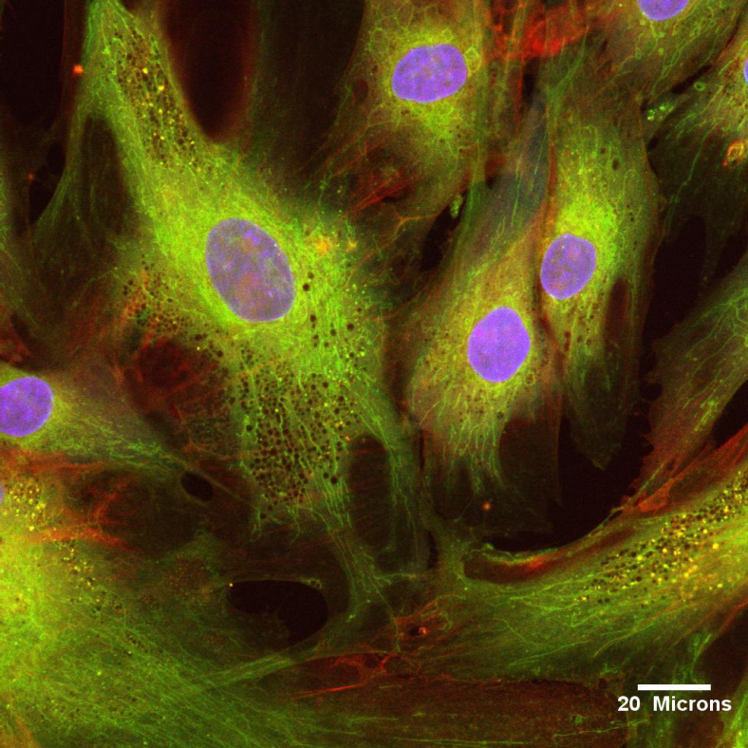
Mesenchymal Stem Cells
Found in mainly in bone marrow but can also be found in umbilical cord blood, peripheral blood, fallopian tube and fetal & liver lung
Can form: Fat, cartilage, bone, tendon, ligament, muscle, skin and nerve cells
Notes:
Bone marrow derived fibroblasts with long bodies
Differentiate under the osteoblastic, adipocytic and chrondrocytic lineages
They can be isolated and amplified without losing their capacity to differentiate into other cells.
They are able to take up and reproduce genes introduced into their nucleus.
Are able to be frozen and defrosted without damaging their function (can still differentiate into multiple cells)
usually have a large round nucleus surrounded by dispersed chromatin particles, the surrounding extracellular matrix is populated by a few reticular fibrils but is vacant of other types of collagen fibers

Slide 5
Mesenchymal Stem Cells
How to identify?
Nucleostemin- intracellular protein which is expressed in MSCs but not differentiated into progenitor cells.
Cell surface receptors- bone morphogenic protiens, endoglin, and stem cell factor receptors
Culture?
Bone marrow is plated into culture plates
MSCs adhere to the plastic within 24-48 hours
Notes:
BMPR: gowth factor and cytokines for formation fo bone and cartilage important role in embryonic development
Endoglin- type 1 membrane glycoprotien on cell surfaces. A part of the PGF beta receptor complex
Stem Cell Factor: binds with SCF cytokine with plays an important role in hematopoiesis (formation of blod cells_ spermatogenesis, and melatongenesis
Lazy RBC and haematopoetic progenitors do not adhere, aspirate and replace media

Slide 6
Mesenchymal Stem Cells
Immunomodulary Effects
MSCs avoid allorecognition
Generate a local immunosuppressive environment by secreting cytokines
Interfere with dendritic cell and T-Cell function and growth
Notes:
Occurs b/c they are hypoimmunogenic, lacking MHC_II and costimulatory molecule expression
Prostaglandins and interlukin-10 production reduces the local tryptophan
Modulates the dendritic cells disrupting CD8+ and CD4+
Good reason why they can be used in therapy
tryptophan : standard amino acid.
CD8 cluster differentiation transmembrane glycoprotien that serves as co-receptor for T cell receptor
CD4, T helper cells, macrophages and dendritic cells

Slide 7
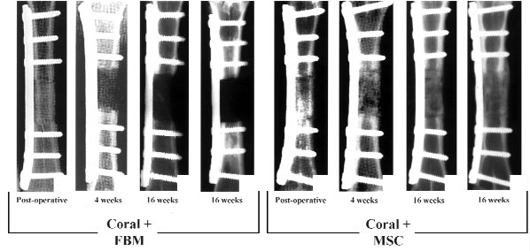
Mesenchymal Stem Cells Research
Tissue Engineered Bone Regeneration:
Use a resorbable scaffold with MSCs to treat bone defects.
Bone itself would not regenerate fast enough but MSCs encouraged growth
Petite, et al :Tissue-engineered bone regeneration,
Notes:
Try to recareate embryonic environment.
Scaffold is hydroxyapatite-tricalcium phosphate ceramic) but failed as it was too weak
Then used coral as it also was adsorbed at the same rate of bone formation.

Slide 8
Mesenchymal Stem Cells Research
Bone Marrow Stem Cells (MSC) and Growth Factors Impregnated in Biodegradable Scaffold for Bone Repair
Hydrogel scaffold was used with osteoprogenitor cells with TGF-B1 and IGF-I.
Results showed after two weeks calcified material was present and after 6 weeks bone was present in defect site.
Notes:
Bone was eventually restored to original shape while control group only had partial healing.
Insulin-like growth factor 1, polypeptide protien hormone

Slide 9
Review
Differentiate into multiple cell lines
Easily obtained and grown
Immunomodulary effects which makes it attractive for therapies
Within the bone research area has shown to facilitate bone growth in treatments of bone injuries and defects

