Slide 1
Durotaxis
4/4/13
Lecture 14, ChE 590B

Slide 2
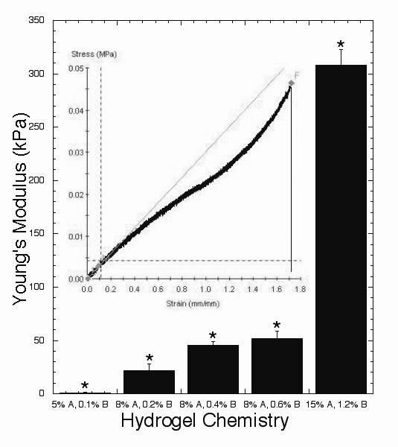
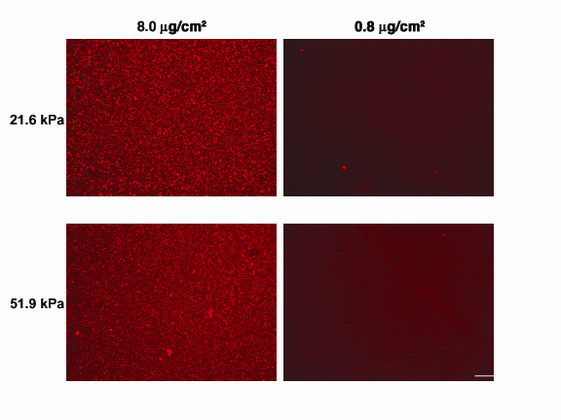
Polyacrylamide as a Biomaterial
Varying acrylamide and bis-acrylamide
Polyacrylamide disc
Heterobifunctional crosslinker sulfo-SANPAH
Fibronectin: 8.0 or 0.8 υg/cm²
Peyton, S.R. and Putnam, A.J. J. Cell. Phys. 2005 Jul;204(1):198-209.

Slide 3
1: Step Changes in Stiffness
3T3 Fibroblasts on PAA
Migrate from soft-to-stiff substrates
Biophys J. Lo et al. (2000) 79;144-152

Slide 4
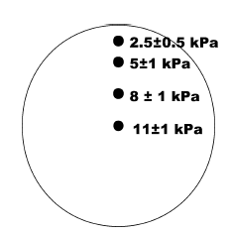
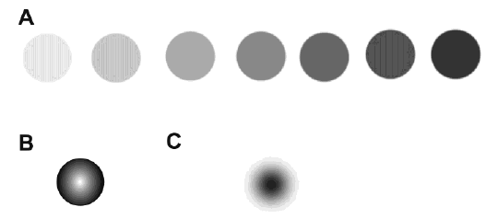
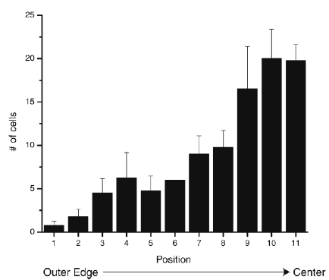
Durotaxis: gradients via photomask polymerization
Wong, J. Langmuir, 2003

Slide 5
Durokinesis: Biphasic Migration Dependence on Substrate Stiffness
Speed (um/hr)
Durokinesis: SMCs migrate fastest on an ‘optimally stiff’ substrate
Lecture 9: actin polymerization controlled by adhesive protein density as well (Haptokinesis).
Cells need stiffer substrate when less fibronectin is attached to surface to migrate at maximum capacity
Substrate stiffness
Peyton and Putnam, J. Cell. Phys. 2005

Slide 6
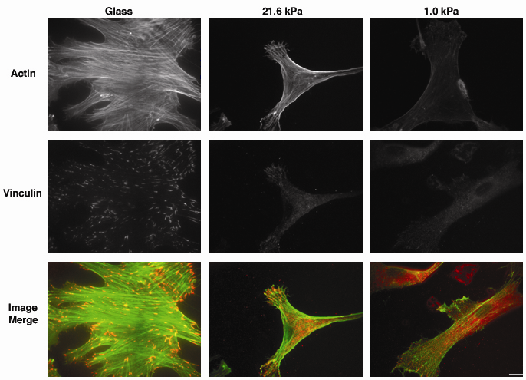
Cytoskeletal Assembly Regulated by Substrate Stiffness
Peyton and Putnam, J. Cell. Phys. 2005
Notes:
In concert with this change in motility, we also saw a clear difference in cytoskeletal assembly as a function of stiffness, indicating the role of the cytoskeleton and potentially RhoA in motivating these changes in cell motility.
As you can see here, the presence of very large, robust focal adhesions is present in cells cultured on the most rigid surface (polystyrene or glass). In contrast, relatively few punctate adhesive structures were observed in SMCs cultured on the softest 1.0 kPa substrate, as most of the vinculin staining in these cells was cytoplasmic. Likewise, the ability of SMCs to form a bundled actin stress fiber network was found to depend on ECM rigidity. As you can see here, there is a relative absence of stress fibers in SMCs on the softest 1.0 kPa substrate, in contrast to the well-defined discrete filaments observed in cells cultured on the stiffer substrates.

Slide 7
Hypothesis: RhoA Mechanosensitive Signaler
“Mechanotransduction”

Slide 8
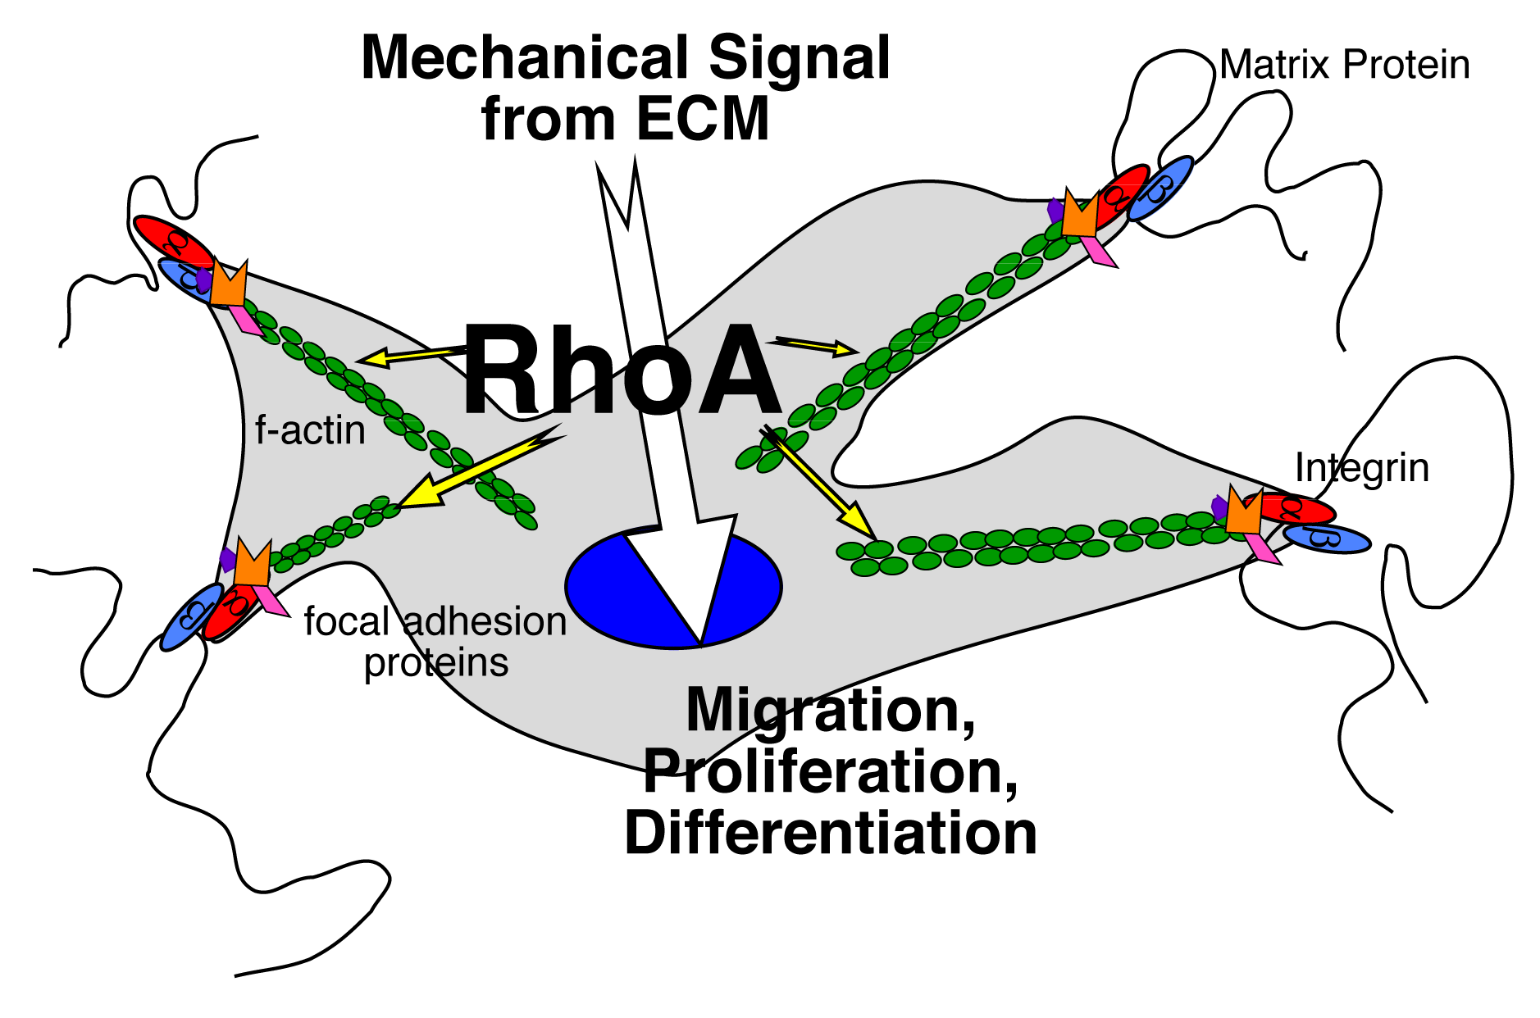
Mechanical Signal → RhoA/Cytoskeleton → Migration
1
2
Notes:
Given all of this information, the hypothesis driving this research is that mechanical information from the ECM is able to generate a cellular response….presumably in concert with, or driven by cytoskeletal assembly and/or RhoA signaling.
First, it’s possible that mechanical signaling modulates the activity of RhoA, which mediates cytoskeletal assembly, and cell behavior. Or, it’s possible that ECM mechanical properties directly regulate cytoskeletal assembly through a presumed force balance, which can feedback to RhoA activity and cell behavior.
Either way, RhoA appears to be at the center of this issue and could be able to integrate this biophysical information from the ECM into a biochemical signal and therefore regulate cell behavior.

Slide 9
ROCK Inhibition Decreases Migration Speed on “Optimal” Substrates
Peyton, S.R. and Putnam, A.J. J. Cell. Phys. 2005 Jul;204(1):198-209.

Slide 10
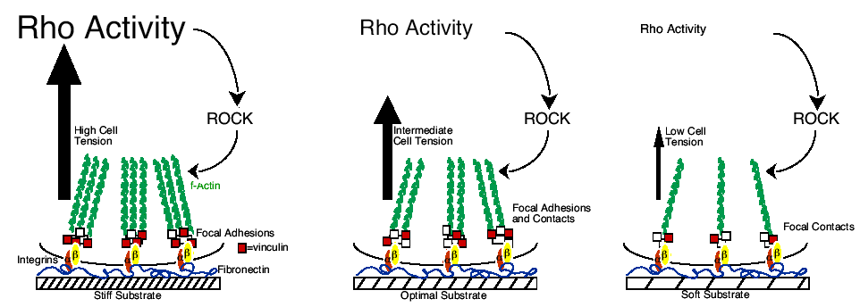
On 2D Biomaterial Substrates
ECM Stiffness Regulates Motility via Cytoskeletal Assembly and RhoA Activity
Optimal Migration Speed on Intermediately Stiff, Adhesive Substrates with Intermediate Cytoskeletal Tension

Slide 11
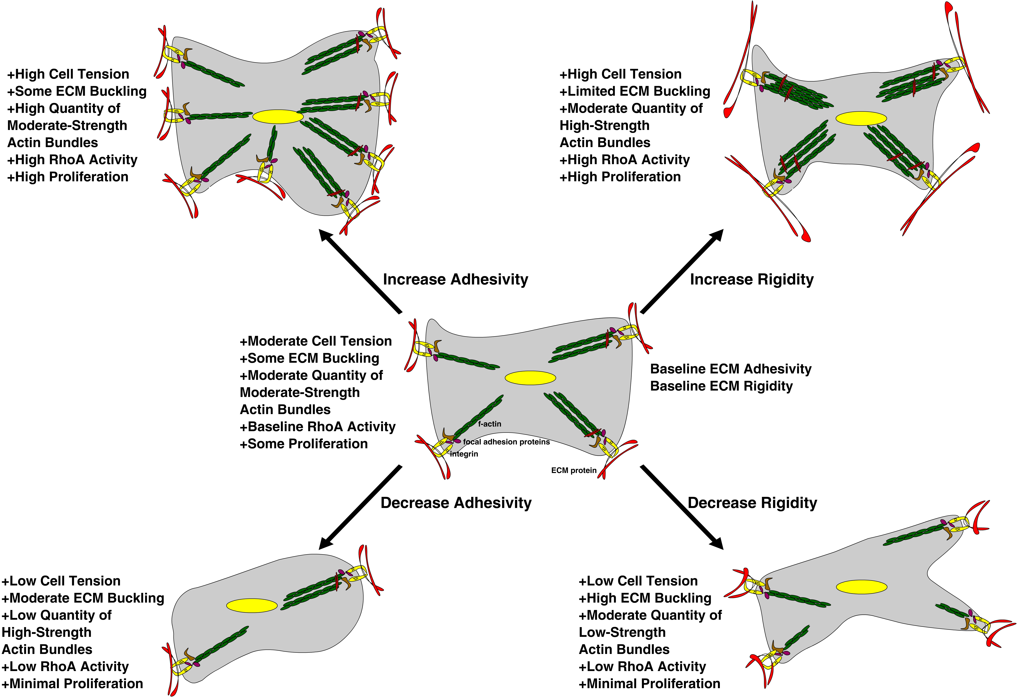
Hypothesis
Mechanics of the ECM Regulate cell Behavior
  Substrate stiffness and ligand density of ECM alter contractility
  Contractility defines behavior
1.
2.
3.
4.

Slide 12
Biomaterials as ECM Mimics
Natural Biopolymers
  Collagen, Fibrin, Matrigel
  Contain cell-adhesive domains, 3D transferable
  Natural chemistries
  Soft 1Pa-10kPa
  Lumped parameters
Synthetic Polymers
  Polyacrylamide (PAA), Poly(ethylene glycol) (PEG), Polydimethylsiloxane (PDMS)
  Independent tunability
  Wide range of mechanical properties (100Pa – MPa)
  Difficult chemistries
  Not always 3D transferable
In Vivo Tissue Elastic Moduli Range
  Brain: 100s of Pa
  Liver: 10-100 kPa
  Artery: ~40kPa
  Skin: ~100 kPa
  Bone: 100s of MPa to GPa

Slide 13
Added Complexity: 3D Microenvironments
Science, Cukierman (2001)
Nat Rev MCB Griffith and Swartz (2006)

Slide 14
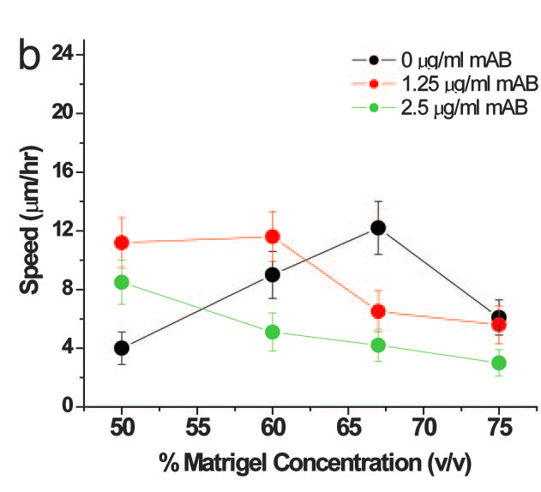
Natural Biopolymer: Matrigel
  Prostate cancer cells have biphasic migration speed as a function of Matrigel concentration.
  When adhesivity was regulated via antibody blocking, biphasic curve shifted in the opposite direction as was predicted by previous 2D studies.
  Matrigel stiffness, pore size, degradation sites, ligand density compounded.
Decreasing adhesivity
Increasing stiffness
Decreasing pore size
Increasing adhesivity
Increase in needed degradation
Change in growth factor sequestering
PNAS Zaman et. al. (2006)

Slide 15
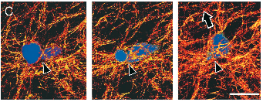
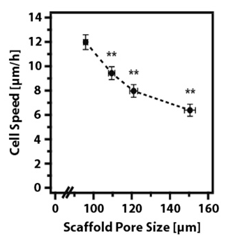
Collagen: Microenvironment Heavily Influenced by Polymerization Conditions
Native bovine dermal type I collagen
Motility requires MT1-MMP
(Nutragen)
JCB Wolf et. al. (2003)
Native bovine dermal type I collagen
Motility can be protease-independent
(Vitrogen, pepsin-extracted, non-covalent crosslinks)
MBC Kim et. al. (2008)
Freeze-dried Collagen-GAG
1D migration along fibers
Biophys J Harley et. al. (2008)

Slide 16
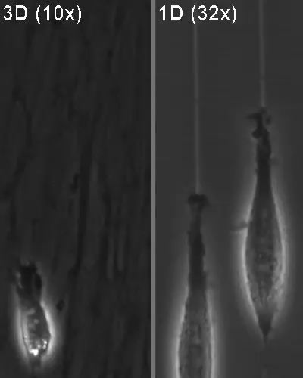
Cell-Secreted ECMs: 3D = 1D?
JCB Doyle et. al. (2009)

Slide 17
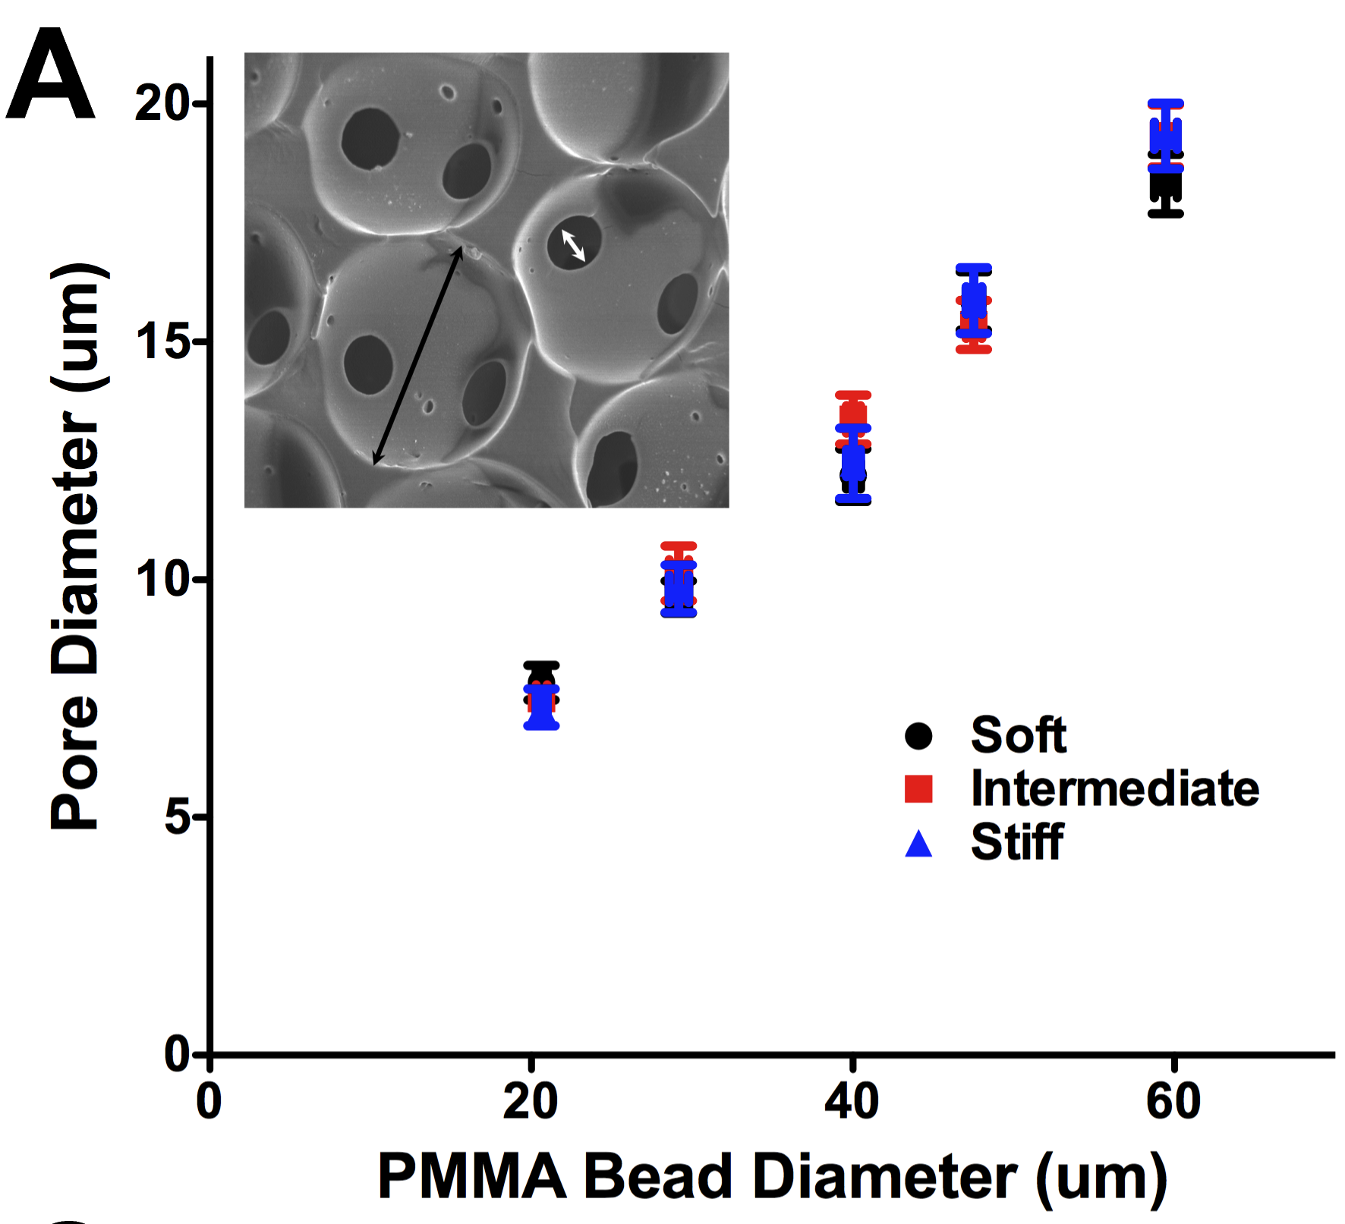
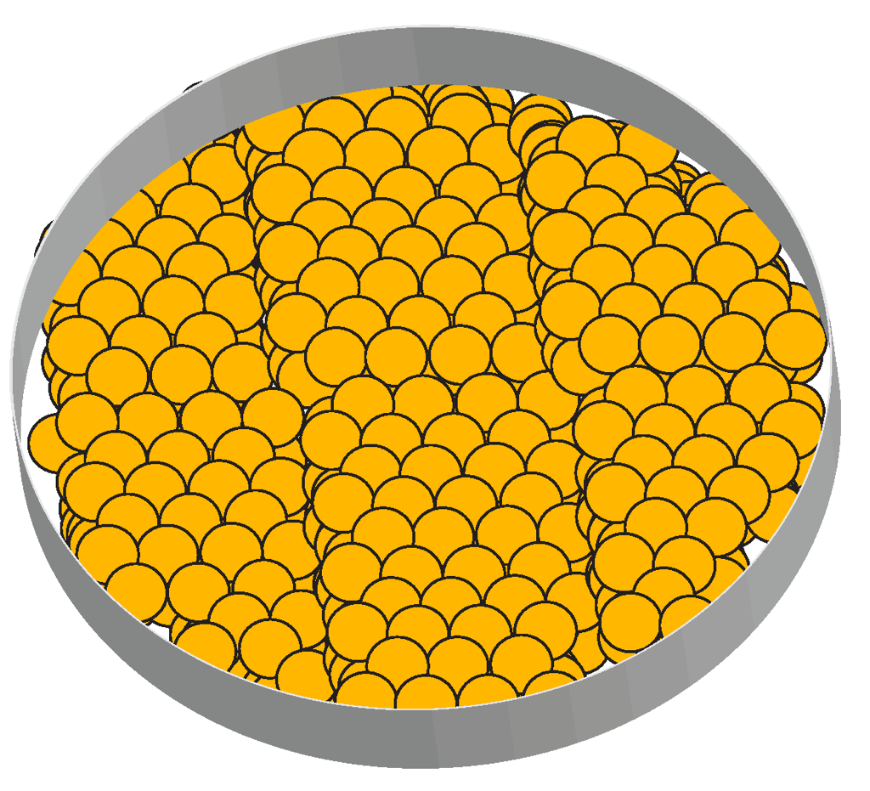

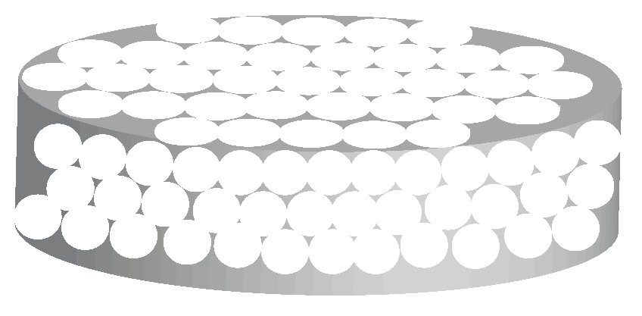
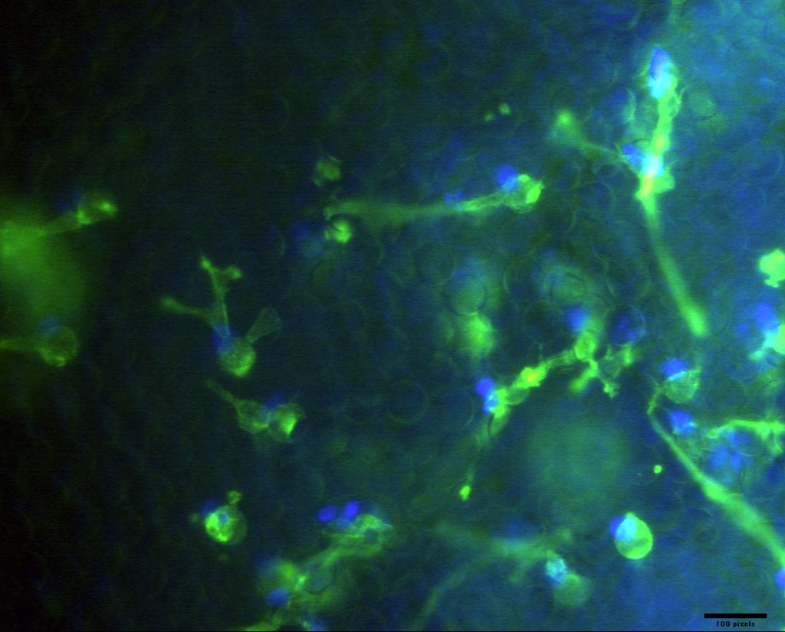
Defined Macropores in Non-Degradable PEG Environment
Stachowiak et. al., Adv. Mat., 2004
PEG polymerized with UV Light
Beads leached
Porous, ordered hydrogel
Peyton et. al. (in review)

Slide 18
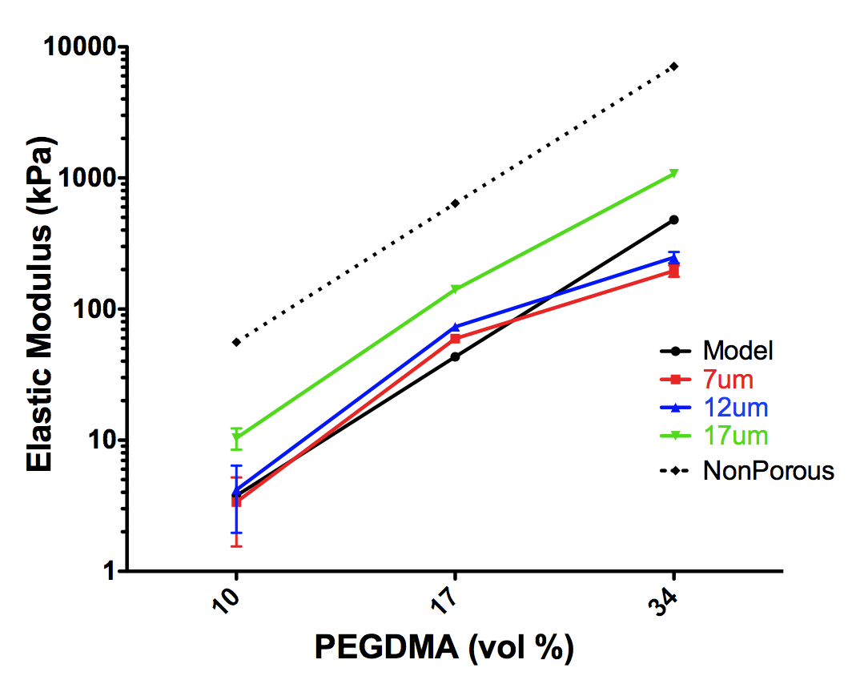
Elastic Modulus in Macroporous Gels Follows Predictive Model
Gibson and Ashby, Cellular Solids
Peyton et. al. (2011)
Nonporous values are similar to previous reports on PEG gel mechanical tests

Slide 19
As we increase the pores, we also increase size of large chambers
Cell Spherical Diameter: ~16um
Chamber: 20um
Pore: 7um
Chamber: 40um
Pore: 12um
Chamber: 60um
Pore: 17um

Slide 20
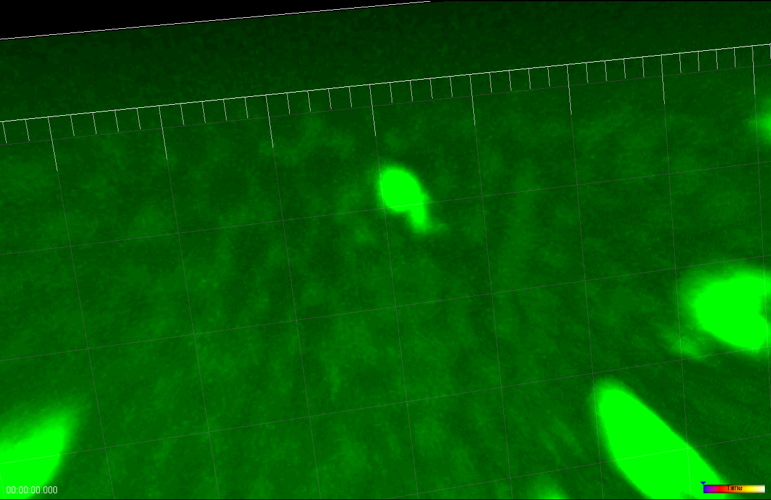
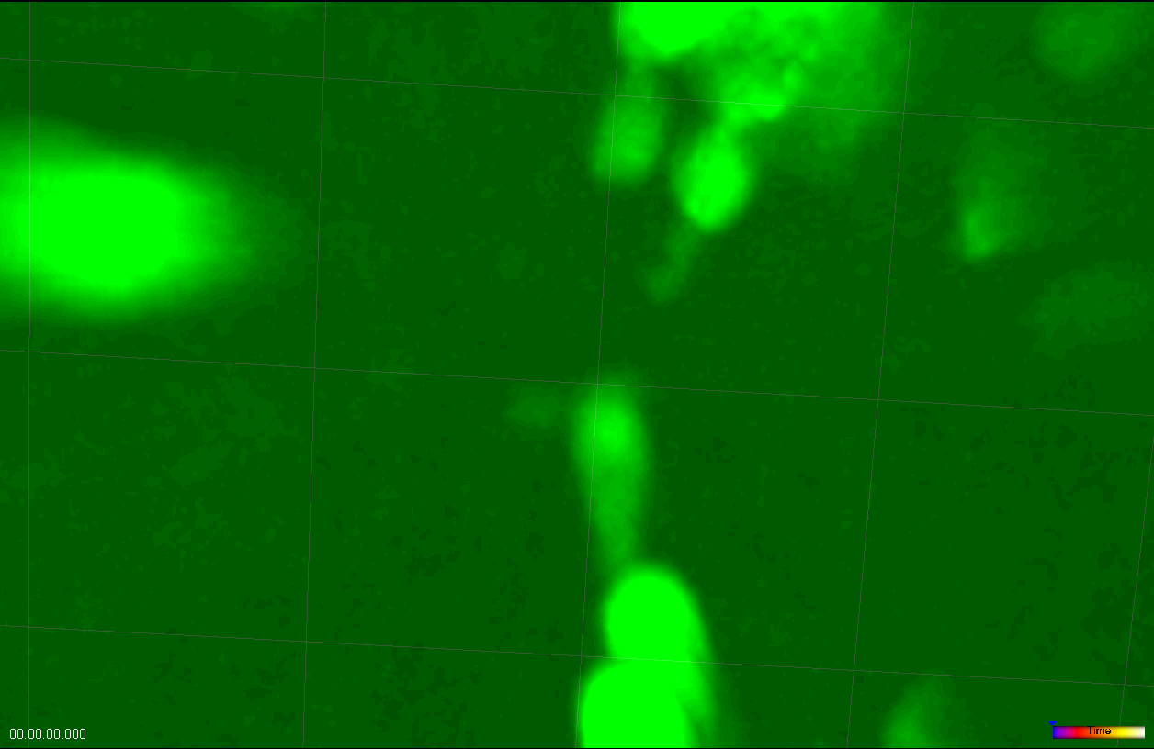
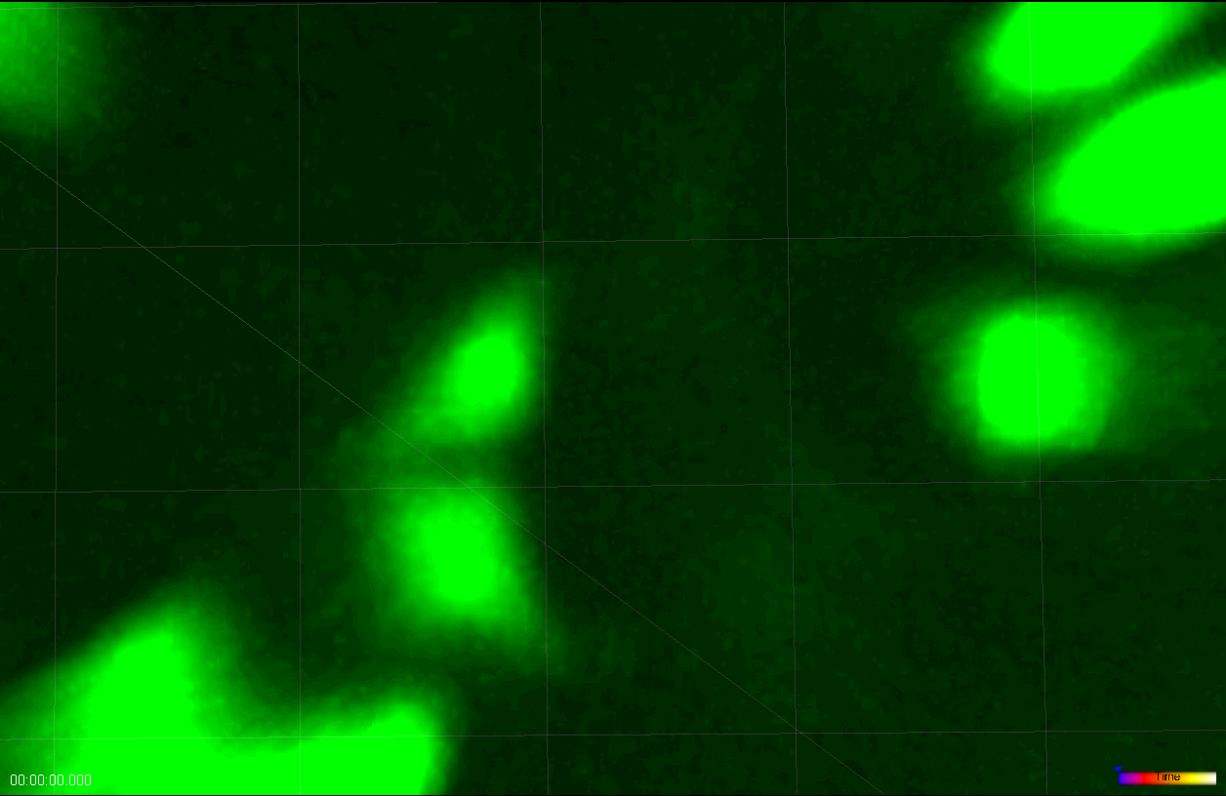
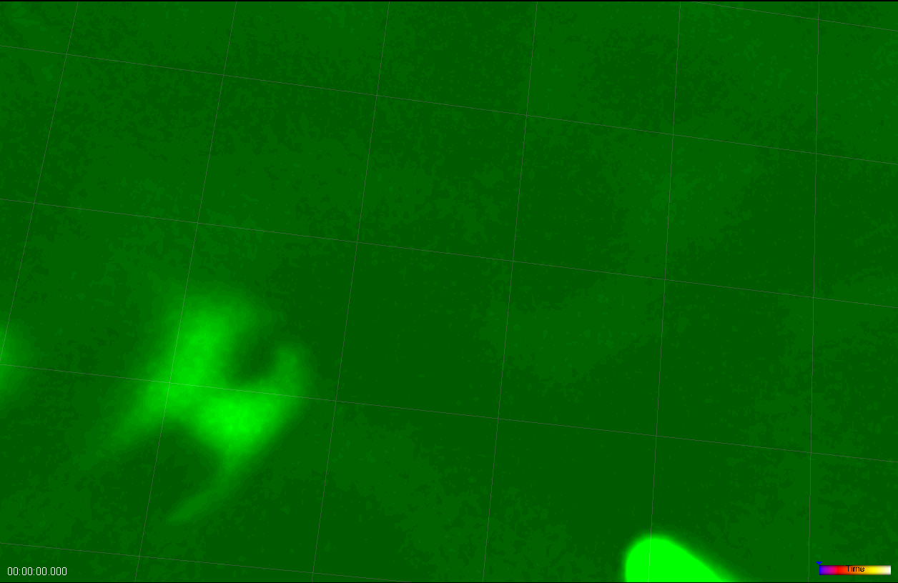
MSCs Exhibit Diverse Migration Phenotypes in 3D Scaffolds
7um pore, Cell Trapped in Chamber
7um pore, Cell Jumps
17um pore, Cell Stays in Chamber
17um pore, Cell Jumps

Slide 21
Adhesivity and Elasticity Affect Cell Speed Only at Largest Pore Diameters
Peyton et. al. (2011)

Slide 22
Geometry of Microenvironment Dictates Durokinesis
2D Polyacrylamide (SMCs)
Adhesivity, Stiffness Dominate
3D Poly(ethylene glycol) (MSCs)
Pore Diameter Dominates
Peyton, S.R., et. al. (in review)
Peyton, S.R. and Putnam, A.J. J. Cell. Phys. 2005
MBC Kim et. al. (2008)
Biophys J Harley et. al. (2008)
Analogous to comparisons
between collagen microenvironments?

