Slide 1
Establishing Baseline Performance Scores for the CAGEN Robust Gene Response Challenge
Shaunak Sen
Caltech CMS
Oct 11, 2011

Slide 2
CAGEN - Critical Assessment of
Genetically Engineered Networks
Systematize the design of genetic networks
(robustness, connectability)
- Facilitate applications, for ex. in agriculture, medicine

Slide 3
CAGEN Challenge #1 : Robust Gene Response
Induce OUTPUT (YFP) in response to INPUT (IPTG), so that,
Detectable: >10 fold induction
Robust: Low variability across cells & temperatures
Fast: Quick response
Speed
>10 X₀
Low Variability
OUTPUT
YFP induction
1 X₀
Time
IPTG Addition
INPUT

Slide 4
Purpose
Establish Baseline Performance
Challenge Specifications
Purpose: Establish Baseline Performance
ANNOUNCEMENT
Self Assessment by Participants
SELECTION
Critical Assessment of Selected Designs

Slide 5
Performance metric to score robustness and speed of designs
Time integral of square error
Worst Case
Normalizing factor
(equilibrium amplitude of reference trace)
r(t)
y_{j}(t)
j=2…15
X
Protein Levels (nM)
P_{x}
x
simulation
Time (hours)

Slide 6
Single cell dynamics are measured for a simple reference design, for different temperatures
P_{inducible}
YFP
E. coli
 | 30 °C | 32 °C | 34 °C
#1 | ? | ? | ?
#2 | ? | ? | ?
#1
P_{lac}
yfp
IPTG
#2
P_{lac}
cI-yfp
IPTG

Slide 7
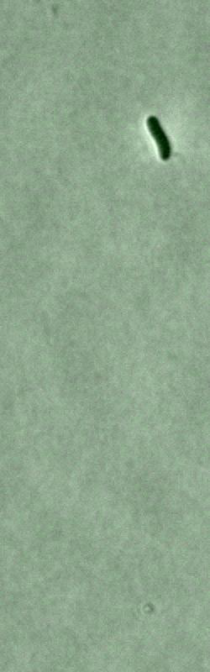
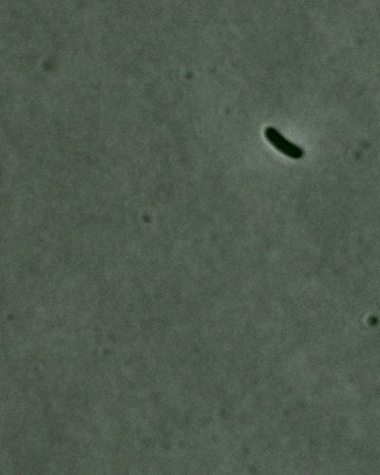
Movies
P_{inducible}
YFP

Slide 8
Reference trace exhibits > 10x induction
Cell division
Mean Fluorescence (a.u.)
10x induction
No induction
Camera Bgd.
Time (minutes)

Slide 9
Performance scores for inducible protein expression circuits
S = 0.27
S = 0.29
#1
P_{lac}
Reference trace (32 °C)
Traces at 32 °C
Traces at 34 °C
Traces at 30 °C
#2
P_{lac}
Reference trace (34 °C)
Traces at 34 °C
Traces at 30 °C
yfp
cI-yfp
IPTG
IPTG
Mean Fluorescence (a.u.)
Mean Fluorescence (a.u.)
Time (minutes)
Time (minutes)

Slide 10
Population level metric to estimate performance score
Single-Cell Dynamics/ Microscopy
Population Dynamics/
Flow Cytometry
r(t)
y_{j}(t)
j=2…15
Protein Levels (nM)
Count
simulation
Protein Levels (nM)
Time (minutes)
Time (hours)

Slide 11
Future Work
Refined single-cell measurements using μfluidics
Challenge Specifications
Simulation/
Eric Klavins
Baseline for Critical Assessment
Self Assessment by Participants
Critical Assessment of Selected Designs
Benefit #1.
Exact induction time
measurement.
Benefit #2:
Similar decay time
measurement.

