Slide 1
Week 14 Assignment
Kara Dismuke

Slide 2
Not Estimated

Slide 3
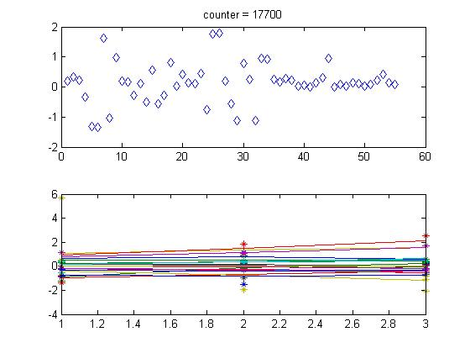
MATLAB Counter with non-estimated b

Slide 4
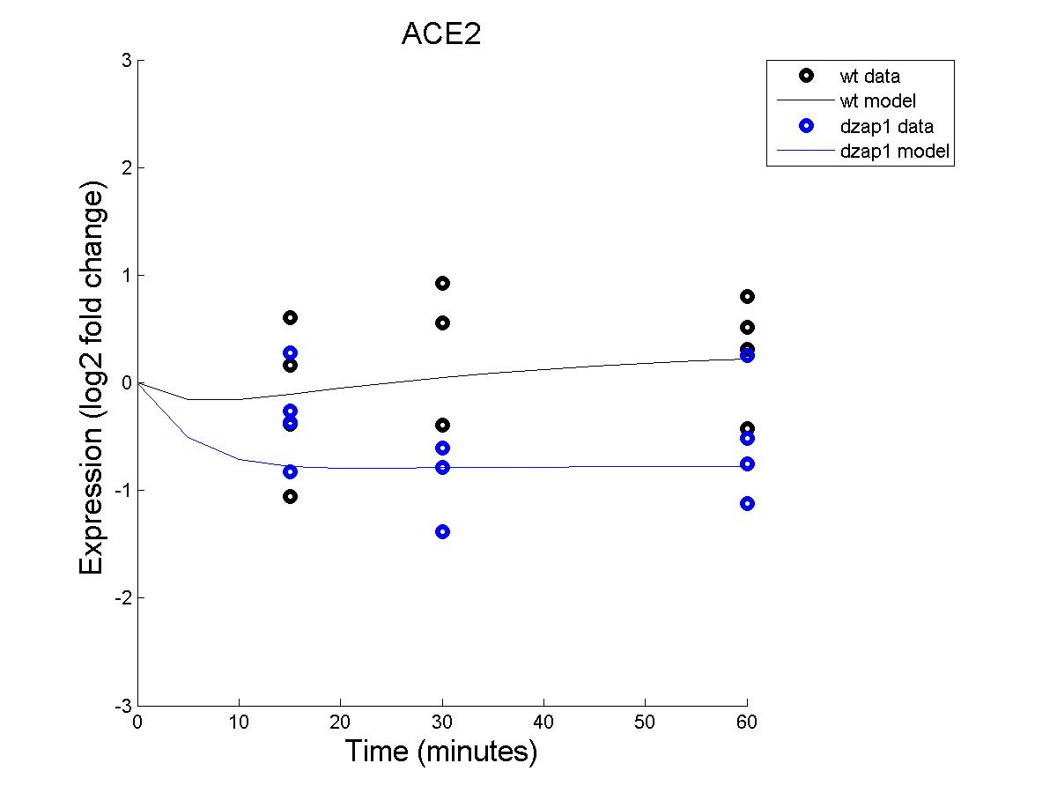
Effect of WT and dZAP1 on ACE2 expression (with non-estimated b)

Slide 5
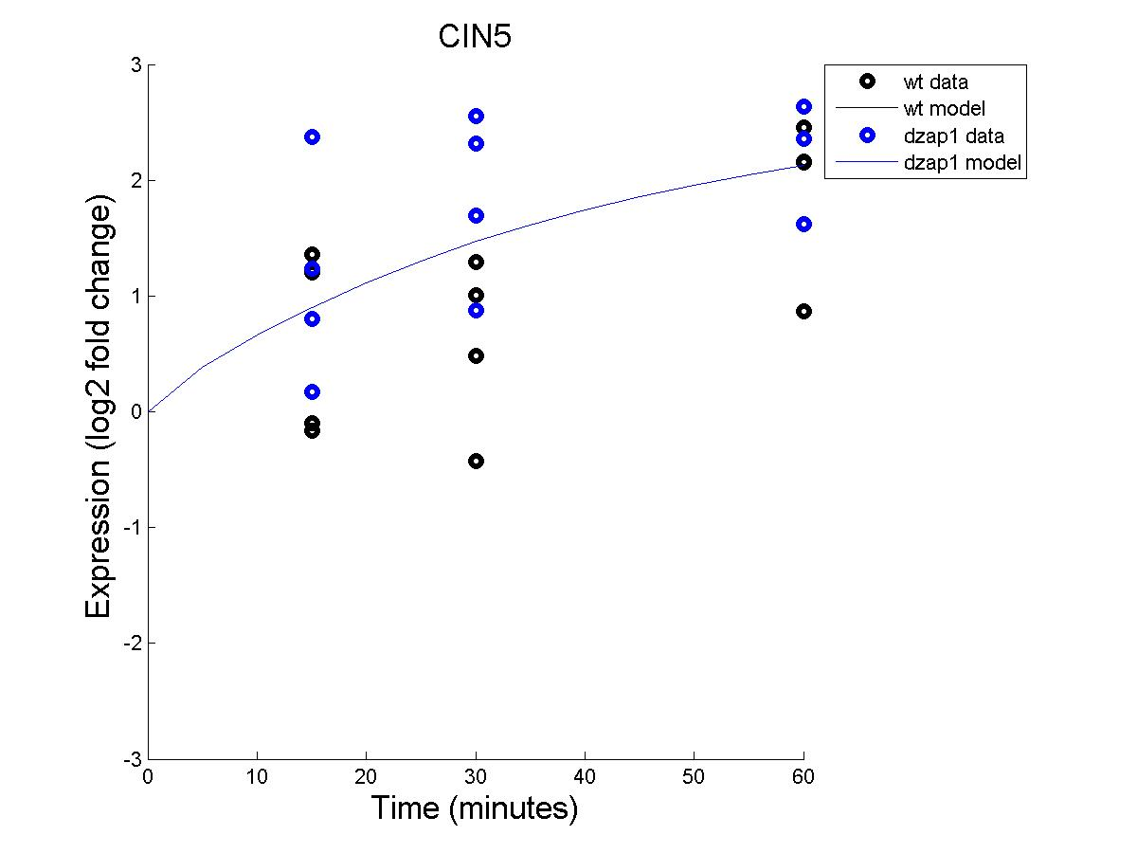
Effect of WT and dZAP1 on CIN5 expression (with non-estimated b)

Slide 6
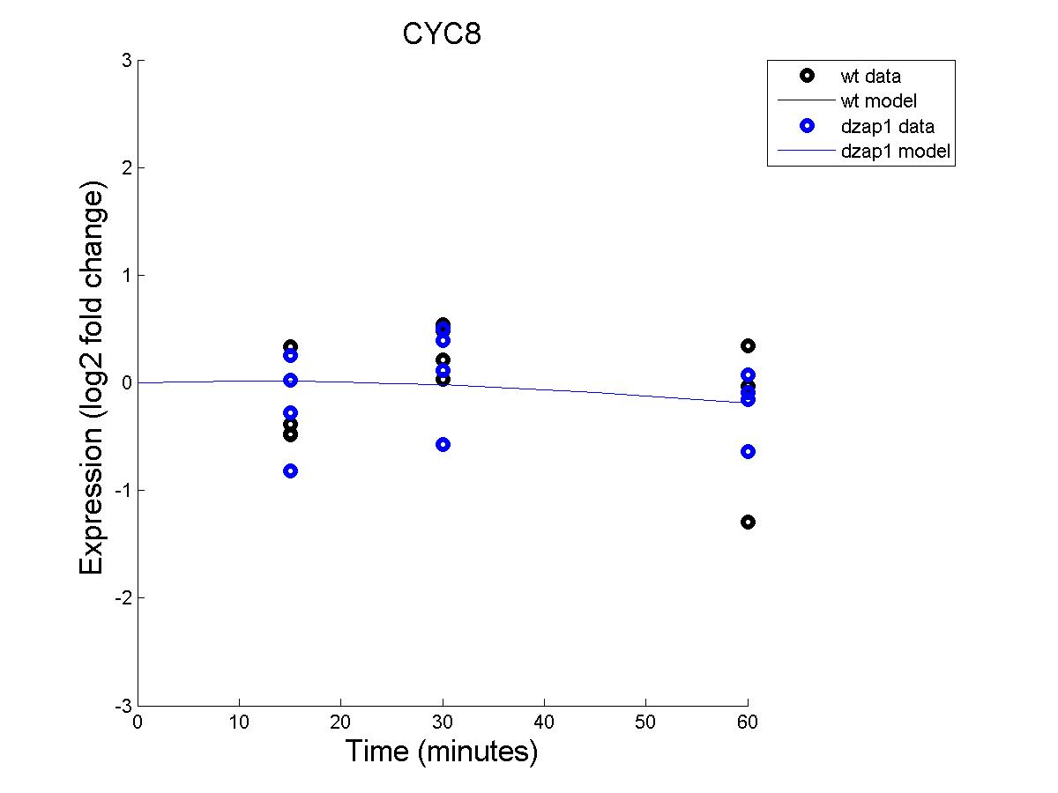
Effect of WT and dZAP1 on CYC8 expression (with non-estimated b)

Slide 7
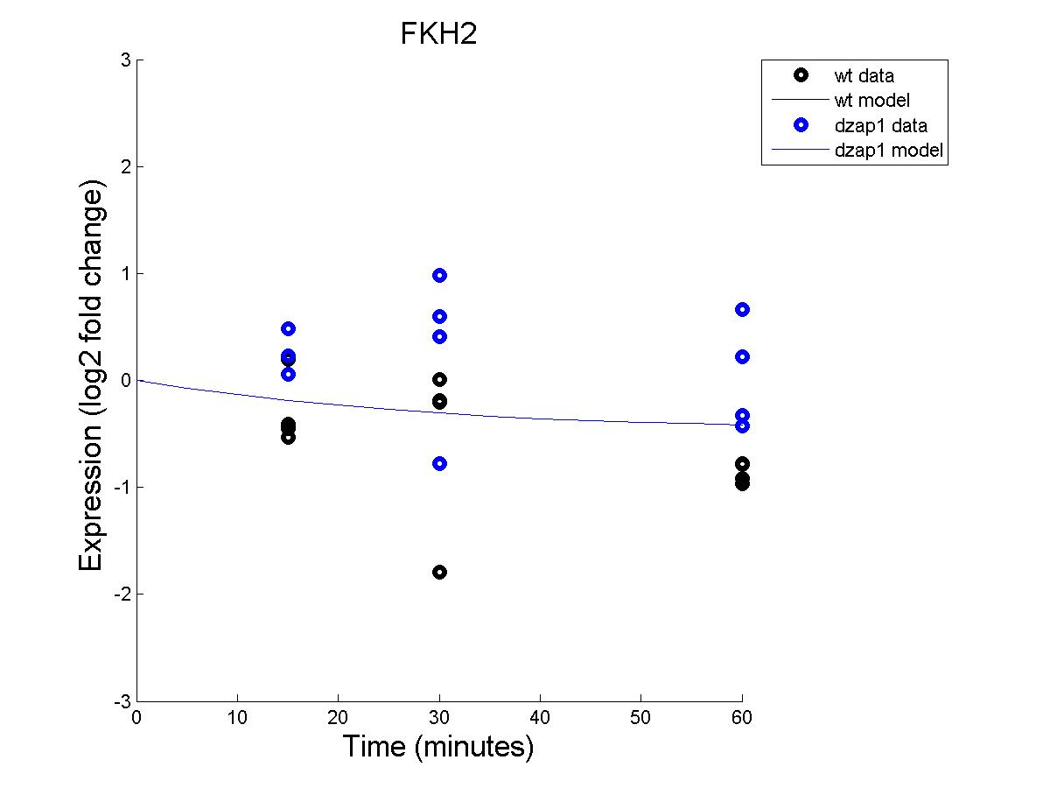
Effect of WT and dZAP1 on FKH2 expression (with non-estimated b)

Slide 8
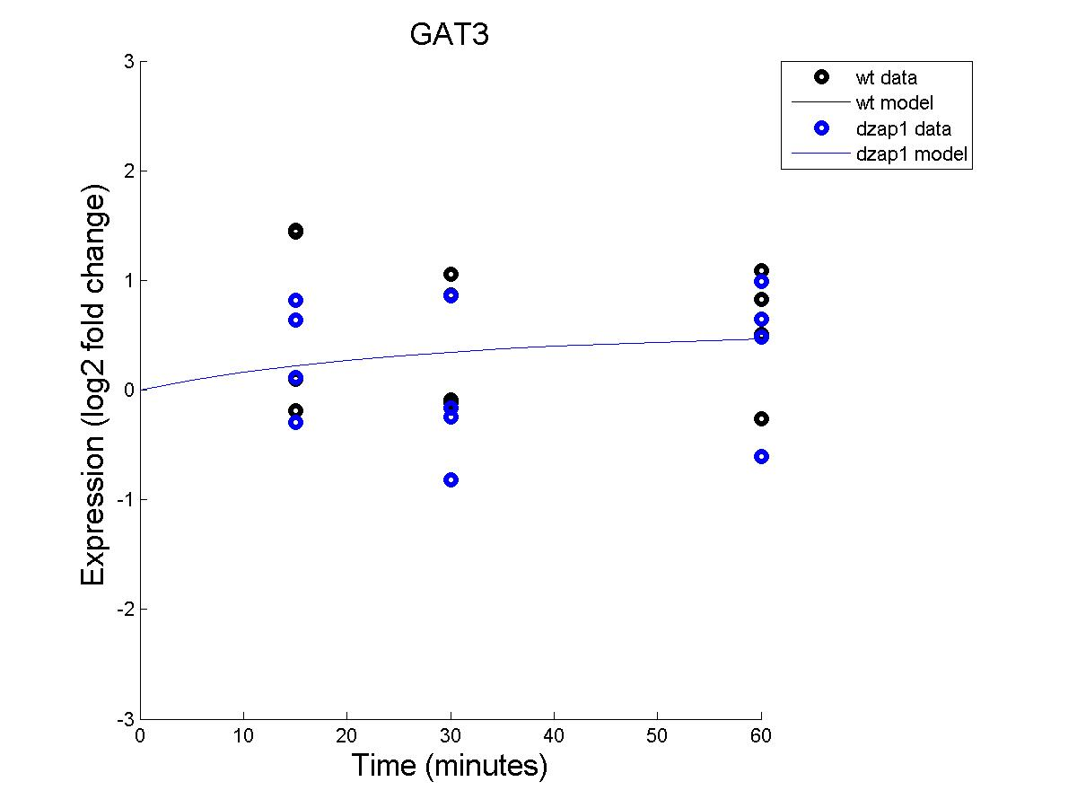
Effect of WT and dZAP1 on GAT3 expression (with non-estimated b)

Slide 9
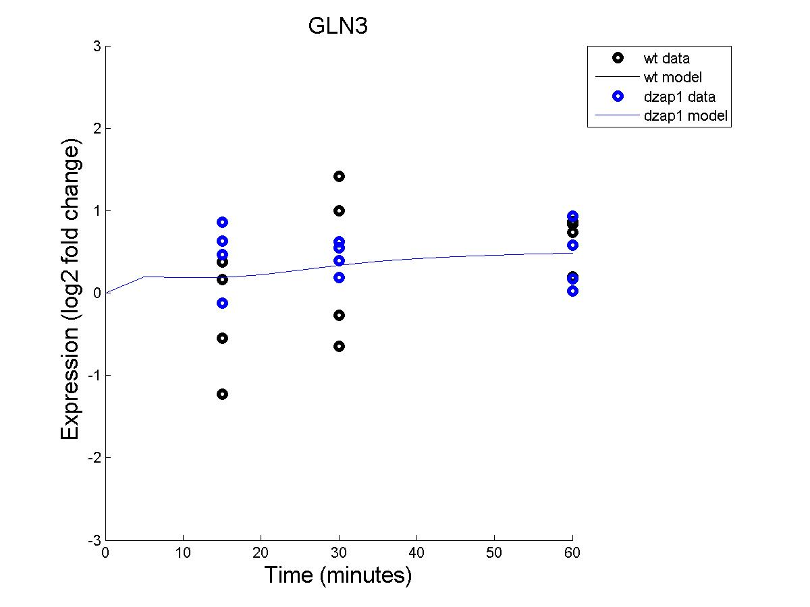
Effect of WT and dZAP1 on GLN3 expression (with non-estimated b)

Slide 10
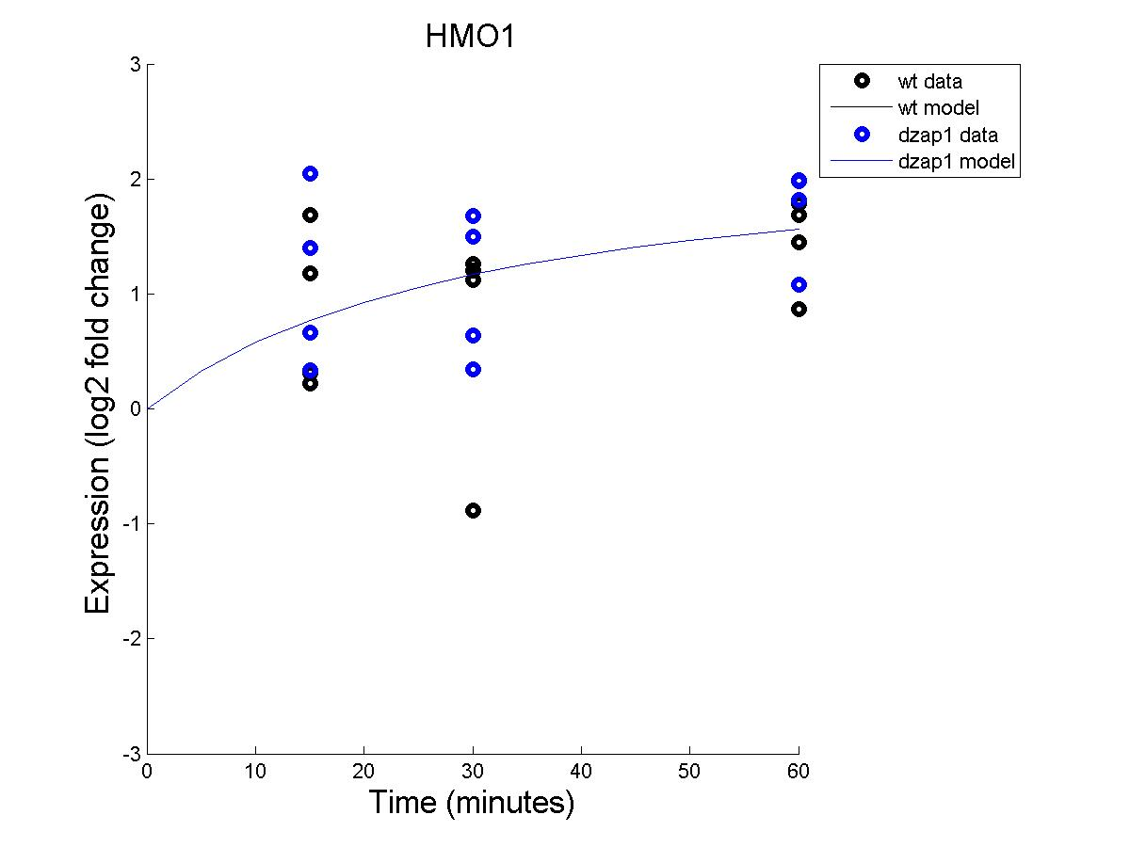
Effect of WT and dZAP1 on HMO1 expression (with non-estimated b)

Slide 11
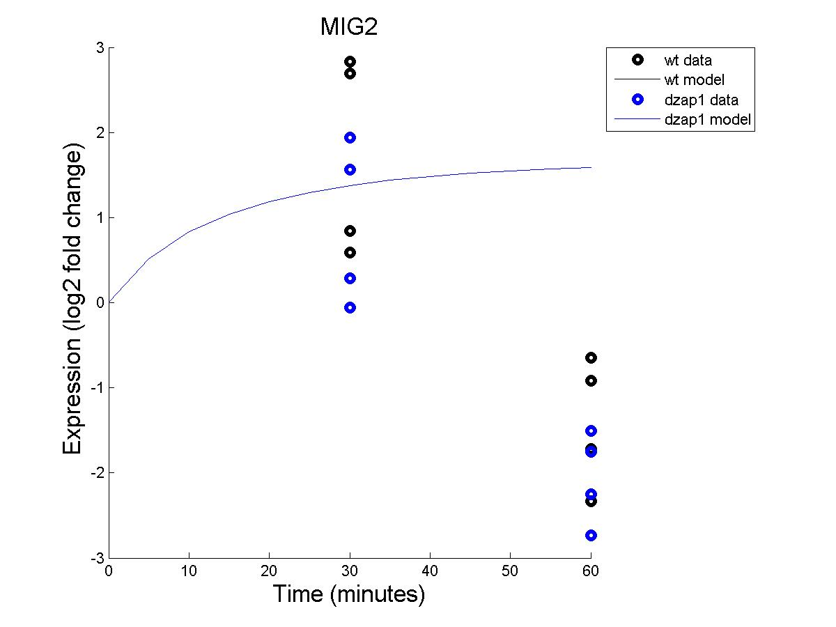
Effect of WT and dZAP1 on MIG2 expression (with non-estimated b)

Slide 12
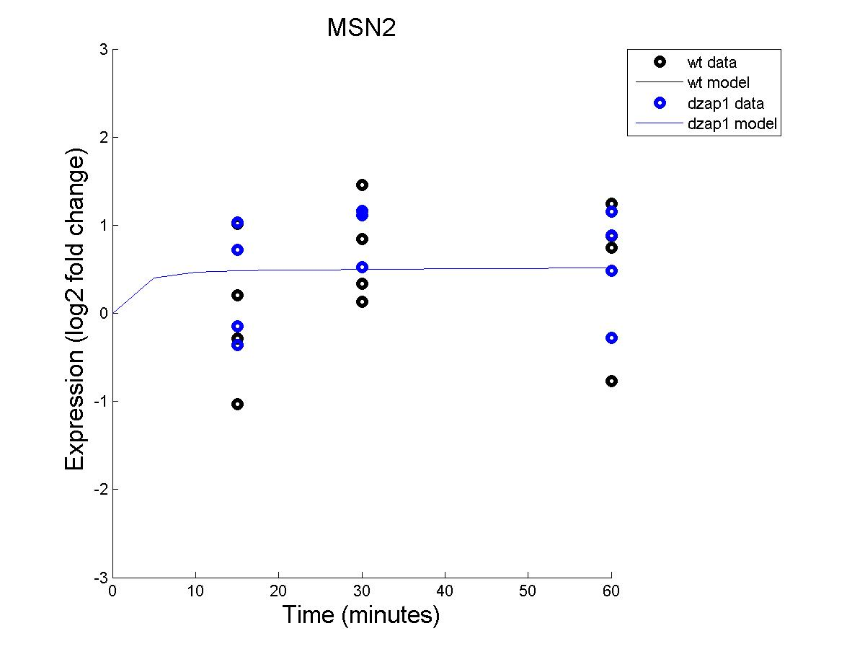
Effect of WT and dZAP1 on MSN2 expression (with non-estimated b)

Slide 13
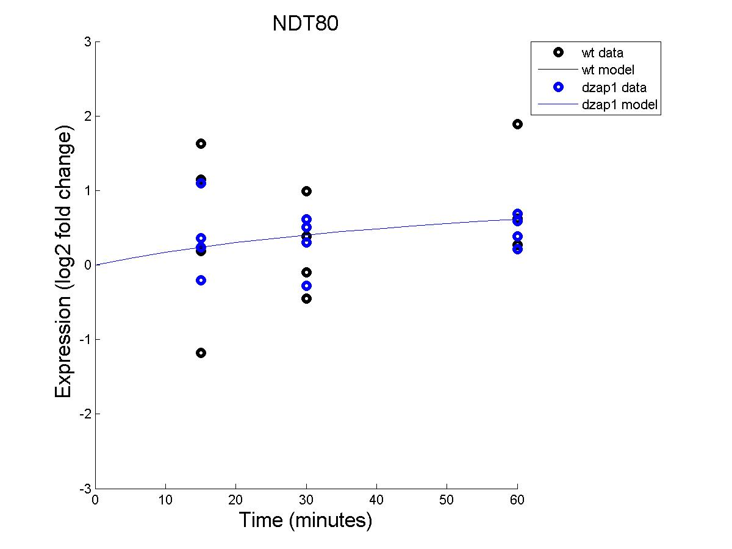
Effect of WT and dZAP1 on NDT80 expression (with non-estimated b)

Slide 14
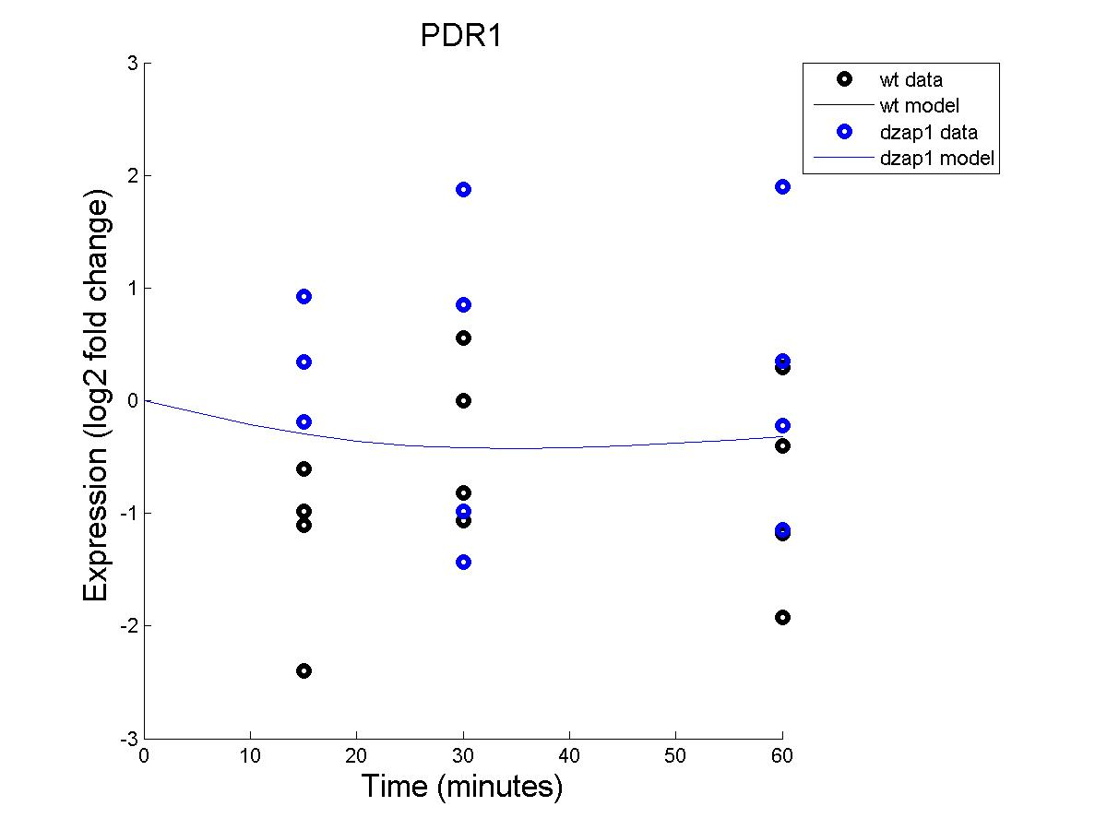
Effect of WT and dZAP1 on PDR1 expression (with non-estimated b)

Slide 15
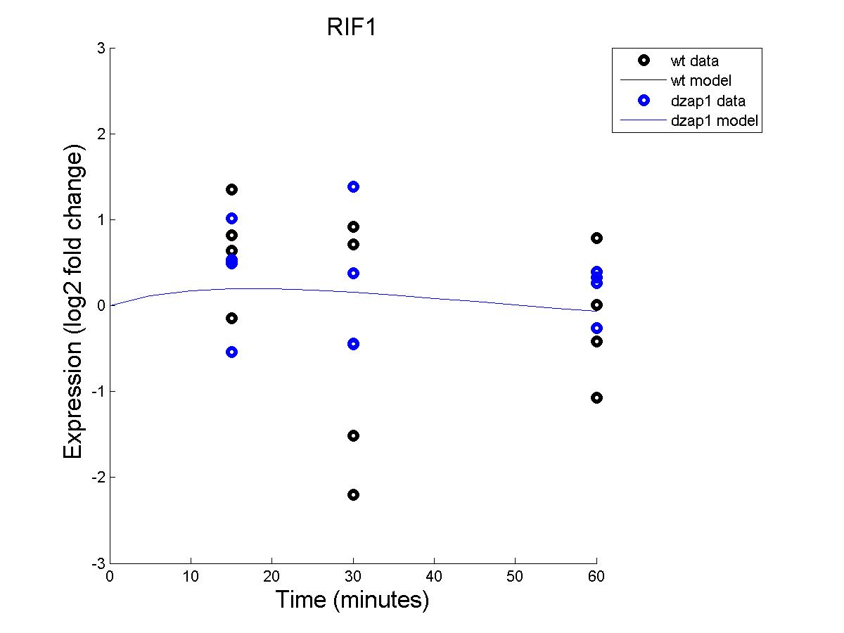
Effect of WT and dZAP1 on RIF1 expression (with non-estimated b)

Slide 16
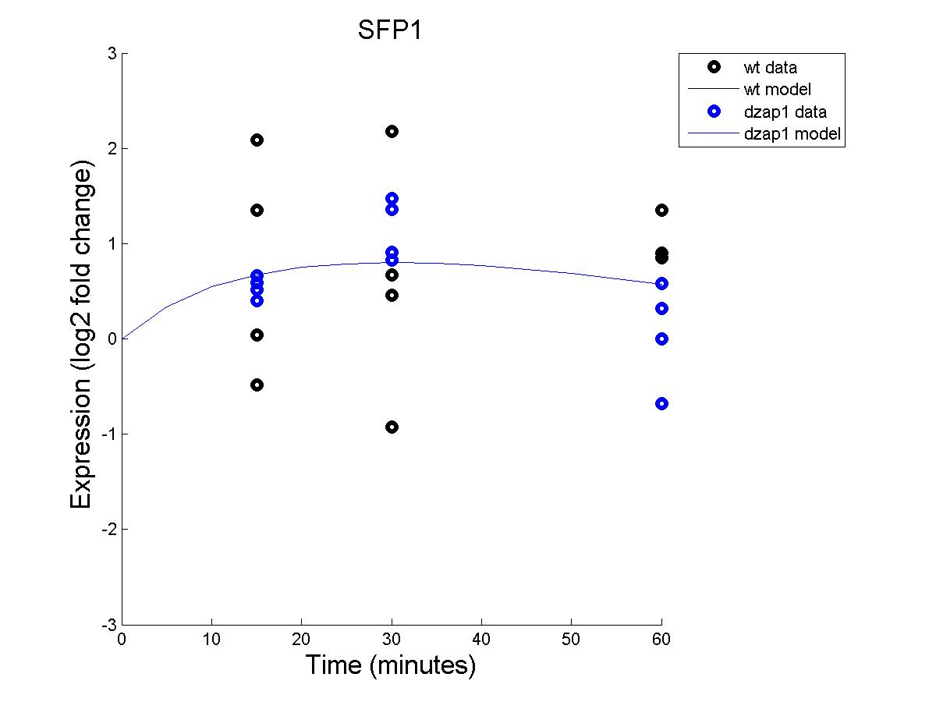
Effect of WT and dZAP1 on SFP1 expression (with non-estimated b)

Slide 17
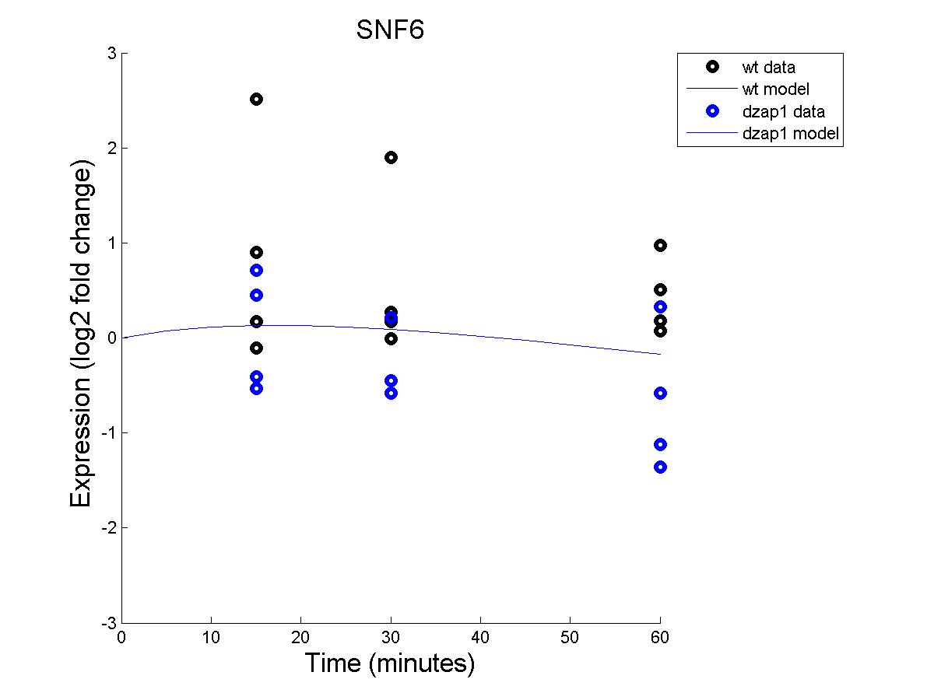
Effect of WT and dZAP1 on SNF6 expression (with non-estimated b)

Slide 18
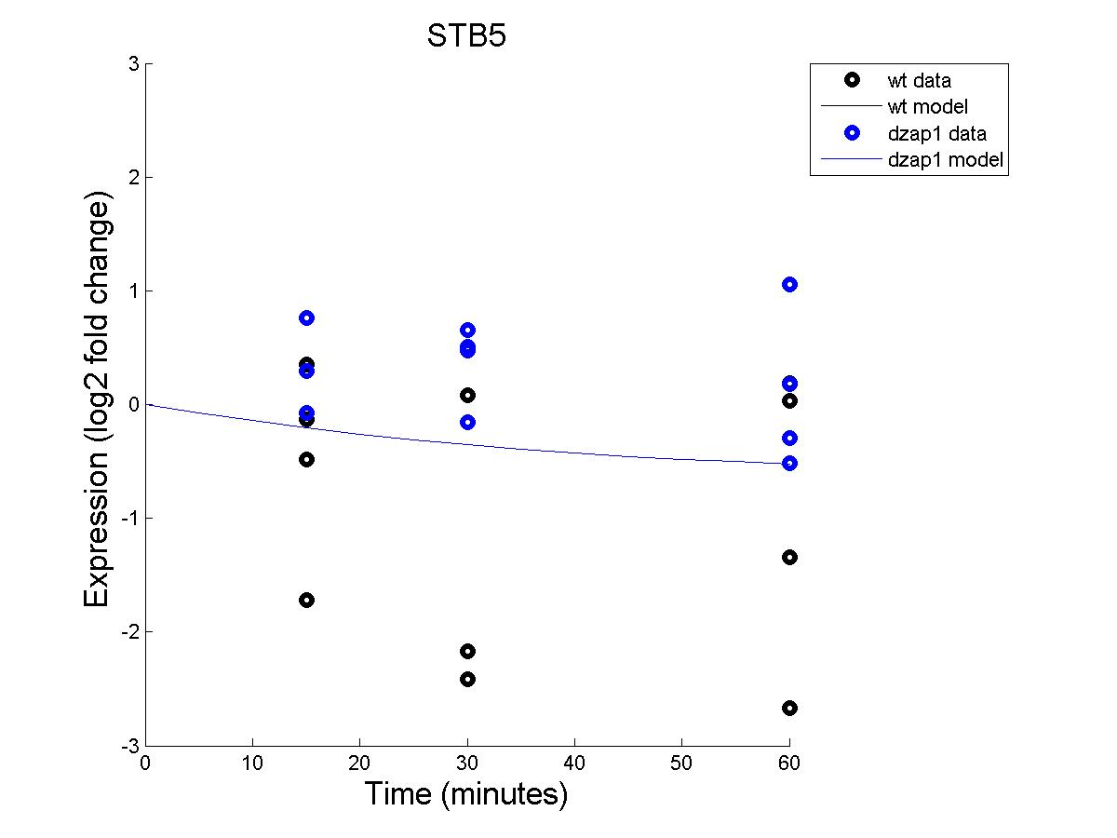
Effect of WT and dZAP1 on STB5 expression (with non-estimated b)

Slide 19
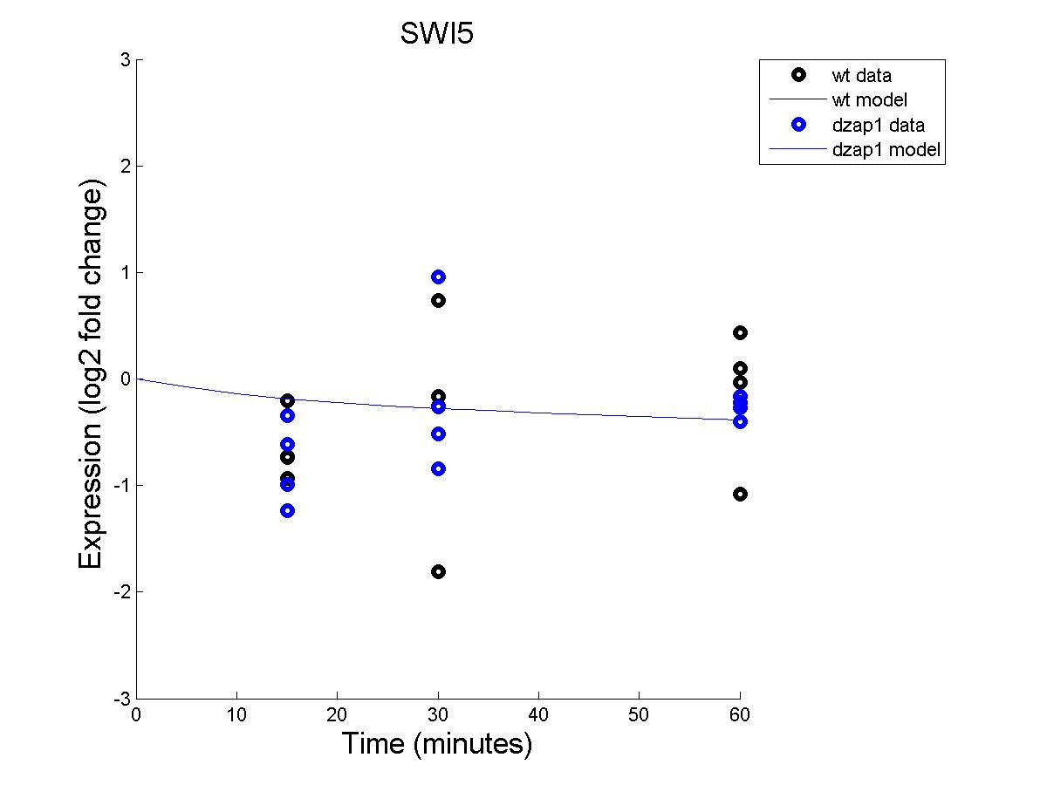
Effect of WT and dZAP1 on SWI5 expression (with non-estimated b)

Slide 20
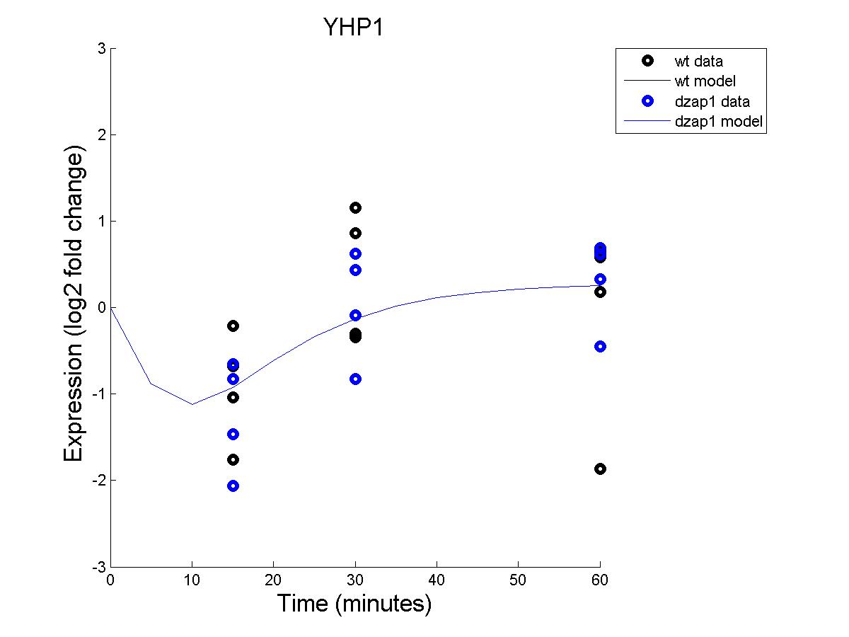
Effect of WT and dZAP1 on YHP1 expression (with non-estimated b)

Slide 21
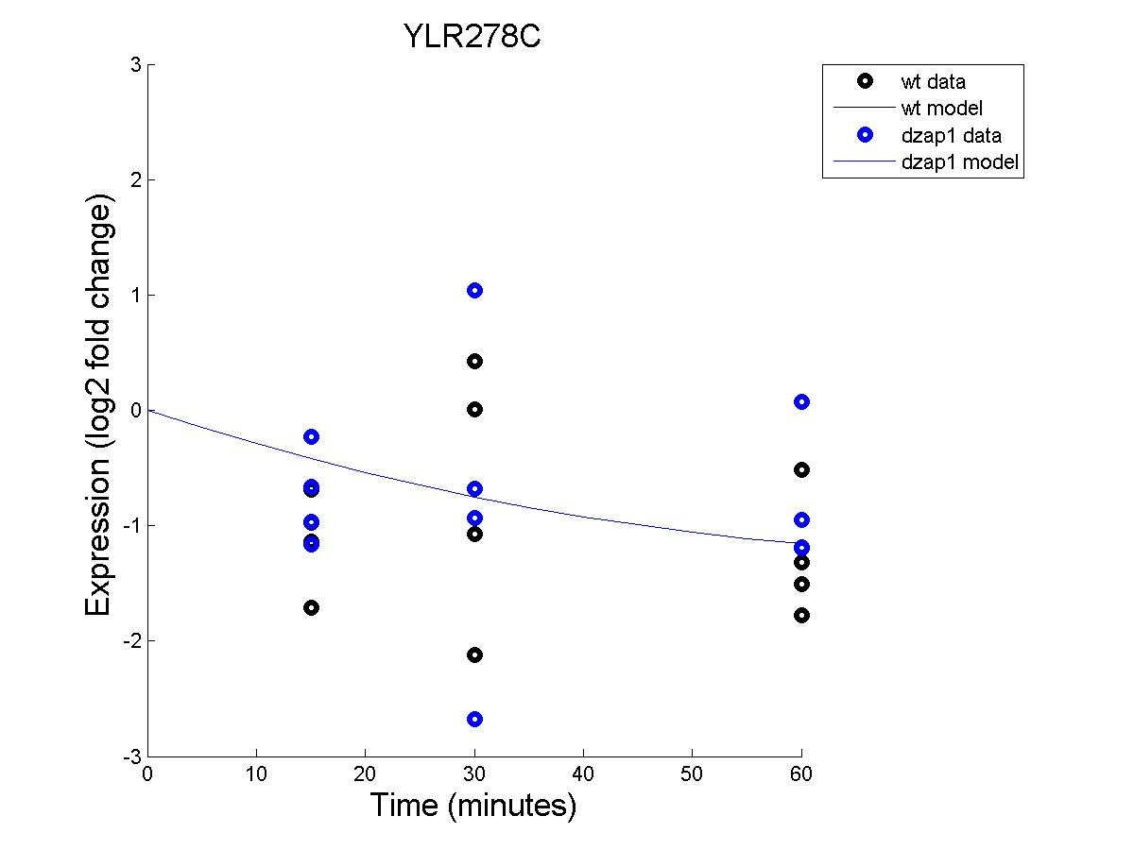
Effect of WT and DZAP1 on YLR278C expression (with non-estimated B)

Slide 22
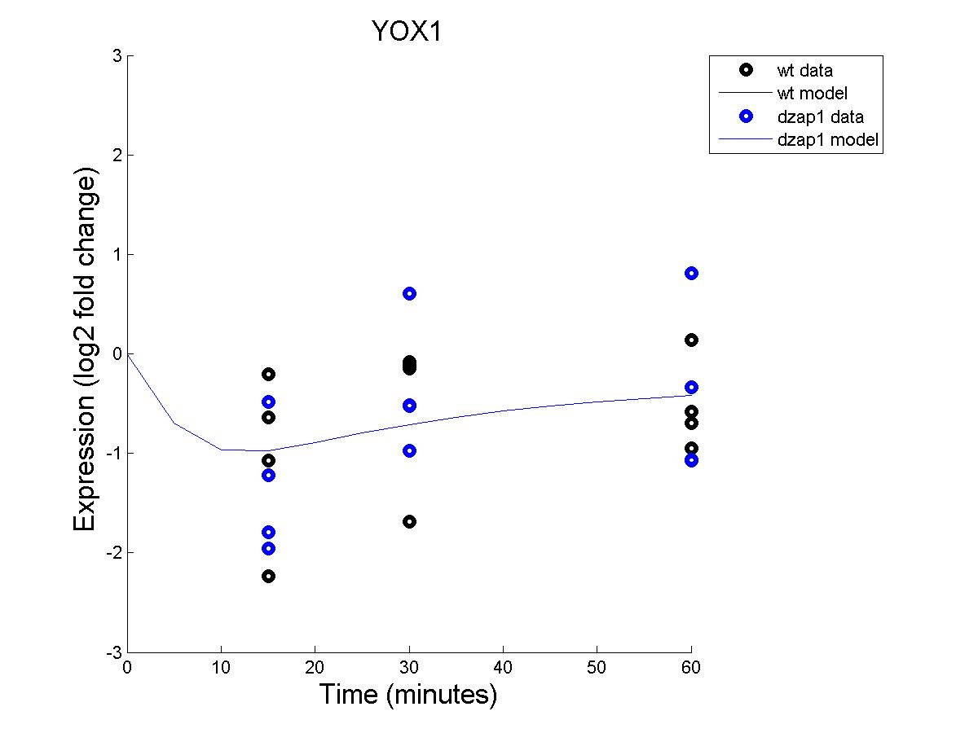
Effect of WT and dZAP1 on YOX1 expression (with non-estimated b)

Slide 23
ESTIMATED

Slide 24
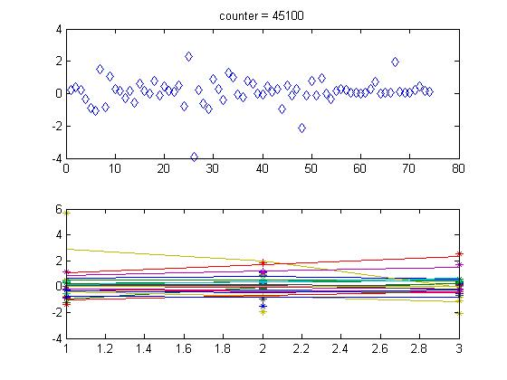
MATLAB Counter with estimated b

Slide 25

Effect of WT and DZAP1 on ACE2 expression (with estimated b)

Slide 26
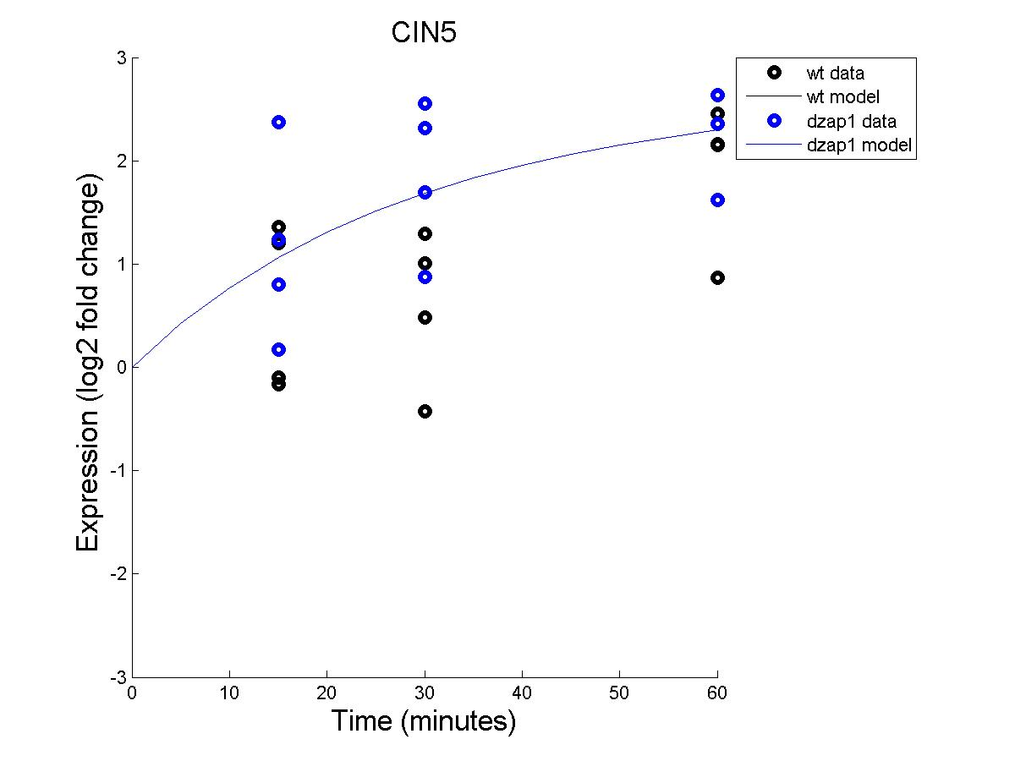
Effect of WT and DZAP1 on CIN5 expression (with estimated b)

Slide 27
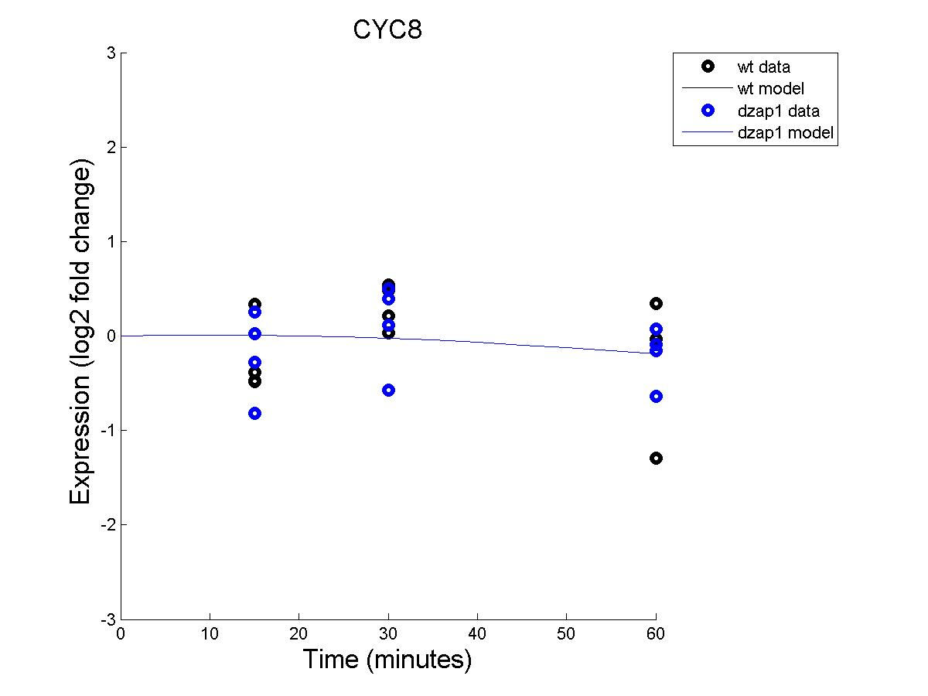
Effect of WT and DZAP1 on CYC8 expression (with estimated b)

Slide 28

Effect of WT and DZAP1 on FKH2 expression (with estimated b)

Slide 29

Effect of WT and DZAP1 on CLN3 expression (with estimated b)

Slide 30
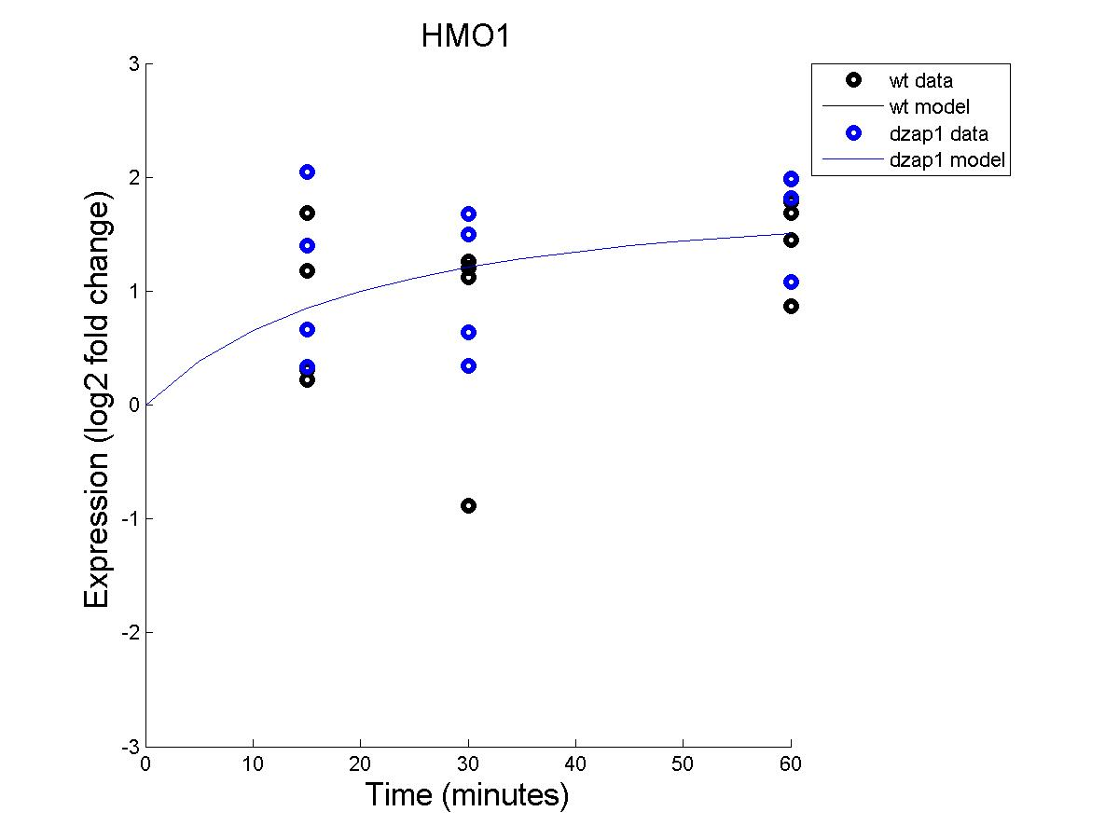
Effect of WT and DZAP1 on HMO1 expression (with estimated b)

Slide 31
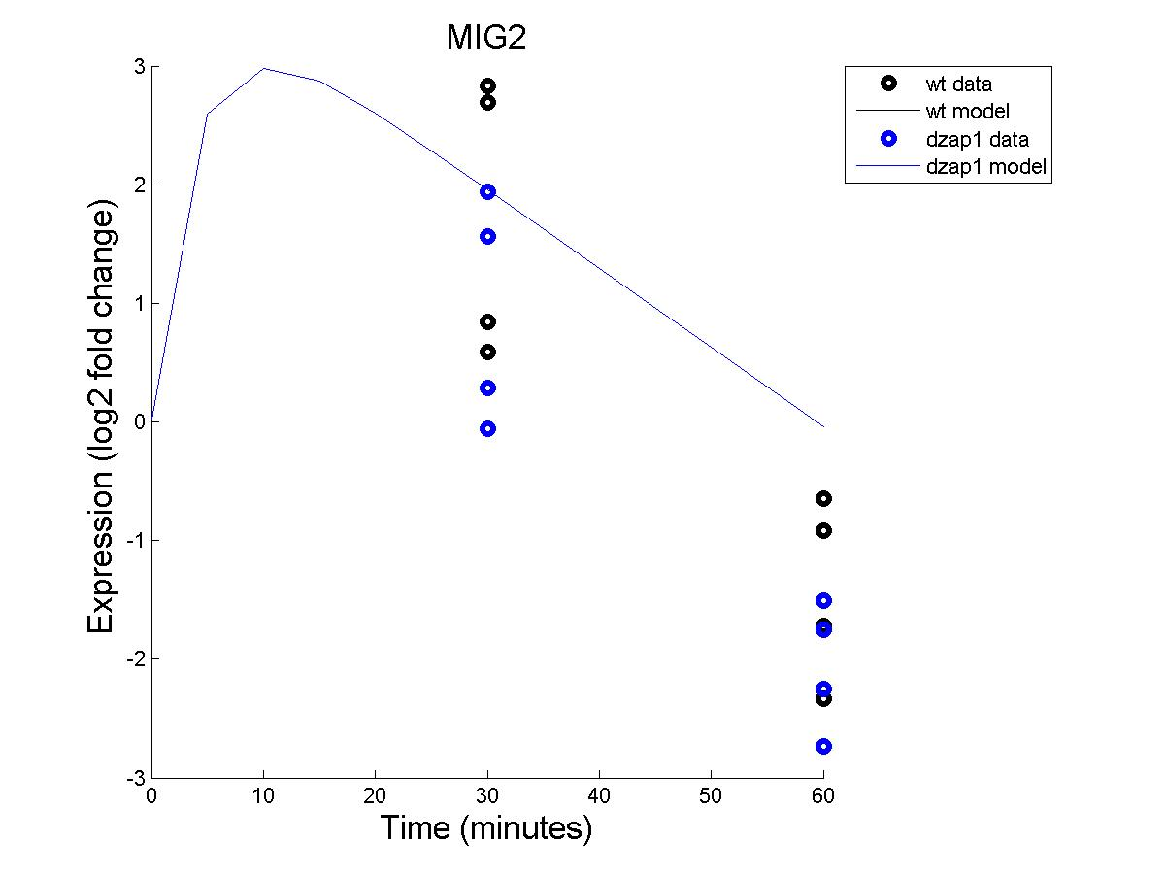
Effect of WT and DZAP1 on MIG2 expression (with estimated b)

Slide 32
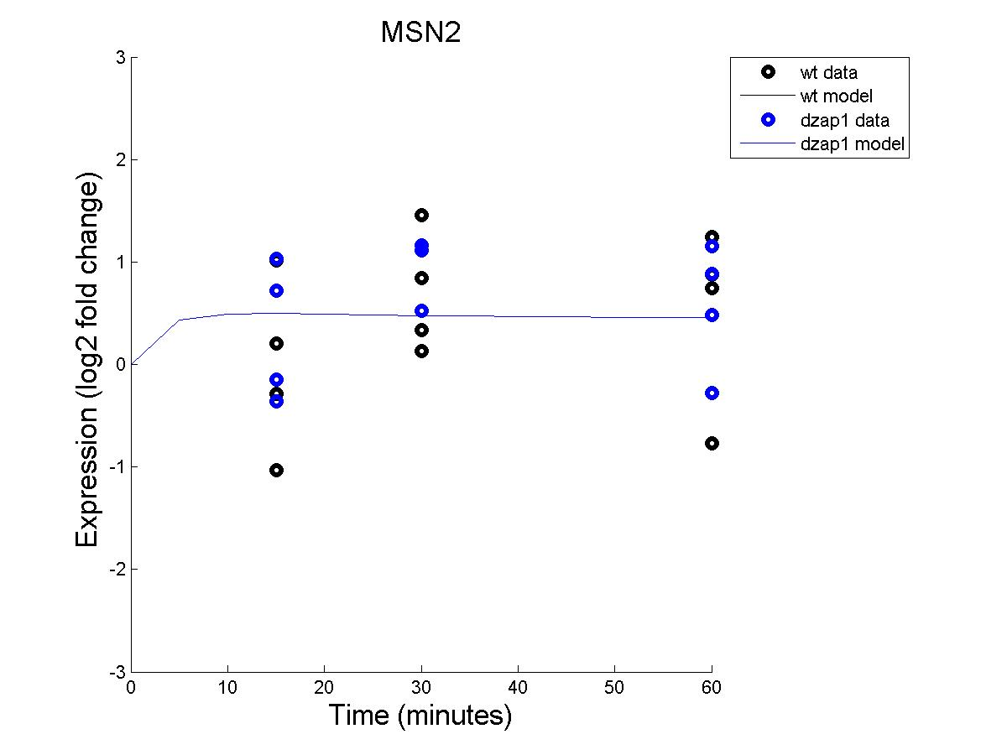
Effect of WT and DZAP1 on MSN2 expression (with estimated b)

Slide 33

Effect of WT and DZAP1 on NDT80 expression (with estimated b)

Slide 34
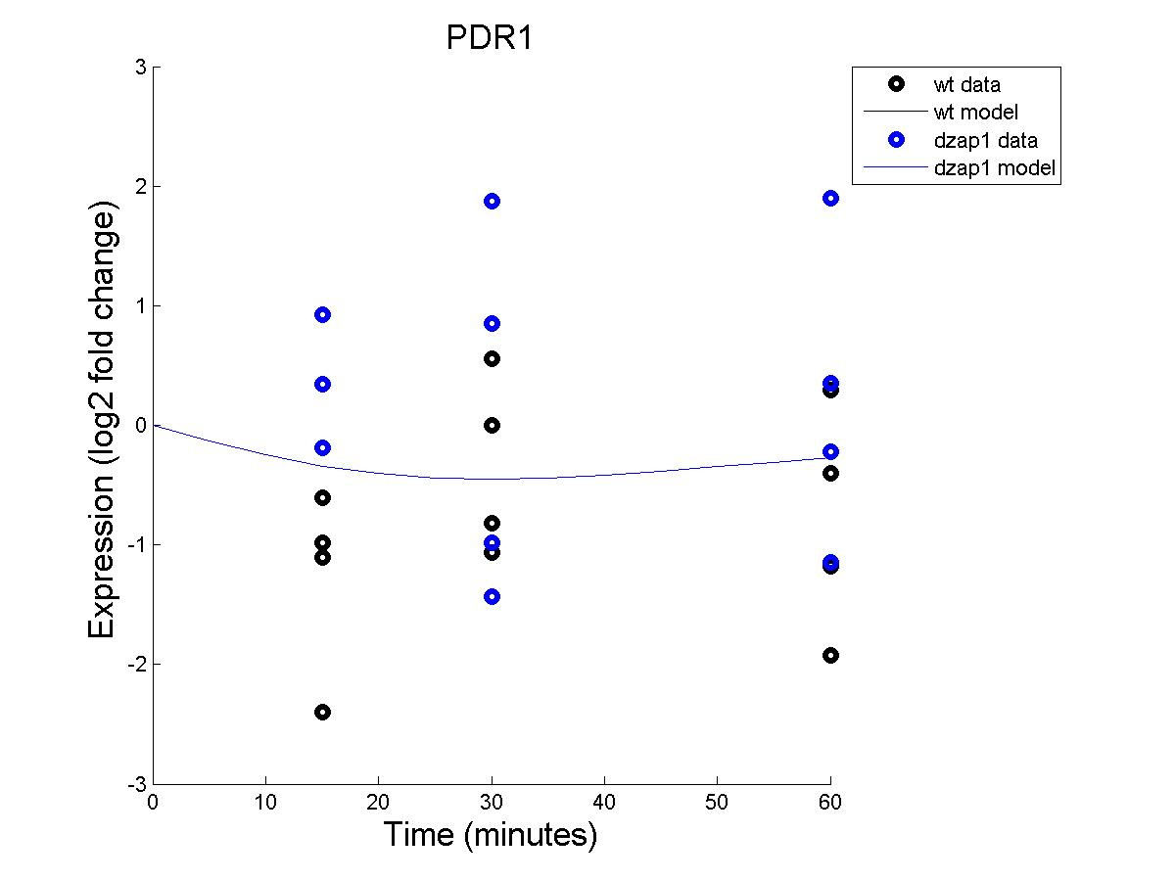
Effect of WT and DZAP1 on PDR1 expression (with estimated b)

Slide 35
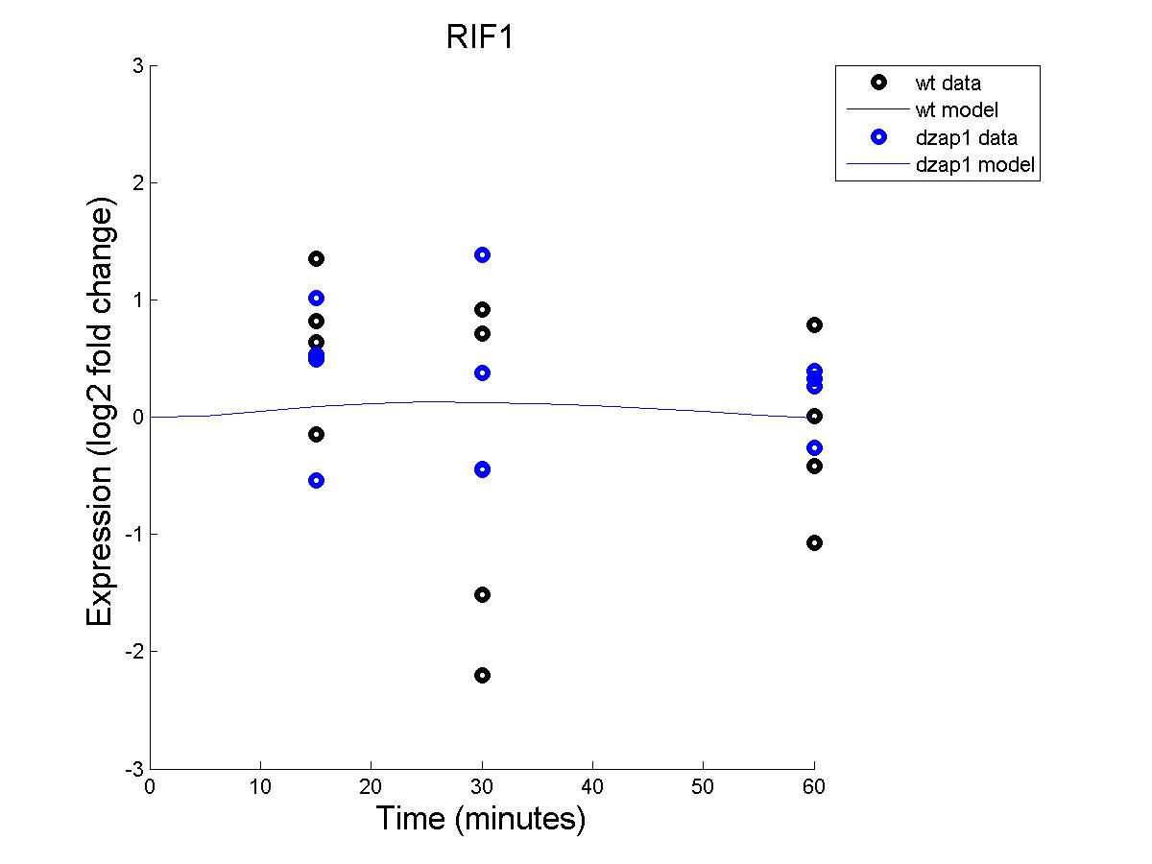
Effect of WT and DZAP1 on RIF1 expression (with estimated b)

Slide 36
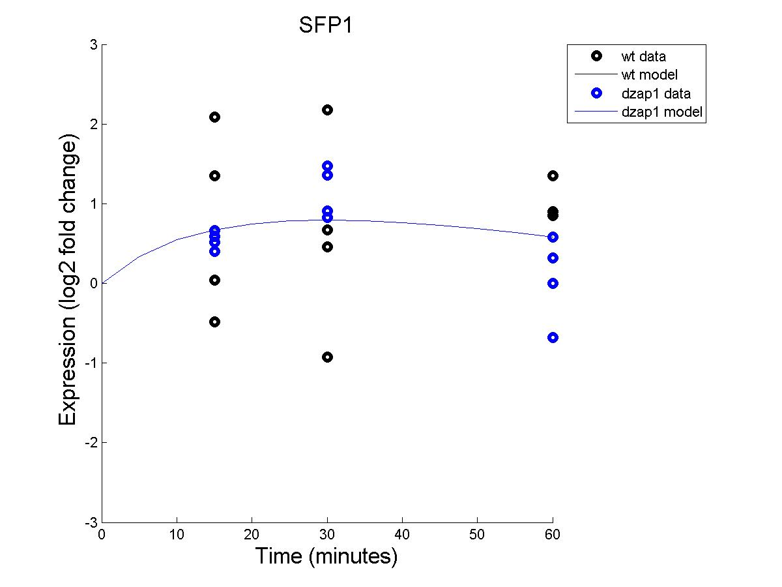
Effect of WT and DZAP1 on SFP1 expression (with estimated b)

Slide 37

Effect of WT and DZAP1 on STB5 expression (with estimated b)

Slide 38
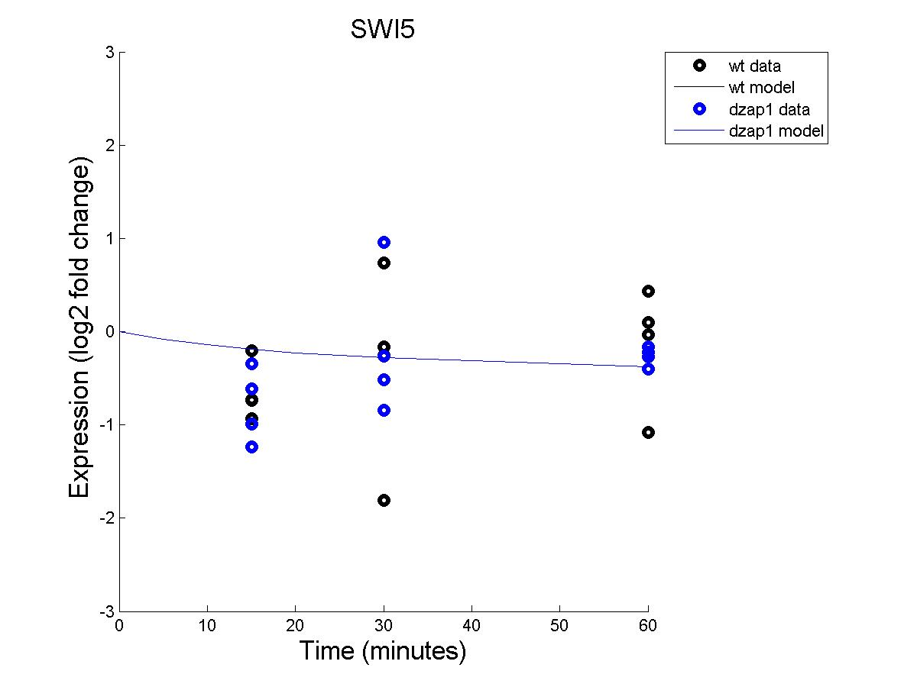
Effect of WT and DZAP1 on SWI5 expression (with estimated b)

Slide 39

Effect of WT and DZAP1 on YHP1 expression (with estimated b)

Slide 40

Effect of WT and DZAP1 on YLR278C expression (with estimated b)

Slide 41

Effect of WT and DZAP1 on YOX1 expression (with estimated b)

Slide 44
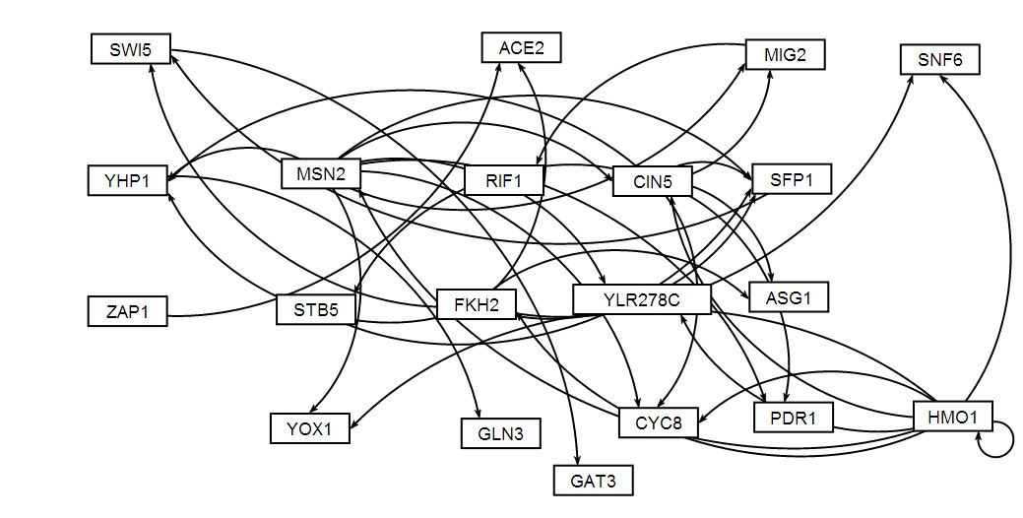
GRNsight Generated Network (non-estimated b)

Slide 45
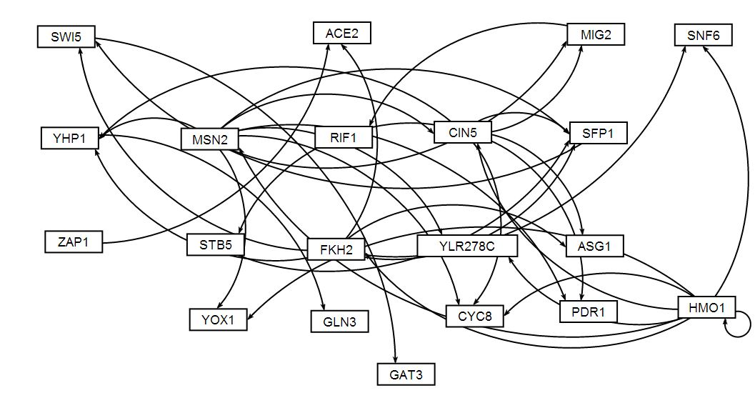
GRNsight Generated Network (estimated b)

