Slide 1
“Tumor cells caught in the act of invading: Their strategy for enhanced cell motility”
Weigang Wang, Sumanta Goswami, Erik Sahai, Jeffrey B. Wyckoff, Jeffrey E. Segall and John S. Condeelis
By Xinqi Li and Megan Roytman

Slide 2
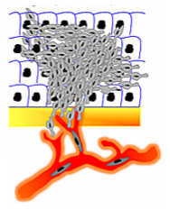
Understanding Cancer Metastasis
Study the causes of enhanced cell motility in cancer cells
Observe gene expression patterns that correlate with metastatic ability
Notes:
The purpose of this study was to try to understand the causes for metastasis – the ability of cancer cells to spread from primary tumors to other sites in the body.
Now, it is known that the ability to spread to other organs relies on enhanced cell motility, which allows cancer cells to invade neighboring connective tissue and blood vessels. So this study focused on understanding the genetic causes for enhanced cell motility, with the goal of identifying potential targets for cancer treatment that could impede the spread of cancer cells from tumors.
Specifically, the study relied on observing gene expression patterns that correlate with metastatic ability.
The goal, then, was to isolate the tumor cells that are specifically invasive and observe their gene expression patterns. And as the paper demonstrated, this was actually the difficult part.

Slide 3
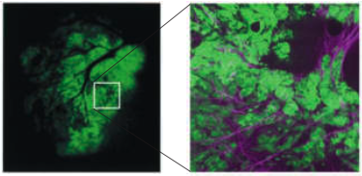
Bulk Tumor Analysis
Analysis performed on bulk tumors, including a variety of tissue elements
Problem: Only a few cells may be capable of metastasizing
Notes:
So most studies have concentrated on the analysis of bulk tumor samples that incorporate other tissue elements. This figure from the paper is showing a bulk tumor sample that contains a variety of tissue elements, including supporting stroma, microvasculature and inﬂammatory cells.
However, a problem with this method is that primary tumors can show extensive variation: different regions of the tumor might have different metastatic potential and only a few cells in the tumor population might actually be capable of metastasizing. So the data taken from whole tumors inevitably results in an averaging of the expression of different cell types from all of these diverse regions.
And there’s the possibility that these expression patterns reflect the non-invasive cells that make up the bulk of the tumor mass. If that’s the case, then the expression signature of invasive tumor cells might be masked.

Slide 4
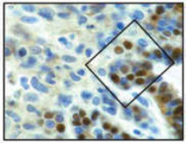
Isolating Metastatic Cells Using Laser Capture Microdissection (LCM)
Isolation of individual cells may be achieved through LCM
Cells chosen based on morphology and location
Problem: Cell shape and location are unreliable indicators of metastatic ability
Notes:
So one solution to this problem is to separate pure populations of invasive cancer cells for these studies.
One such method has been developed using laser capture microdissection, in which precise isolation of individual cells of interest can be achieved using guided laser transfer of specific groups of cells. In this procedure, the specific group of cells is chosen based on morphology and location.
This figure from the paper shows a section from an invading margin in a tumor and a sample region from which cells might be collected.
The problem with this procedure, however, is that cell shape and location aren’t very reliable indicators of metastatic ability. So classification of these cells as migratory and invasive isn’t actually certain.

Slide 5
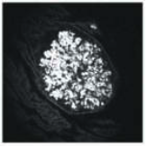
Collecting Cells from Metastatic Tumors
One approach is to collect cells from tumors known to be metastatic
These cells must be expanded in culture
Problem: Gene expression patterns may change in vitro
Notes:
Alternatively, cells can be collected specifically from tumors known to be metastatic. These cells must be expanded in culture either for further cycles of tumor growth or to obtain sufficient cell mass for analysis.
However, as in all approaches that rely on culturing in vitro, there’s concern that the gene expression patterns might change during culturing, partly because of cellular responses to in vitro conditions.
So given these limitations, the authors of this paper thought it would be ideal to catch tumor cells that are actually in the process of invading neighboring tissues. And that’s exactly what they did…

Slide 6
“Using chemotaxis to catch invasive cells in the act of spreading”
Chemotaxis facilitates cancer cell migration to blood vessels
Metastatic cells can be collected using microneedles containing chemoattractants
Solution: the in vivo invasion assay
Notes:
To accomplish this, the authors took advantage of one of the properties that is likely to be important for invasion metastasis – chemotaxis. It is known that chemotaxis to blood vessels facilitates the movement of invasive tumor cells into the vascular system.
So the authors developed a method for collecting invasive tumor cells by using microneedles containing chemoattractants to mimic chemotaxic signaling. And this allowed them to catch invasive cells in the act of spreading.
The authors called this method the in vivo invasion assay.

Slide 7
Protrusion – important pathways involved in tumor cell migration
Upregulated genes to increase actin polymerization
e.g. LIM kinase 1
- coupled with higher cofilin expression
Downregulated genes to help invasion
e.g. ZBP1 (zipcoded-binding protein 1)
- binds to β-actin mRNA – protect it from cofilin and capping protein
- localize mRNA to leading edge of cell - maintain polarity

Slide 8
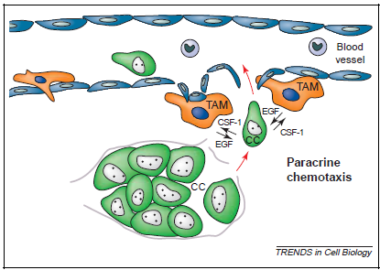
The in vivo invasion assay
Carcinoma cells (CC) secrete CSF-1, attracting tumor-associated macrophages (TAM) to accumulate in blood vessels
TAM secrete EGF in return, attracting CCs to invade blood vessels

Slide 9
TME Model
Examples of microenvironments:
blood supply, oxygen level, pH
Transient gene expression occurs during tumor progression
Invasion assay – mimic microenvironment and collect invading cells

Slide 10
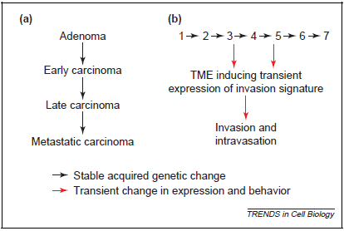
Traditional vs. TME model

Slide 11
Importance
Invasiveness is caused by transient microenvironments
Not all tumor cells within a tumor are invasive or metastatic
Can use the TME model to isolate invasive cells and identify their gene expressions

Slide 12
Thank you!

