Slide 1
Integrins, Intro to Biomaterials
2/18/16
Lecture 6, ChE 575

Slide 2
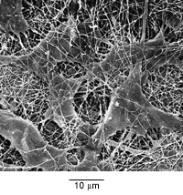
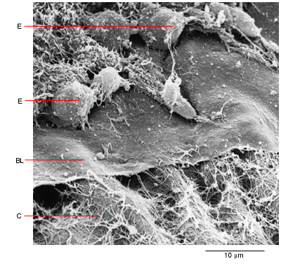
Natural Cell Microenvironment: ECM
PROTEINS AND SUGARS
Fibroblasts in connective tissue
Molecular Biology of the Cell
Epithelial, basal lamina, connective tissue
Molecular Biology of the Cell

Slide 3
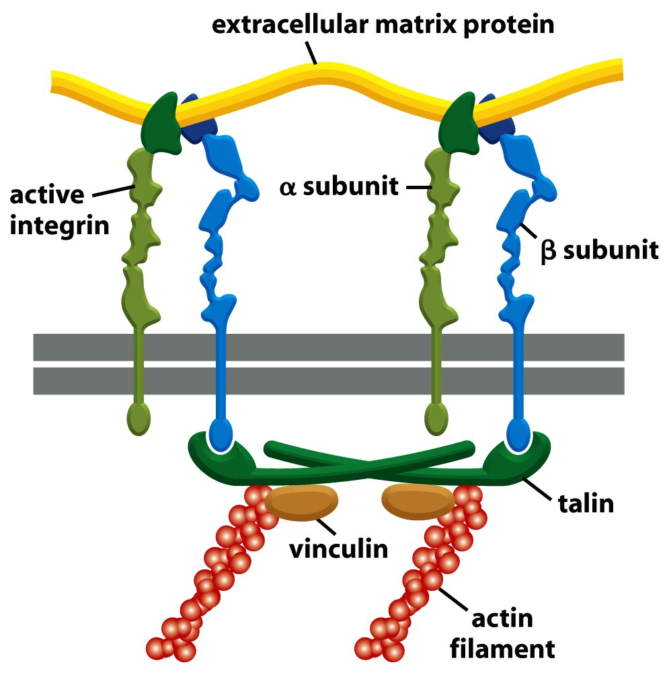
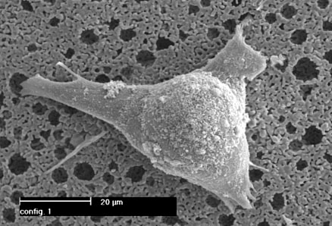
Integrin Structure

Slide 4
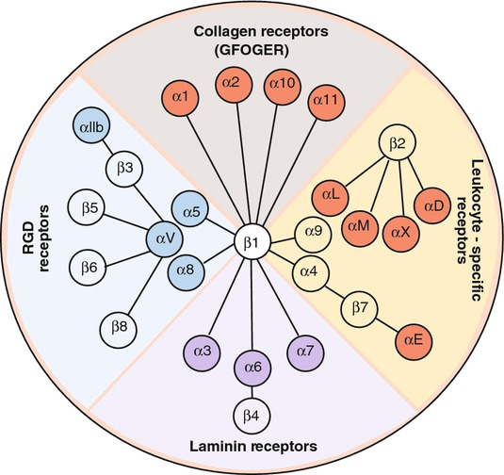
Many different heterodimers of integrins
Heterodimers are specific to the ECM proteins in tissue: matching cell type to tissue
8 betas, 18 alphas = 24 combinations (even though 8x18 = 144)

Slide 5
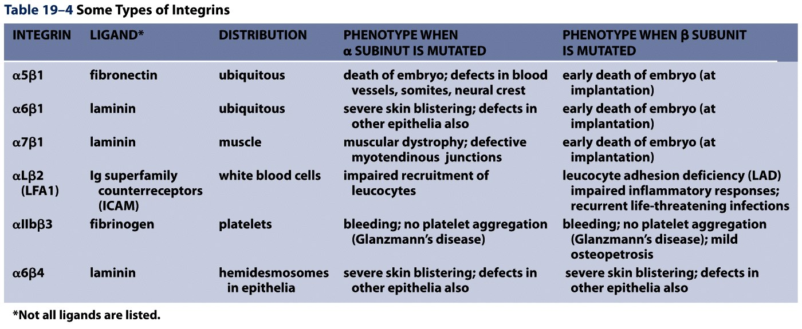
Not all cells express all integrin pairs!
Differential expression of integrins helps isolate cell types to different tissue areas
Epithelia: attach to laminin.
  Carcinoma (epithelial cancer) cells: begin to express fibronectin and collagen-binding integrins, so they can invade the surrounding tissue and metastasize.
Tissue engineered material: coat these with proteins that will ONLY BIND the cells you want there!

Slide 6
Your projects from 2/4
What integrins attach to these ECM proteins?
Fibronectin
Collagen
Laminin
Fibrinogen
Titanium?
Ceramic?
PLGA?

Slide 7
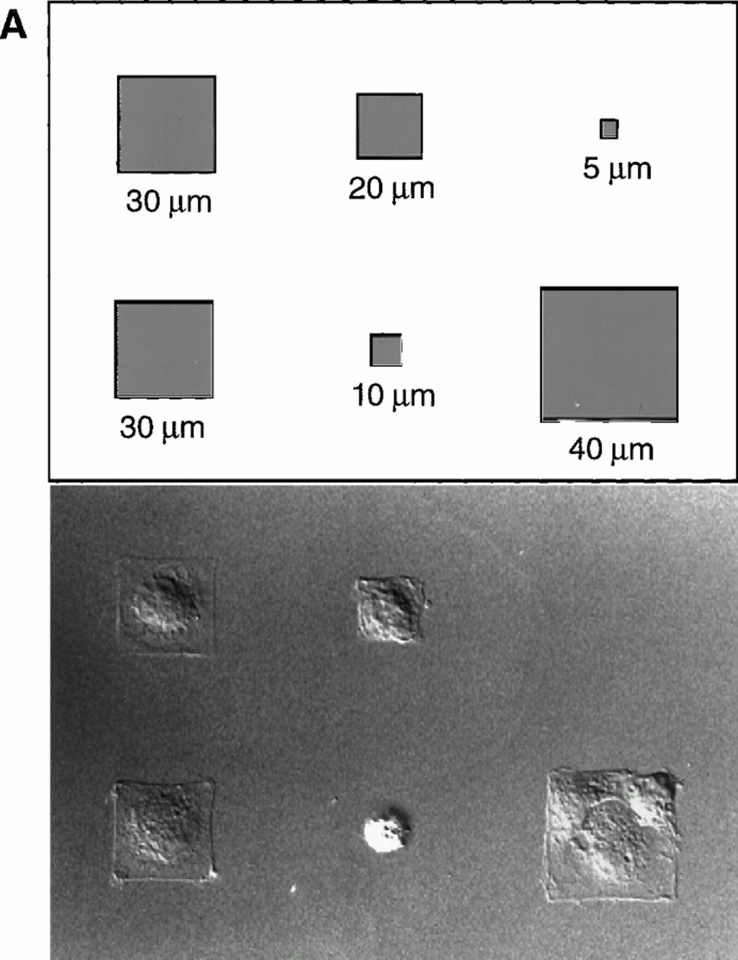
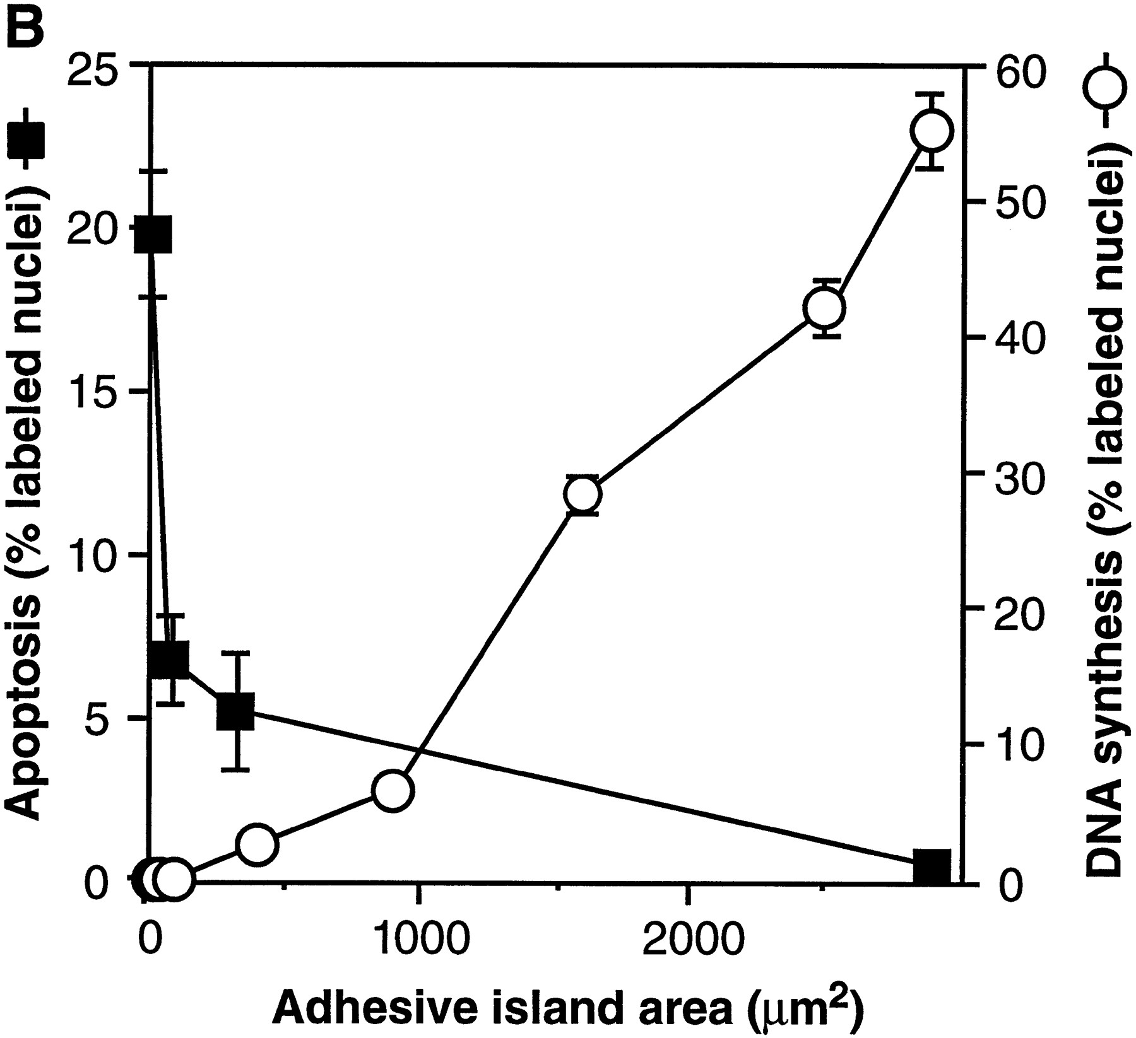
Most Cells Need to Adhere and Spread to Survive
Geometric Control of Cell Life and Death
Christopher S. Chen, et al.
Science 276, 1425 (1997);

Slide 8
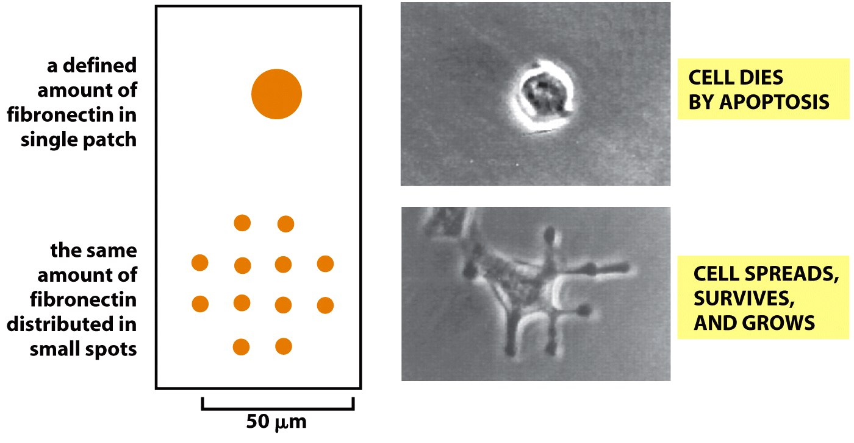
This effect not from “# of integrin bonds”
“anoikis”

Slide 9
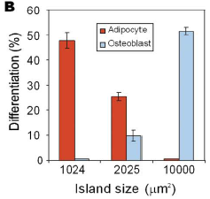
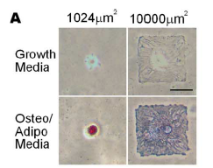
Stem Cell Differentiation by controlling size of adhesion sites
McBeath et al., Dev Cell, 2004

Slide 10
Introduction to Biomaterials

Slide 11
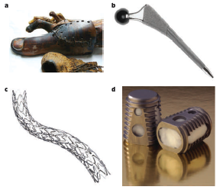
History of biomaterials
Biomaterials range from prosthetics, to stents, to implantable scaffolds
“Classes” of biomaterials we’ll go through:
  Synthetic, Bioinert
  Synthetic, Bioactive/Bioinstructive
  Natural, Bioderived Polymers
Biomaterials developed, at least initially, for tissue engineering
Huebesch and Mooney, Nature, 2009

Slide 12
Choice:
1. Do you want a biomaterial that the body ignores?
2: or a material that is responsive to, or instructive toward the body?

Slide 13
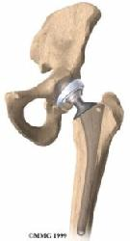
If 1: Bioinert materials
Purposes:
1) do not entice an immune response once implanted into the body.
2) Have incredible mechanical toughness withstand physiological loading
3) Long lasting in the body (won’t degrade over time)
Applications:
1) Skeletal tissue prosthesis (hip, knee replacement)
2) Vascular stents, heart valves
3) Tooth caps, replacements, other dental applications

Slide 14
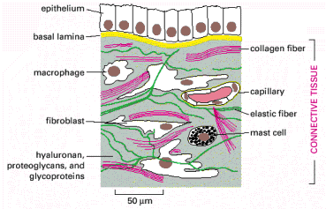
If 2: Natural biopolymers
Taken straight from body: are native proteins found in the ECM
Fibrous, instructive, soft (in bulk): the opposite of bioinert examples
Regulate cell function, act as a physical scaffold, can be remodeled by cells
Not very controllable (lumped parameters)
Images taken from Molecular Biology of the Cell
Examples: Type I Collagen, Fibrin, Matrigel

Slide 15
Newer option: Functionalize inert surfaces with cell instructions

Slide 16
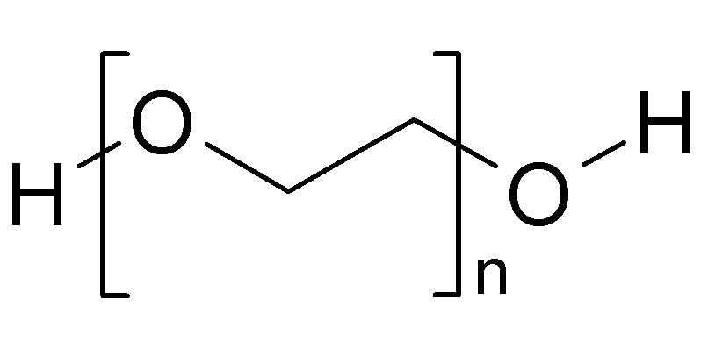
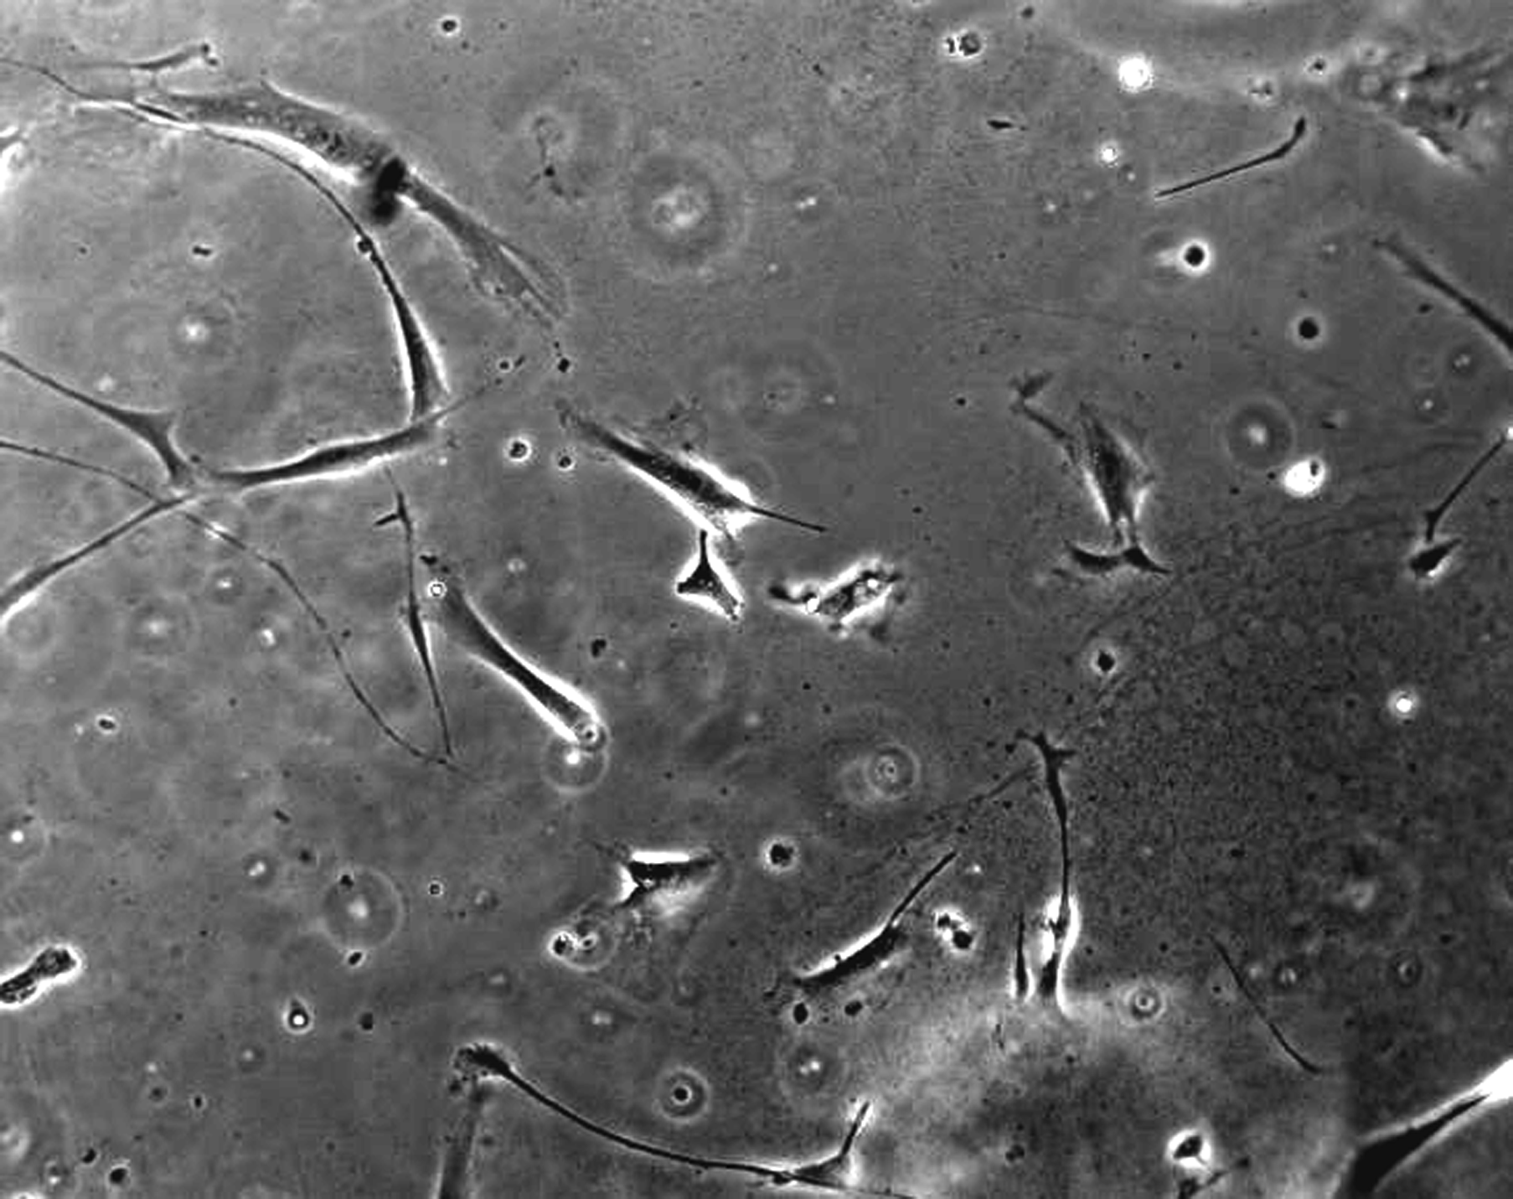
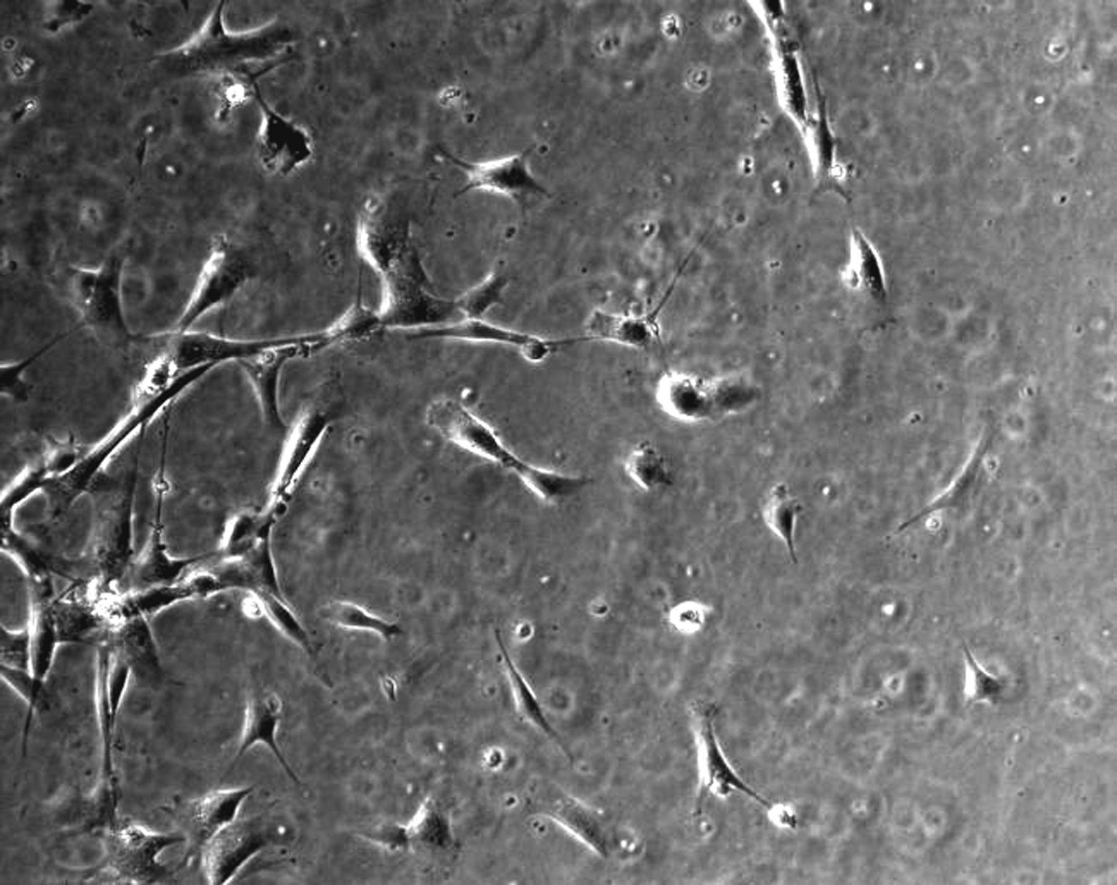
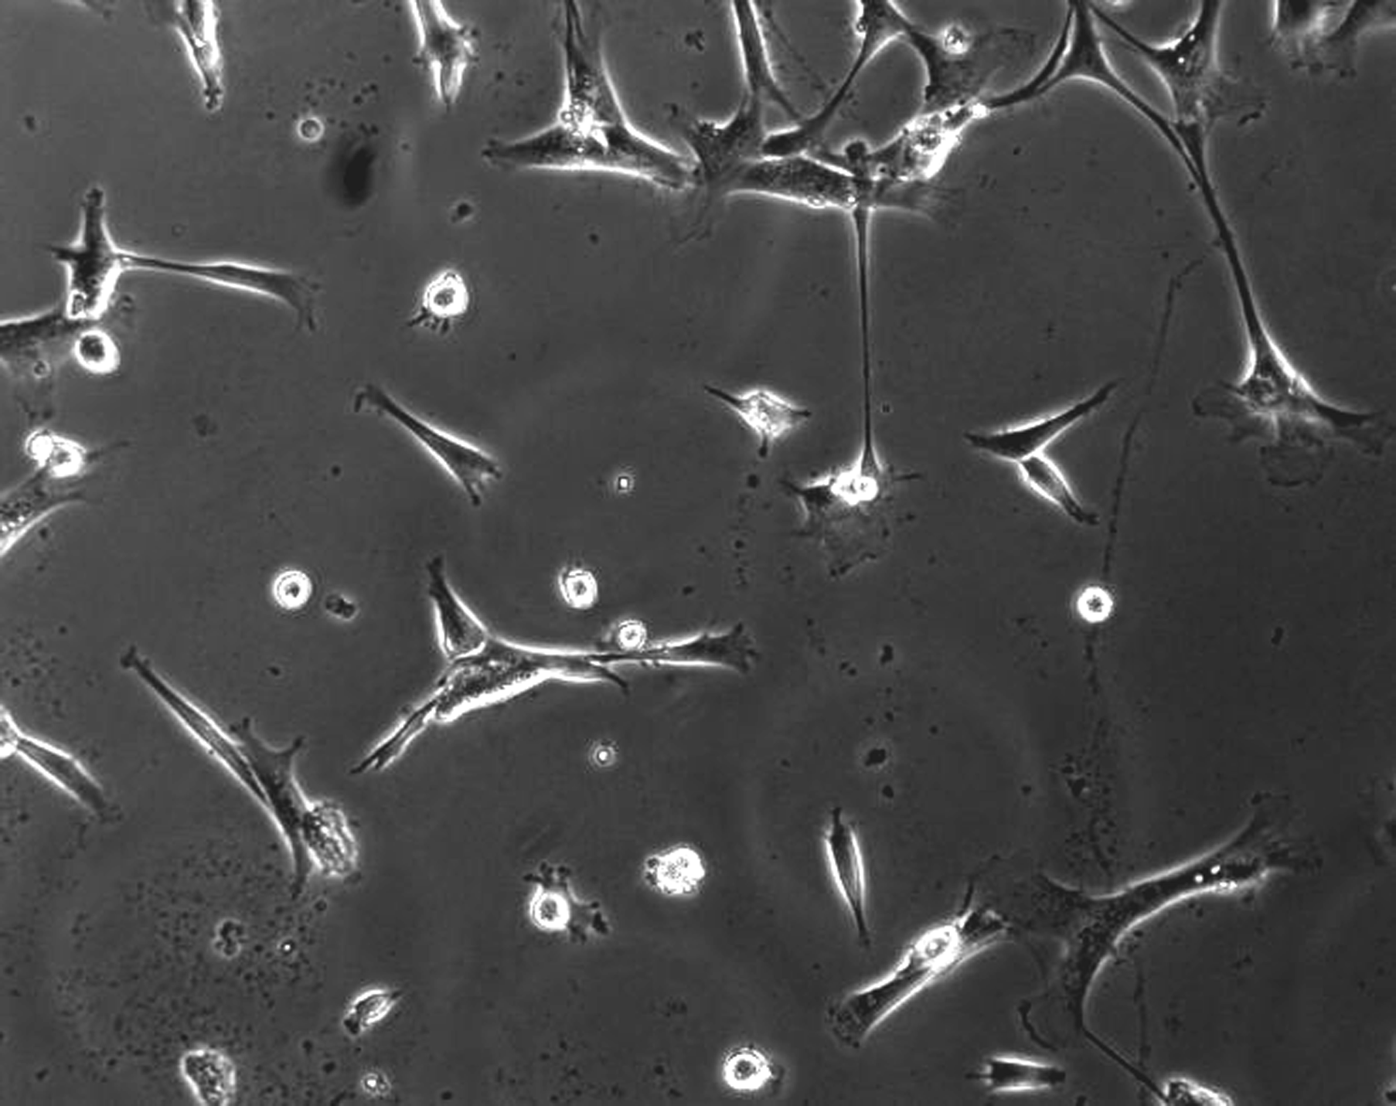
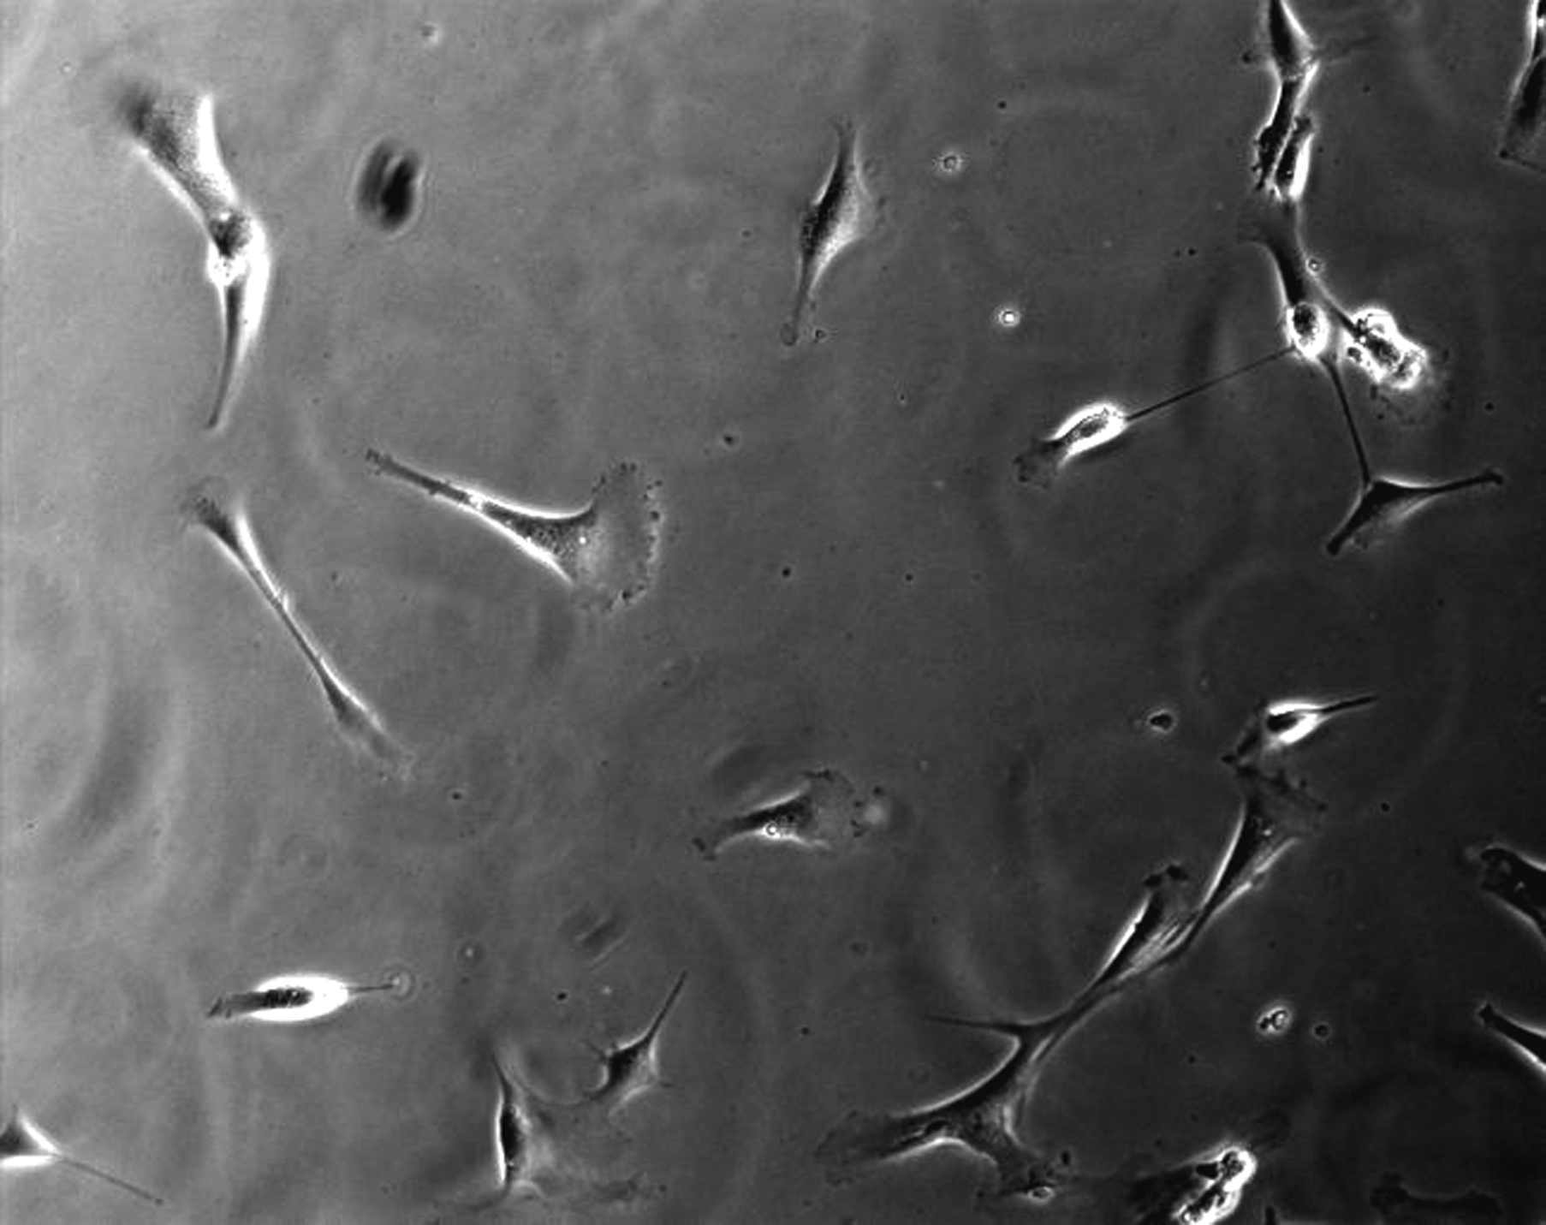
1: Regulate Cell Adhesion
Attack amines, thiols on proteins, or biotinylate them
No treatment
Type I Collagen
RGDS
Hydrophilic surface, so no protein will stick
Fibronectin
KQAGDV

Slide 17
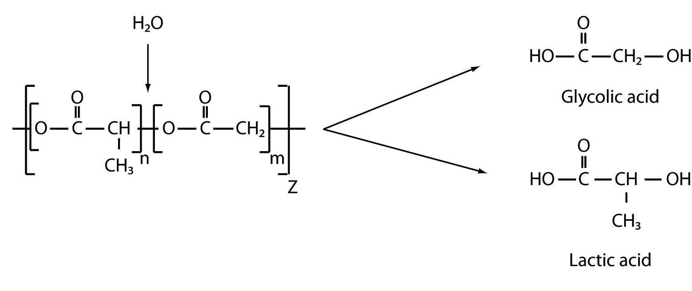
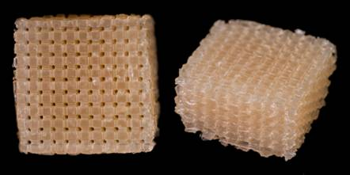
2: Regulate bio-degradation
Purposes:
Temporary space holder for tissue replacement
Not entirely bioinert – meant to degrade away while being replace by native tissue in vivo
Typically adhesive to ECM proteins and, therefore, cells
Tune biodegradation to match body’s kinetics (rate of tissue production/replacement)
Degradation typically hydrolytic (ester groups)
Unstable.
Degradation half life, in months
100% PGA
50-50 blend
100% PLA
% PLA in PLGA blend
Applications:
Both Hard and Soft tissue repair
where vascularization is needed

Slide 18
Thoughts, Perspectives
There’s a biomaterial out there for every need, only a subset mentioned here.
Establish design criteria from biological purpose
Some are easier than others to modify – so justify your choice!
Some are cheaper than others – so justify your choice!

Slide 19
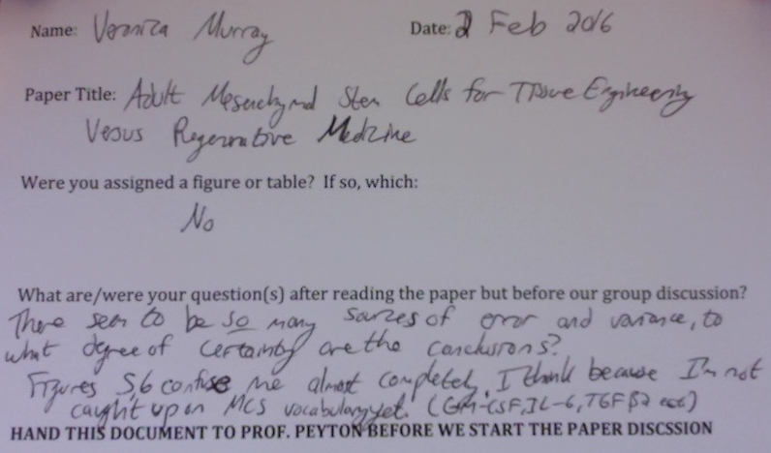
Paper Discussion Grading
A small portion of your final grade is based on preparation/participation during our paper review.
  This is outside of the grade for leading a figure.
  You aren’t getting those grades back.
  I give you 0, 1, or 2 points per paper, based on the sheet you turn in before we start, and the paper you turn in at the end.

