Slide 1
THINK ABOUT IT
Homeostasis is hard work. Organisms and the cells within them have to grow and develop, move materials around, build new molecules, and respond to environmental changes.
What powers so much activity, and where does that power come from?

Slide 2
Chemical Energy and ATP
Why is ATP useful to cells?
ATP can easily release and store energy by breaking and re-forming the bonds between its phosphate groups. This characteristic of ATP makes it exceptionally useful as a basic energy source for all cells.

Slide 3
ENERGY MOLECULES in the CELL
Glucose- Good for long term storage but not to power cell metabolism
ATP- Good to power cell metabolism but not for long term storage
NADP, FADH2, NADH- Good for shuttling energy to and within the mitochondria and chloroplast but not for other purposes

Slide 4
Chemical Energy and Food
Food provides living things with the chemical building blocks they need to grow and reproduce.
Food molecules contain chemical energy that is released when its chemical bonds are broken.

Slide 5
Chemical Energy and Food
Energy stored in food is expressed in units of calories. A Calorie is the amount of energy needed to raise the temperature of 1 gram of water by 1 degree Celsius. 1000 calories = 1 kilocalorie, or Calorie.
Cells use all sorts of molecules for food, including fats, proteins, and carbohydrates. The energy stored in each of these molecules varies because their chemical structures, and therefore their energy-storing bonds, differ.
Cells break down food molecules gradually and use the energy stored in the chemical bonds to produce compounds such as ATP that power the activities of the cell.

Slide 6
Chemical Energy and ATP
Energy is the ability to do work.
Your cells are busy using energy to build new molecules, contract muscles, and carry out active transport.
Without the ability to obtain and use energy, life would cease to exist.

Slide 7
Chemical Energy and ATP
One of the most important compounds that cells use to store and release
energy is adenosine triphosphate (ATP).
ATP consists of adenine, a 5-carbon sugar called ribose, and three
phosphate groups.

Slide 8
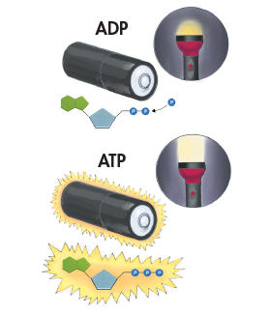
Storing Energy
Adenosine diphosphate (ADP) looks almost like ATP, except that it has two phosphate groups instead of three. ADP contains some energy, but not as much as ATP.
When a cell has energy available, it can store small amounts of it by adding phosphate groups to ADP, producing ATP.
ADP is like a rechargeable battery that powers the machinery of the cell.

Slide 9
Releasing Energy
Cells can release the energy stored in ATP by breaking the bonds between the second and third phosphate groups.
Because a cell can add or subtract these phosphate groups, it has an efficient way of storing and releasing energy as needed.

Slide 10
Using Biochemical Energy
One way cells use the energy provided by ATP is to carry out active transport.
ATP powers movement, providing the energy for motor proteins that contract muscle and power the movement of cilia and flagella.
.

Slide 11
Using Biochemical Energy
Energy from ATP powers the synthesis of proteins and responses to chemical signals at the cell surface.

Slide 12
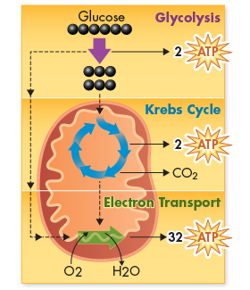
Using Biochemical Energy
ATP is not a good molecule for storing large amounts of energy over the long term.
It is more efficient for cells to keep only a small supply of ATP on hand.
Cells can regenerate ATP from ADP as needed by using the energy in foods like glucose.

Slide 13
Heterotrophs and Autotrophs
What happens during the process of photosynthesis?
In the process of photosynthesis, plants convert the energy of sunlight into chemical energy stored in the bonds of carbohydrates.

Slide 14
Heterotrophs and Autotrophs
Organisms that obtain food by consuming other living things are known as heterotrophs.
Some heterotrophs get their food by eating plants.
Other heterotrophs, such as this cheetah, obtain food from plants indirectly by feeding on plant-eating animals.
Still other heterotrophs, such as mushrooms, obtain food by decomposing other organisms.

Slide 15
Heterotrophs and Autotrophs
Organisms that make their own food are called autotrophs.
Plants, algae, and some bacteria are able to use light energy from the sun to produce food. The process by which autotrophs use the energy of sunlight to produce high-energy carbohydrates that can be used for food is known as photosynthesis.

Slide 16
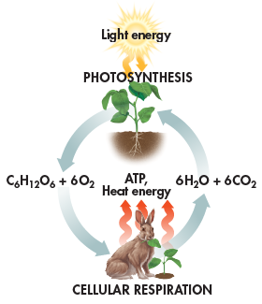
Photosynthesis and Cellular Respiration
Photosynthesis and cellular respiration are opposite processes
Energy flows in opposite directions
Photosynthesis “deposits” energy; cellular respiration “withdraws” energy

Slide 17
Photosynthesis and Cellular Respiration
Cellular respiration takes place in plants, animals, fungi, protists, and most bacteria
Energy capture by photosynthesis occurs only in plants, algae, and some bacteria

Slide 18
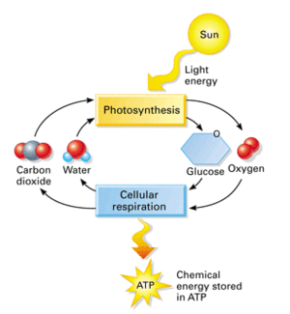

Slide 19
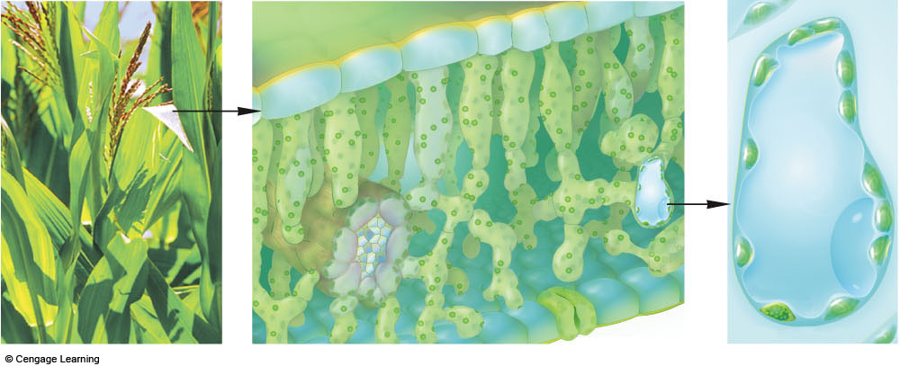
upper epidermis
photosynthetic cells
leaf vein
a Zooming in on a
photosynthetic cell.
lower epidermis
Fig. 6.6a, p.97

Slide 20
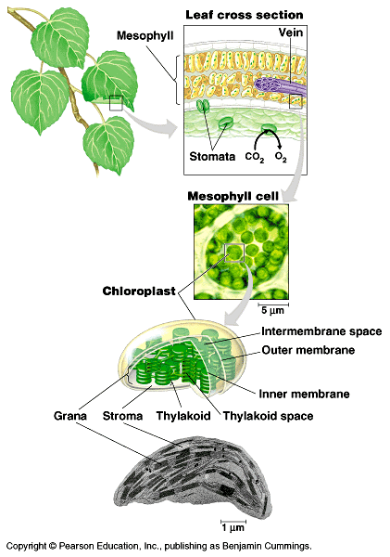
Figure 10.2 Focusing in on the location of photosynthesis in a plant

Slide 21
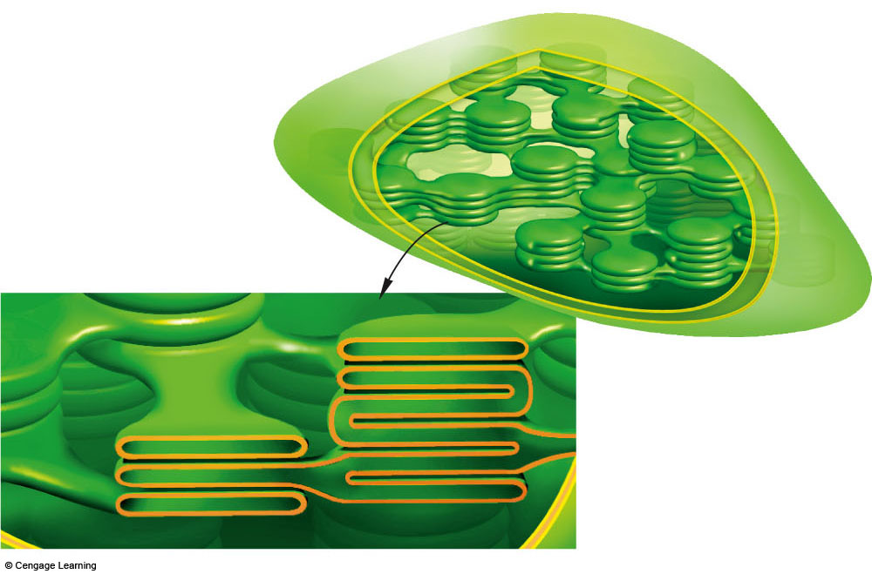
two outer membranes
of chloroplasts
stroma
part of thylakoid membrane
system bathed in stroma:
thylakoid
compartment,
cutaway view
b Chloroplast structure. No matter how highly folded, its thylakoid membrane system forms a single, continuous compartment in the stroma.
Fig. 6.6b, p.97

Slide 22
Chlorophyll and Chloroplasts
What role do pigments play in the process of photosynthesis?
Photosynthetic organisms capture energy from sunlight with pigments.

Slide 23
Light
Energy from the sun travels to Earth in the form of light.
Sunlight is a mixture of different wavelengths, many of which are visible to our eyes and make up the visible spectrum.

Slide 24
Light
Our eyes see the different wavelengths of the visible spectrum as different colors: red, orange, yellow, green, blue, indigo, and violet.

Slide 25
Pigments
Plants gather the sun’s energy with light-absorbing molecules called pigments.
The plants’ principal pigment is chlorophyll.

Slide 26
Chloroplasts
Photosynthesis takes place inside organelles called chloroplasts.
Chloroplasts contain saclike photosynthetic membranes called thylakoids, which are interconnected and arranged in stacks known as grana.

Slide 27
Chloroplasts
Pigments are located in the thylakoid membranes.
The fluid portion outside of the thylakoids is known as the stroma.

Slide 28
Energy Collection
Because light is a form of energy, any compound that absorbs light absorbs energy. Chlorophyll absorbs visible light especially well.
When chlorophyll absorbs light, a large fraction of the light energy is transferred to electrons. These high-energy electrons make photosynthesis work.

Slide 29
An Overview of Photosynthesis
What are the reactants and products of photosynthesis?
Photosynthesis uses the energy of sunlight to convert water and carbon dioxide (reactants) into high-energy sugars and oxygen (products).

Slide 30
An Overview of Photosynthesis
Photosynthesis uses the energy of sunlight to convert water and carbon dioxide into high-energy sugars and oxygen.

Slide 31
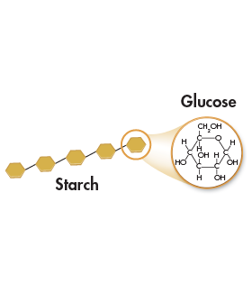
An Overview of Photosynthesis
Plants use the sugars generated by photosynthesis to produce complex carbohydrates such as starches, and to provide energy for the synthesis of other compounds, including proteins and lipids.

Slide 32
The End Results
The two sets of photosynthetic reactions work together—the light-dependent reactions trap the energy of sunlight in chemical form, and the light-independent reactions use that chemical energy to produce stable, high-energy sugars from carbon dioxide and water.
In the process, animals, including humans, get food and an atmosphere filled with oxygen.

Slide 33
THINK ABOUT IT
Why do chloroplasts contain so many membranes?
When most pigments absorb light, they eventually lose most of that energy as heat. Chloroplasts avoid such losses. Membranes are the key to capturing light energy in the form of high-energy electrons.

Slide 34
The Light-Dependent Reactions: Generating ATP and NADPH
What happens during the light-dependent reactions?

Slide 35
The Light-Dependent Reactions: Generating ATP and NADPH
What happens during the light-dependent reactions?
The light-dependent reactions use energy from sunlight to produce oxygen
and convert ADP and NADP⁺ into the energy carriers ATP and NADPH.

Slide 36
The Light-Dependent Reactions: Generating ATP and NADPH
The light-dependent reactions encompass the steps of photosynthesis that directly involve sunlight.
The light-dependent reactions occur in the thylakoids of chloroplasts.

Slide 37
The Light-Dependent Reactions: Generating ATP and NADPH
Thylakoids contain clusters of chlorophyll and proteins known as photosystems.
Photosystems absorb sunlight and generate high-energy electrons that are then passed to a series of electron carriers embedded in the thylakoid membrane.

Slide 38
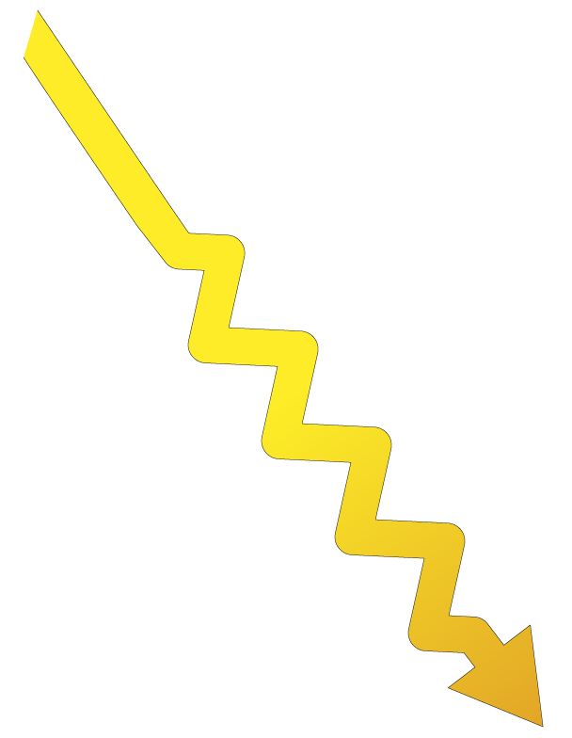
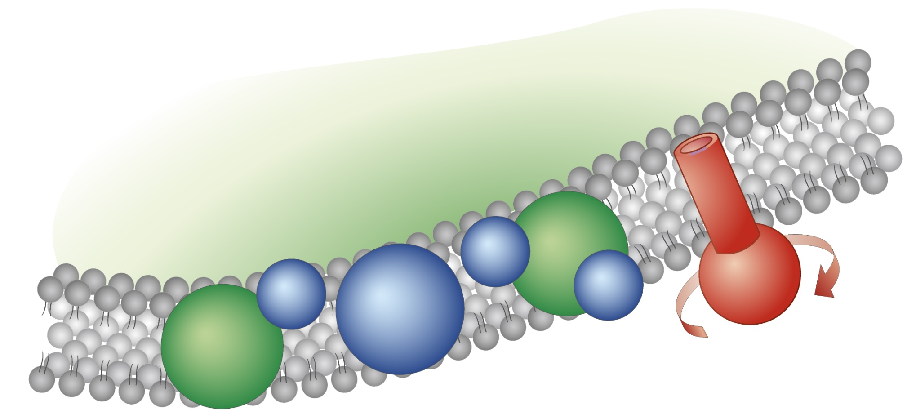
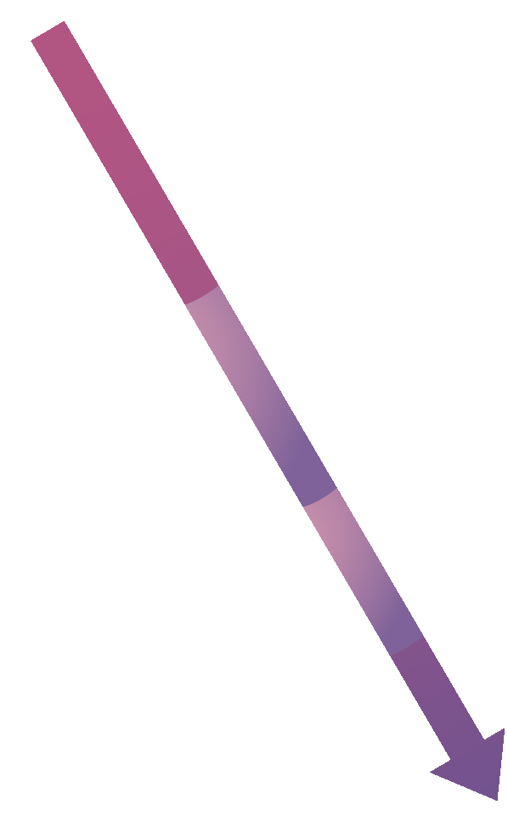
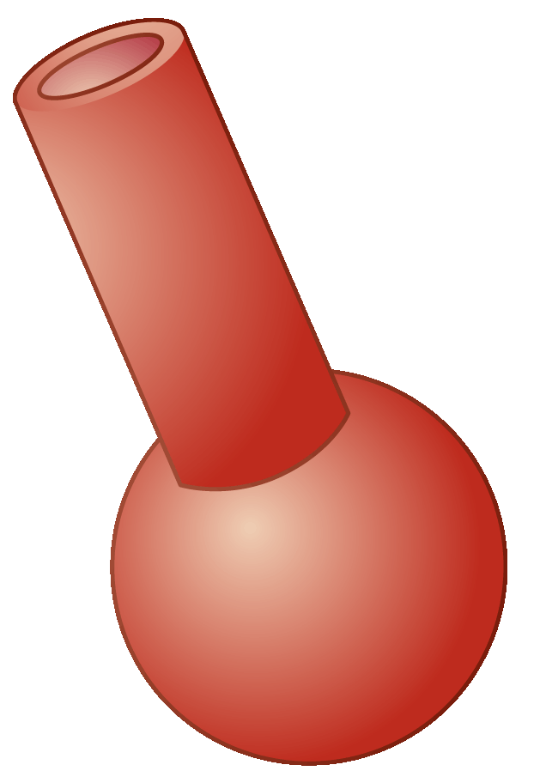
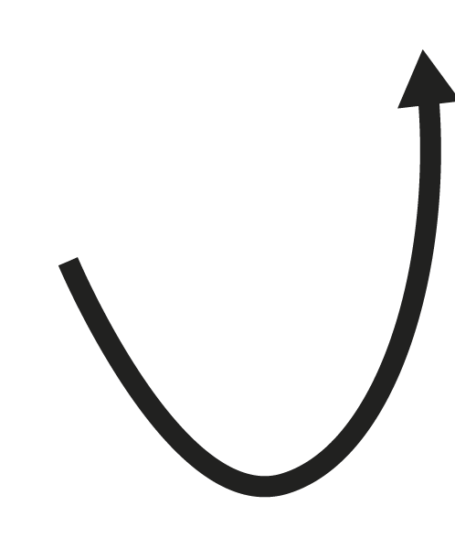
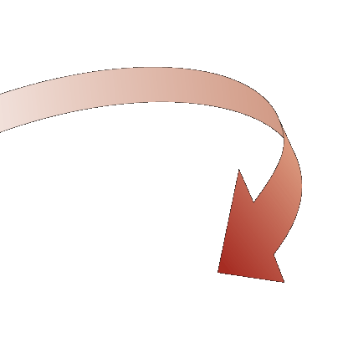
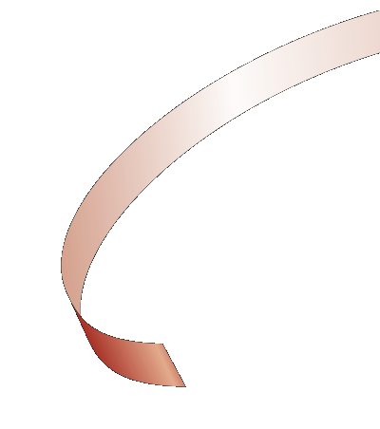
Light-Dependent Reactions
ATP synthase
+ O₂
2H₂O
ADP
2 NADP⁺
2
2
NADPH
Notes:
The light-dependent reactions use energy from sunlight to produce ATP, NADPH, and oxygen.

Slide 39
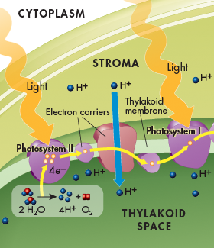
Photosystem II
Light energy is absorbed by electrons in the pigments within photosystem II, increasing the electrons’ energy level.
The high-energy electrons are passed to the electron transport chain, a series of electron carriers that shuttle high-energy electrons during ATP-generating reactions.

Slide 40
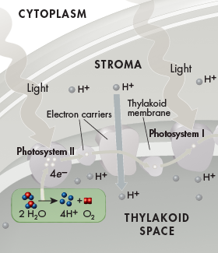
Photosystem II
The thylakoid membrane provides new electrons to chlorophyll from water molecules.
Enzymes of the inner surface of the thylakoid break up water molecules into 2 electrons, 2 H⁺ ions, and 1 oxygen atom.

Slide 41
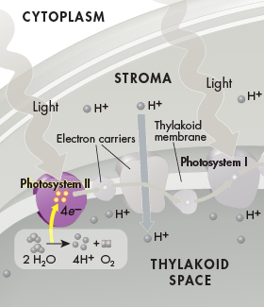
Photosystem II
The 2 electrons replace the high-energy electrons that have been lost to the electron transport chain.
Oxygen is released into the air. This reaction is the source of nearly all of the oxygen in Earth’s atmosphere.
The H⁺ ions are released inside the thylakoid.

Slide 42
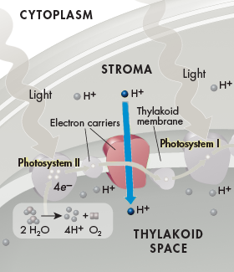
Electron Transport Chain
Energy from the electrons is used by proteins in the electron transport chain to pump H⁺ ions from the stroma into the thylakoid space.

Slide 43
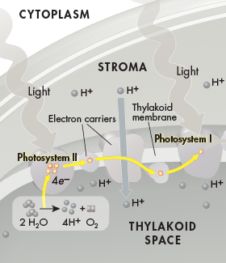
Electron Transport Chain
At the end of the electron transport chain, the electrons pass to photosystem I.

Slide 44
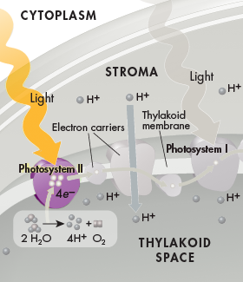
Photosystem I
Because some energy has been used to pump H⁺ ions across the thylakoid membrane, electrons do not contain as much energy as they used to when they reach photosystem I.
Pigments in photosystem I use energy from light to reenergize the electrons.

Slide 45
Photosystem I
At the end of a short second electron transport chain, NADP⁺ molecules in the stroma pick up the high-energy electrons and H⁺ ions at the outer surface of the thylakoid membrane to become NADPH.

Slide 46
Hydrogen Ion Movement and ATP Formation
H⁺ ions accumulate within the thylakoid space from the splitting of water and from being pumped in from the stroma.
The buildup of H⁺ ions makes the stroma negatively charged relative to the space within the thylakoids.

Slide 47
Hydrogen Ion Movement and ATP Formation

Slide 48
Light-Dependent Reactions
ATP synthase
+ O₂
2H₂O
ADP
2 NADP⁺
2
2
NADPH
Notes:
The light-dependent reactions use energy from sunlight to produce ATP, NADPH, and oxygen.

Slide 49
Hydrogen Ion Movement and ATP Formation
This gradient, the difference in both charge and H⁺ ion concentration across the membrane, provides the energy to make ATP.

Slide 50
Hydrogen Ion Movement and ATP Formation
H⁺ ions cannot directly cross the thylakoid membane. However, the thylakoid membrane contains a protein called ATP synthase that spans the membrane and allows H⁺ ions to pass through it.

Slide 51
Hydrogen Ion Movement and ATP Formation
Powered by the gradient, H⁺ ions pass through ATP synthase and force it to rotate.
As it rotates, ATP synthase binds ADP and a phosphate group together to produce ATP.

Slide 52
Hydrogen Ion Movement and ATP Formation
This process, called chemiosmosis, enables light-dependent electron transport to produce not only NADPH (at the end of the electron transport chain), but ATP as well.

Slide 53
Summary of Light-Dependent Reactions
The light-dependent reactions produce oxygen gas and convert ADP and NADP⁺ into the energy carriers ATP and NADPH.
ATP and NADPH provide the energy needed to build high-energy sugars from low-energy carbon dioxide.

Slide 54
Light-Dependent Reactions
ATP synthase
+ O₂
2H₂O
ADP
2 NADP⁺
2
2
NADPH
Notes:
The light-dependent reactions use energy from sunlight to produce ATP, NADPH, and oxygen.

Slide 55
The Light-Independent Reactions: Producing Sugars
What happens during the light-independent reactions?

Slide 56
The Light-Independent Reactions: Producing Sugars
What happens during the light-independent reactions?
During the light-independent reactions, ATP and NADPH from the light
dependent reactions are used to produce high-energy sugars.

Slide 57
The Light-Independent Reactions: Producing Sugars
During the light-independent reactions, commonly referred to as the Calvin cycle, plants use the energy that ATP and NADPH contains to build stable high-energy carbohydrate compounds that can be stored for a long time.

Slide 58
Carbon Dioxide Enters the Cycle
Carbon dioxide molecules enter the Calvin cycle from the atmosphere.
An enzyme in the stroma of the chloroplast combines carbon dioxide molecules with 5-carbon compounds that are already present in the organelle, producing 3-carbon compounds that continue into the cycle.

Slide 59
Carbon Dioxide Enters the Cycle
For every 6 carbon dioxide molecules that enter the cycle, a total of twelve 3-carbon compounds are produced.

Slide 60
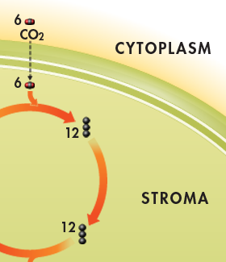
Carbon Dioxide Enters the Cycle
Other enzymes in the chloroplast then convert the 3-carbon compounds into higher-energy forms in the rest of the cycle, using energy from ATP and high-energy electrons from NADPH.

Slide 61
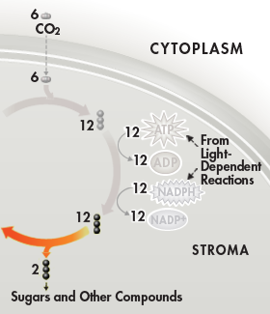
Sugar Production
At midcycle, two of the twelve 3-carbon molecules are removed from the cycle.
These molecules become the building blocks that the plant cell uses to produce sugars, lipids, amino acids, and other compounds.

Slide 62
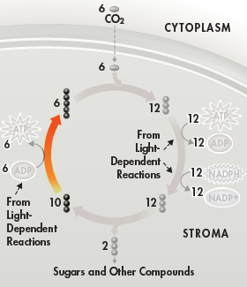
Sugar Production
The remaining ten 3-carbon molecules are converted back into six 5-carbon molecules that combine with six new carbon dioxide molecules to begin the next cycle.

Slide 63
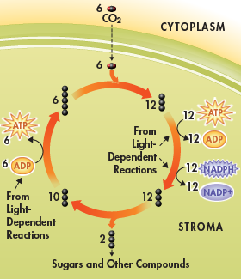
Summary of the Calvin Cycle
The Calvin cycle uses 6 molecules of carbon dioxide to produce a single 6-carbon sugar molecule.

Slide 64
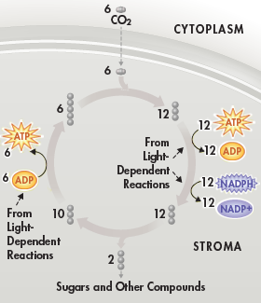
Summary of the Calvin Cycle
The energy for the reactions is supplied by compounds produced in the light-dependent reactions.

Slide 65
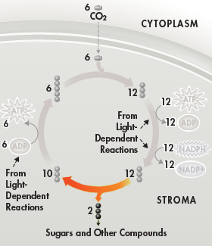
Summary of the Calvin Cycle
The plant uses the sugars produced by the Calvin cycle to meet its energy needs and to build macromolecules needed for growth and development.
When other organisms eat plants, they can use the energy and raw materials stored in these compounds.

Slide 66
The End Results
The two sets of photosynthetic reactions work together—the light-dependent reactions trap the energy of sunlight in chemical form, and the light-independent reactions use that chemical energy to produce stable, high-energy sugars from carbon dioxide and water.
In the process, animals, including humans, get food and an atmosphere filled with oxygen.

Slide 67
Factors Affecting Photosynthesis
What factors affect photosynthesis?

Slide 68
Factors Affecting Photosynthesis
What factors affect photosynthesis?
Among the most important factors that affect photosynthesis are
temperature, light intensity, and the availability of water.

Slide 69
Temperature, Light, and Water
The reactions of photosynthesis are made possible by enzymes that function best between 0°C and 35°C.
Temperatures above or below this range may affect those enzymes, slowing down the rate of photosynthesis or stopping it entirely.

Slide 70
Temperature, Light, and Water
High light intensity increases the rate of photosynthesis.
After the light intensity reaches a certain level, however, the plant reaches its maximum rate of photosynthesis, as is seen in the graph.

Slide 71
Temperature, Light, and Water
Because water is one of the raw materials in photosynthesis, a shortage of water can slow or even stop photosynthesis.
Water loss can also damage plant tissues.
Plants that live in dry conditions often have waxy coatings on their leaves to reduce water loss. They may also have biochemical adaptations that make photosynthesis more efficient under dry conditions.

Slide 72
Photosynthesis Under Extreme Conditions
In order to conserve water, most plants under bright, hot conditions close the small openings in their leaves that normally admit carbon dioxide.
This causes carbon dioxide within the leaves to fall to very low levels, slowing down or even stopping photosynthesis.
C4 and CAM plants have biochemical adaptations that minimize water loss while still allowing photosynthesis to take place in intense sunlight.

Slide 73
C4 Photosynthesis
C4 plants have a specialized chemical pathway that allows them to capture even very low levels of carbon dioxide and pass it to the Calvin cycle.
The name “C4 plant” comes from the fact that the first compound formed in this pathway contains 4 carbon atoms.
The C4 pathway requires extra energy in the form of ATP to function.
C4 organisms include crop plants like corn, sugar cane, and sorghum.

Slide 74
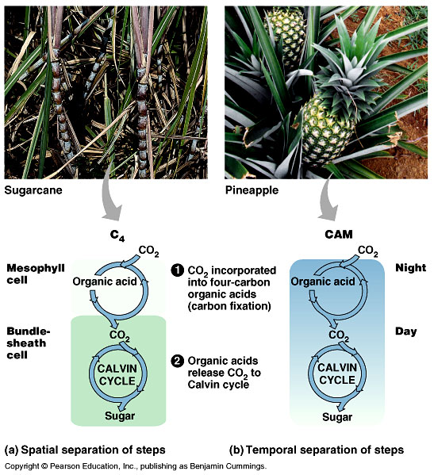

Slide 75
CAM Plants
Members of the Crassulacae family, such as cacti and succulents, incorporate carbon dioxide into organic acids during photosynthesis in a process called Crassulacean Acid Metabolism (CAM).

Slide 76
CAM Plants
CAM plants admit air into their leaves only at night, where carbon dioxide is combined with existing molecules to produce organic acids, “trapping” the carbon within the leaves.
During the daytime, when leaves are tightly sealed to prevent water loss, these compounds release carbon dioxide, enabling carbohydrate production.
CAM plants include pineapple trees, many desert cacti, and “ice plants”.

Slide 77
Overview of Cellular Respiration
If oxygen is available, organisms can obtain energy from food by a process called cellular respiration. The summary of cellular respiration is presented below.
In symbols:
6 O₂ + C₆H₁₂O₆ → 6 CO₂ + 6 H₂O + Energy
In words:
Oxygen + Glucose → Carbon dioxide + Water + Energy
The cell has to release the chemical energy in food molecules (like glucose) gradually, otherwise most of the energy would be lost in the form of heat and light.

Slide 78
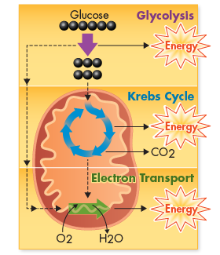
THREE Stages of Cellular Respiration
Glycolysis
Krebs cycle
Electron transport chain

Slide 79
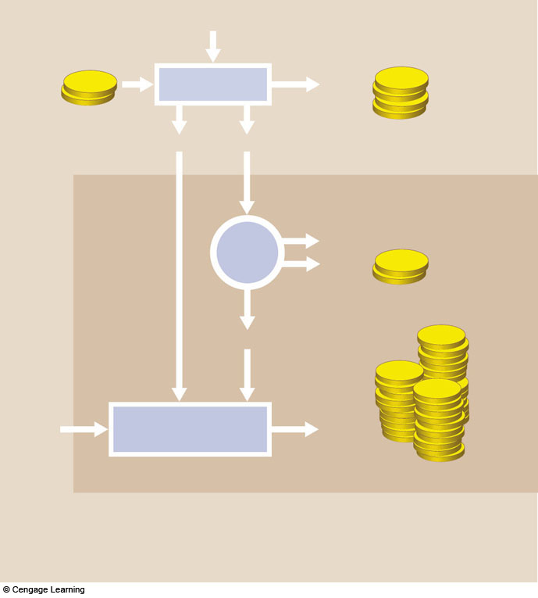
Cytoplasm
glucose
a The first stage, glycolysis, occurs
in the cell’s cytoplasm. Enzymes convert a glucose molecule to 2 pyruvate for a net yield of 2 ATP. During the reactions, 2 NAD+ pick
up electrons and hydrogen atoms,
so 2 NADH form.
2 ATP
ATP
GLYCOLYSIS
4 ATP
(2net)
ATP
2 NADH
2 pyruvate
Mitochondrion
Krebs
Cycle
6 CO2
ATP
b The second stage, the Krebs cycle and a few steps before it, occurs inside mitochondria. The 2 pyruvates are broken down to CO2, which leaves the cell. During the reactions, 8 NAD+ and 2 FAD pick up electrons and hydrogen atoms, so 8 NADH and 2 FADH2 form. 2 ATP also form.
2 ATP
8 NADH, 2 FADH₂
ATP
oxygen
Electron Transfer
Phosphorylation
32 ATP
c The third and final stage, electron transfer phosphorylation, occurs inside mitochondria. 10 NADH and 2 FADH2 donate electrons and hydrogen ions at electron transfer chains.
Electron flow through the chains sets up H+ gradients that drive ATP formation. Oxygen
Fig. 7.3, p.109

Slide 80
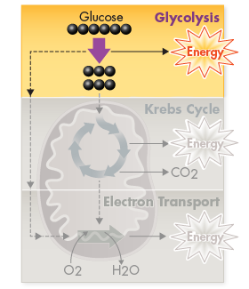
Glycolysis
Anaerobic - no oxygen
Takes place in cytoplasm

Slide 81
Stages of Cellular Respiration
Glycolysis produces only a small amount of energy. Most of glucose’s energy (90%) remains locked in the chemical bonds of pyruvic acid at the end of glycolysis.

Slide 82
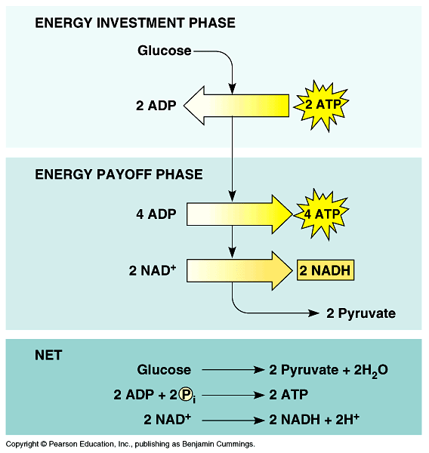

Slide 83
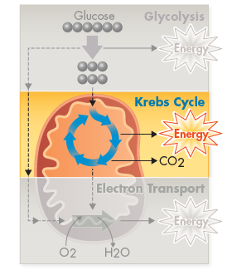
Stages of Cellular Respiration
During the Krebs cycle, a little more energy is generated from pyruvic acid.

Slide 84
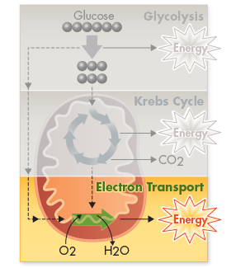
Stages of Cellular Respiration
The electron transport chain produces the bulk of the energy in cellular respiration by using oxygen, a powerful electron acceptor.

Slide 85
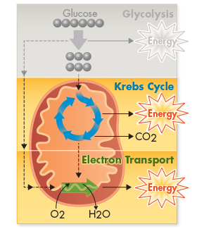
Oxygen and Energy
Pathways of cellular respiration that require oxygen are called aerobic. The Krebs cycle and electron transport chain are both aerobic processes. Both processes take place inside the mitochondria.

Slide 86
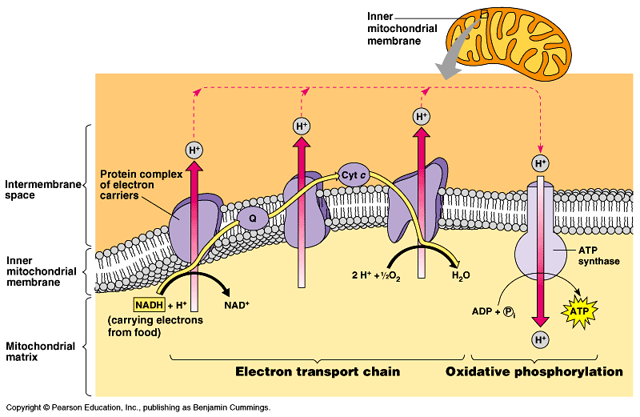
Figure 9.15 Chemiosmosis couples the electron transport chain to ATP synthesis

Slide 87
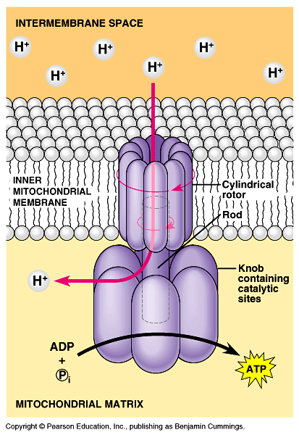

Slide 88
Cytoplasm
glucose
a The first stage, glycolysis, occurs
in the cell’s cytoplasm. Enzymes convert a glucose molecule to 2 pyruvate for a net yield of 2 ATP. During the reactions, 2 NAD+ pick
up electrons and hydrogen atoms,
so 2 NADH form.
2 ATP
ATP
GLYCOLYSIS
4 ATP
(2net)
ATP
2 NADH
2 pyruvate
Mitochondrion
Krebs
Cycle
6 CO2
ATP
b The second stage, the Krebs cycle and a few steps before it, occurs inside mitochondria. The 2 pyruvates are broken down to CO2, which leaves the cell. During the reactions, 8 NAD+ and 2 FAD pick up electrons and hydrogen atoms, so 8 NADH and 2 FADH2 form. 2 ATP also form.
2 ATP
8 NADH, 2 FADH₂
ATP
oxygen
Electron Transfer
Phosphorylation
32 ATP
c The third and final stage, electron transfer phosphorylation, occurs inside mitochondria. 10 NADH and 2 FADH2 donate electrons and hydrogen ions at electron transfer chains.
Electron flow through the chains sets up H+ gradients that drive ATP formation. Oxygen
Fig. 7.3, p.109

Slide 89
Fermentation
Glycolysis (2 ATP/glucose)
Energy can be released from food molecules without oxygen
Occurs in the cytoplasm of cells

Slide 90
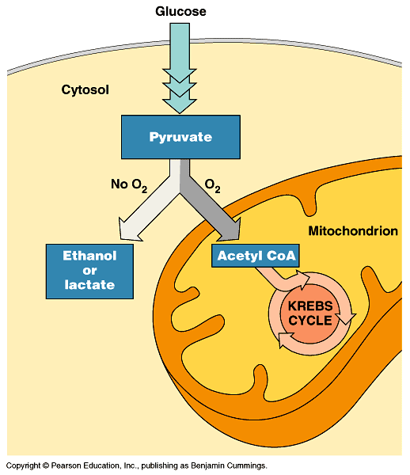

Slide 91
Alcoholic Fermentation
Yeast produce ethyl alcohol and carbon dioxide after glucose is split once

Slide 92
Lactic Acid Fermentation
Humans produce lactic acid after glucose is split once

Slide 93
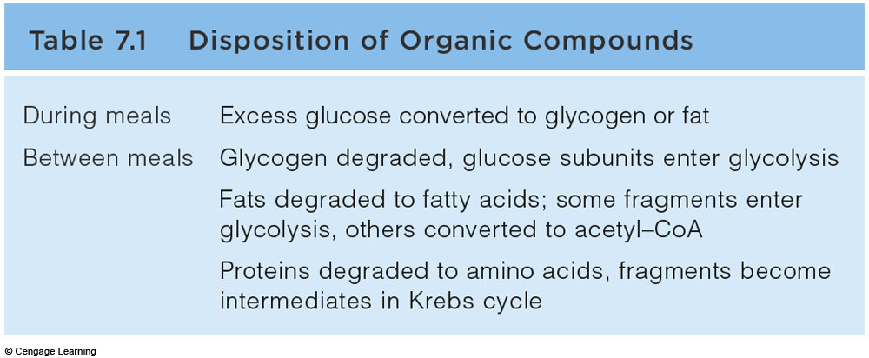
Disposition of Organic Compounds

Slide 94
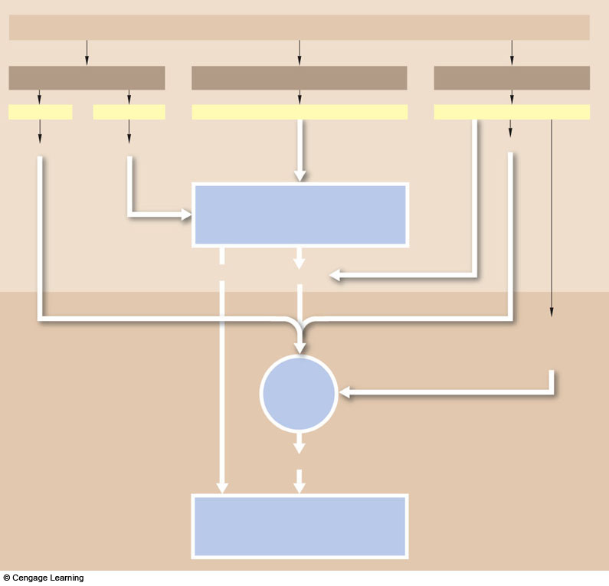
FOOD
fats
COMPLEX CARBOHYDRATES
PROTEINS
fatty acids
glycerol
glucose, other simple sugars
amino acids
acetyl-coA
PGAL
acetyl-coA
Glycolysis
NADH
pyruvate
oxaloacetate
or another
intermediate
of the Krebs
Krebs
Cycle
NADH, FADH²
Electron Transfer
Phosphorylation
Fig. 7.12a, p.119

Slide 95
Comparing Photosynthesis and Cellular Respiration
What is the relationship between photosynthesis and cellular respiration?
Photosynthesis removes carbon dioxide from the atmosphere, and cellular respiration puts it back. Photosynthesis releases oxygen into the atmosphere, and cellular respiration uses that oxygen to release energy from food.

Slide 96
Comparing Photosynthesis and Cellular Respiration
Photosynthesis and cellular respiration are opposite processes.
The energy flows in opposite directions. Photosynthesis “deposits” energy, and cellular respiration “withdraws” energy.
The reactants of cellular respiration are the products of photosynthesis and vice versa.

Slide 97
Comparing Photosynthesis and Cellular Respiration
The release of energy by cellular respiration takes place in plants, animals, fungi, protists, and most bacteria.
Energy capture by photosynthesis occurs only in plants, algae, and some bacteria.

