Slide 1
Significance Table from Anova Test
ANOVA | WT | HMO1
p < 0.05 | 2378 (38%) | 903 (14.6%)
p < 0.01 | 1527 (25%) | 337 (5.4%)
p < 0.001 | 860 (14%) | 69 (1.1%)
p < 0.0001 | 460 (7%) | 18 (0.3%)
B-H p < 0.05 | 228 (4%) | 39 (0.6%)
Bonferroni p < 0.05 | 228 (4%) | 8 (0.1%)

Slide 2
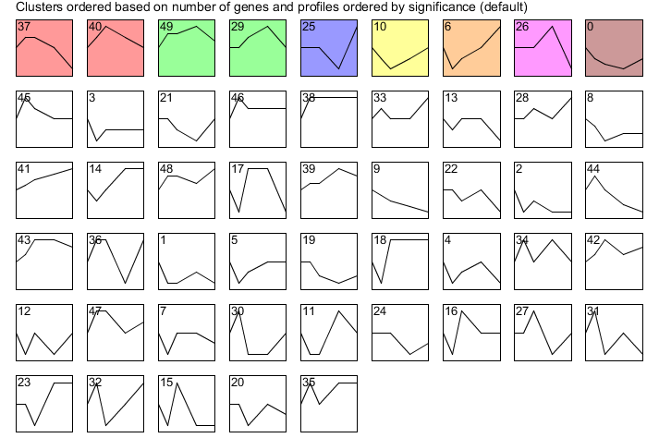
All Stem Profiles: wild type

Slide 3
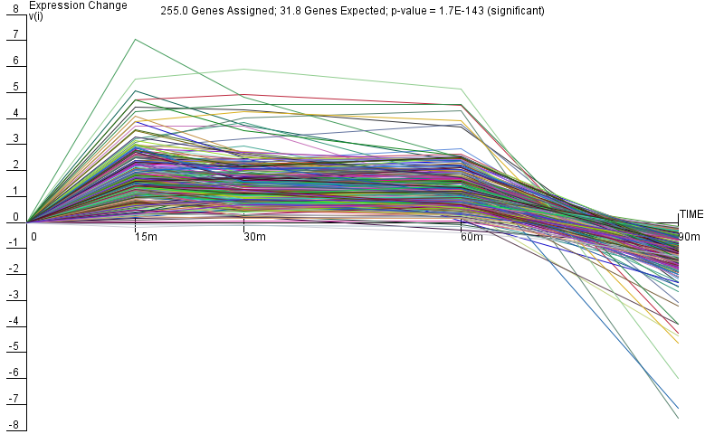
Wt_Profile #37

Slide 4
Wt_Profile #40

Slide 5
Wt_Profile #49

Slide 6
Wt_Profile #29

Slide 7
Wt_Profile #25

Slide 8
Wt_Profile #10

Slide 9
Wt_Profile #6

Slide 10
Wt_Profile #26

Slide 11
Wt_Profile #0

Slide 12
HMO1_Profile #1
Only DNA binding evidence

Slide 13
HMO1_Profile #2
DNA binding and expression evidence

Slide 14
HMO1_Profile #13

Slide 15
HMO1_Profile #22

Slide 16
HMO1_Profile #38

Slide 17
HMO1_Profile #40

Slide 18
HMO1_Profile #43

Slide 19
HMO1_Profile #44

Slide 20
HMO1_Profile #49

Slide 21
*DNA binding plus expression evidence

Slide 22
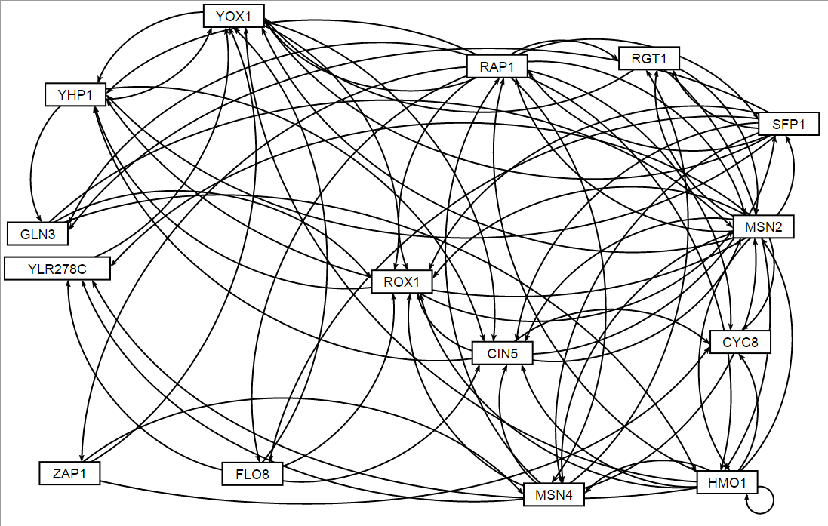
Gene regulatory Network HMO1_profile43
*GRNsight software

Slide 24
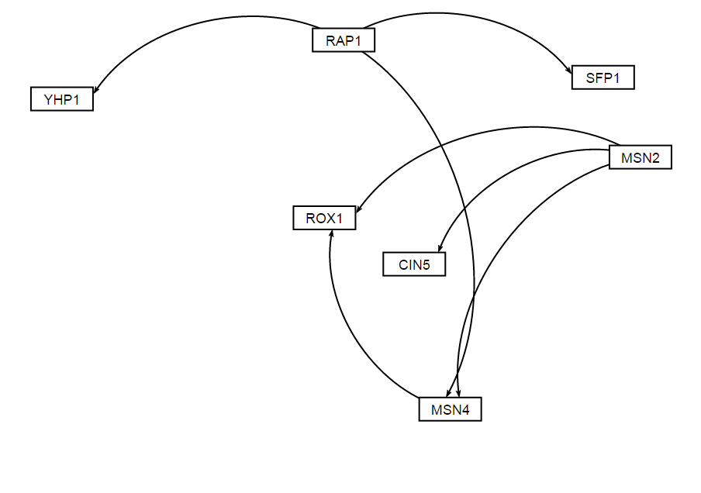
Gene regulatory Network HMO1_profile43

Slide 26
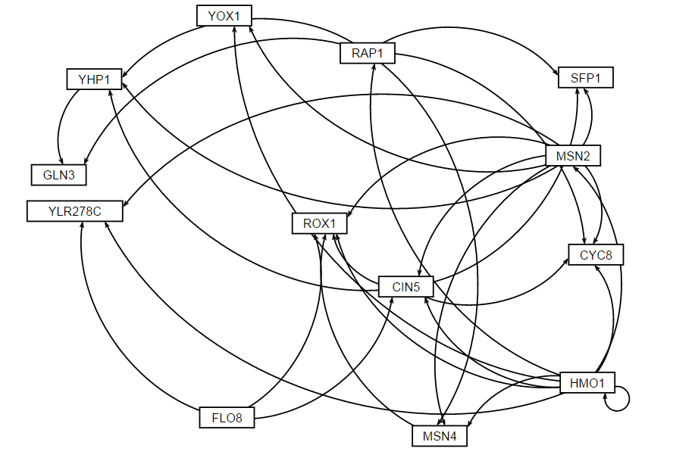
Gene regulatory Network HMO1_profile43

