Slide 1
GRNmap Testing Analysis
Grace Johnson and Natalie Williams
June 10, 2015

Slide 2
Strain Run Comparison
We looked at outputs from last week’s various strain runs to interpret the results

Slide 3
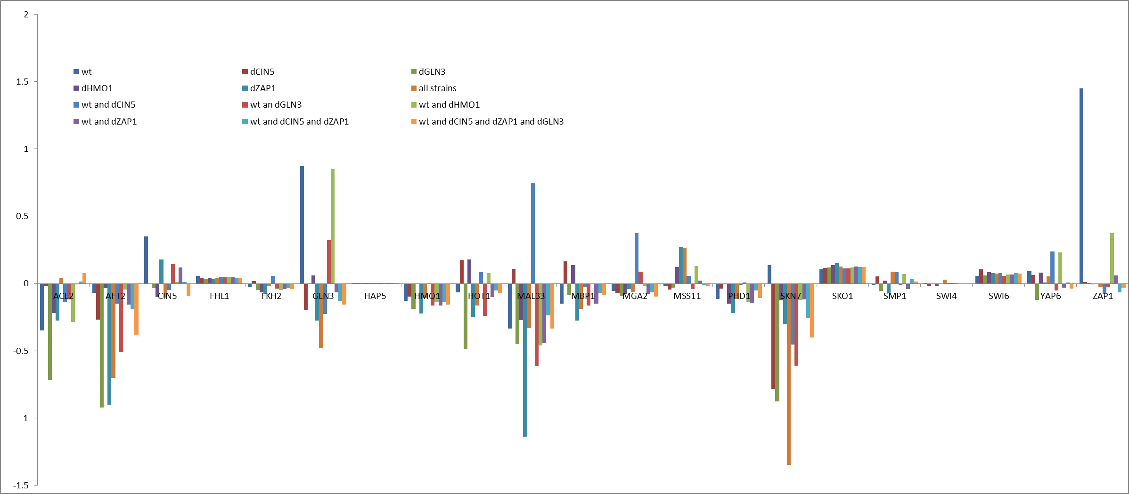
Estimated production rates and b values varied widely between strain runs
Figure 1: Estimated b values
Figure 2: Estimated production rates

Slide 4
We investigated genes that had either fluctuating or stable estimated b’s and production rates
Auto-Regulators with no other inputs (fluctuating) | Genes with no inputs (stable)
SKN7 | FHL1
ZAP1 | SWI6
MBP1 | SKO1

Slide 5
Visualized networks also display variations between runs.
Figure 8: wt only, initial weights 1
Figure 9: All strains, initial weights 1

Slide 6
To evaluate each gene, we looked at:
Production vs. degradation rate
How do these combine to produce effects seen in output graphs?
ANOVA within-strain p-values
Are the genes significant? If so, is this due to dynamics or tight data?
Fit vs. parameter stability
Good fit with stable parameter values?
Bad fit with unstable parameter values?
Bad fit with stable parameter values?
Good fit with unstable parameter values?

Slide 7
Genes with no inputs (stable parameters) revealed how to detect missing information.
For a gene with no inputs, you would expect little dynamics, aside from initial adjusting to production/degradation effect
FHL1 – modeled well
SWI6 – missing input
SKO1 – missing input

Slide 8
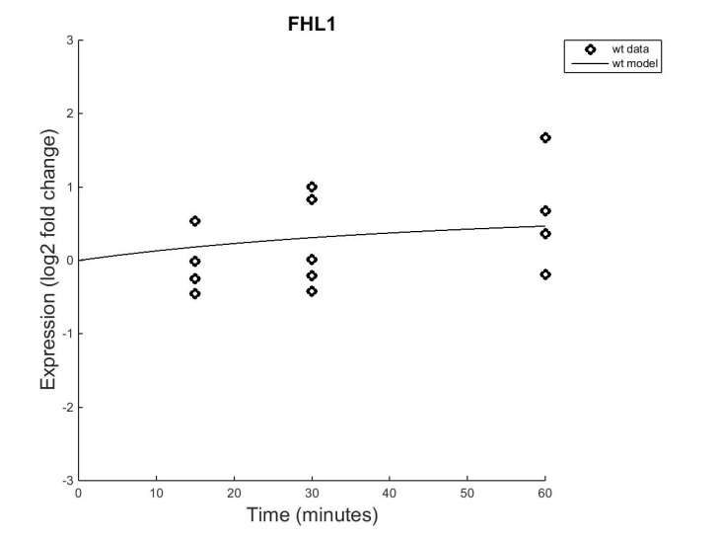
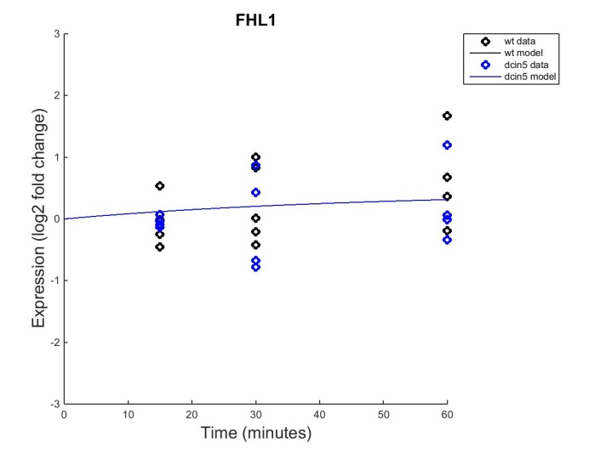
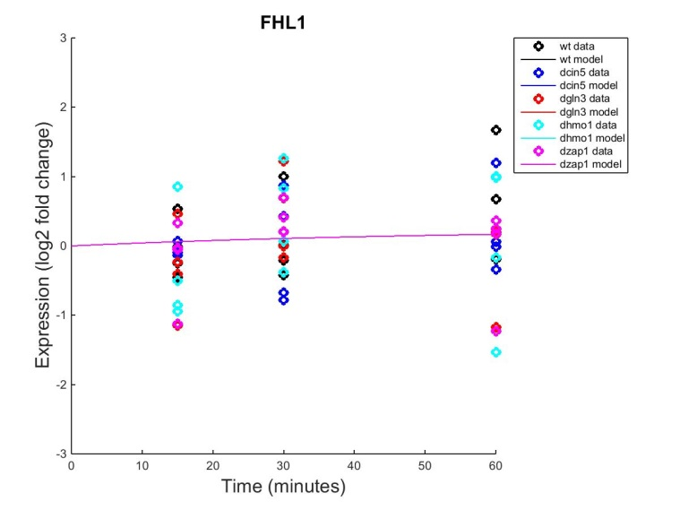
FHL1 is modeled well.
Production vs. degradation rate
At steady state, expect logFC = 0.58
Slight increase is observed in output graphs
No p-value significance for wt or dHAP4 ANOVA
Variance is not huge, so FHL1 must not have significant dynamics. This is expected of a gene that has no inputs.
FHL1 has a good fit with stable parameters, indicating it is modeled well in this 21 gene network

Slide 9
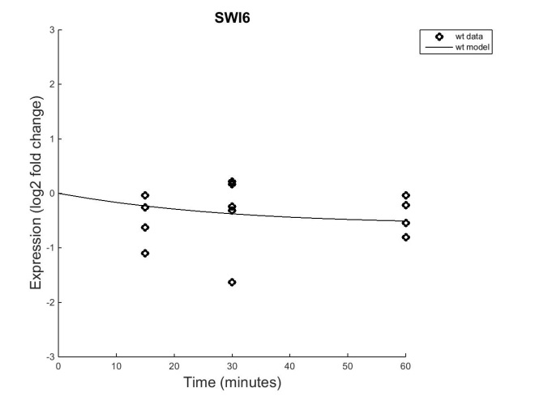
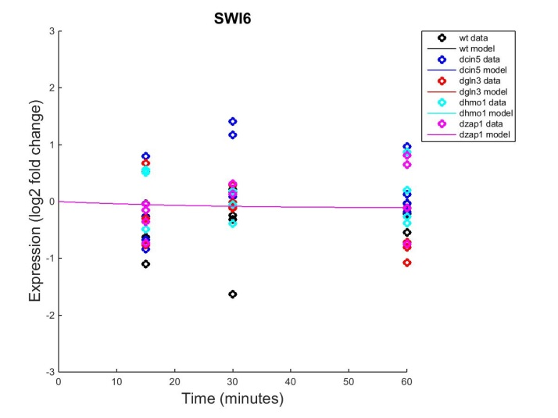
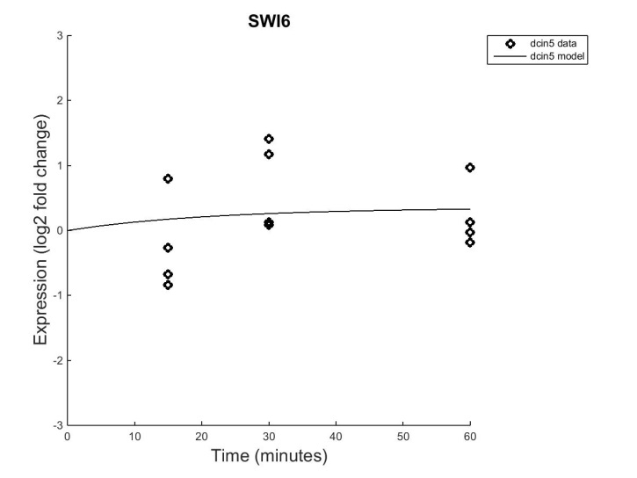
SWI6 is missing an input.
Production vs. degradation rate
At steady state, expect logFC = -0.12
Slight decrease is observed in output graphs, excepting dCIN5
No p-value significance for wt or dHAP4 ANOVA
Could be because of variance, or just little dynamics
It would be useful to see dCIN5 ANOVA
SWI6 has a okay fit with stable parameters, but the dCIN5 run indicates that SWI6 should be connected to CIN5 in some way

Slide 10
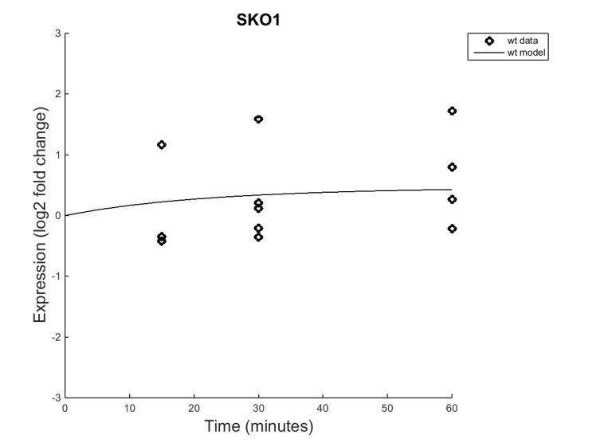
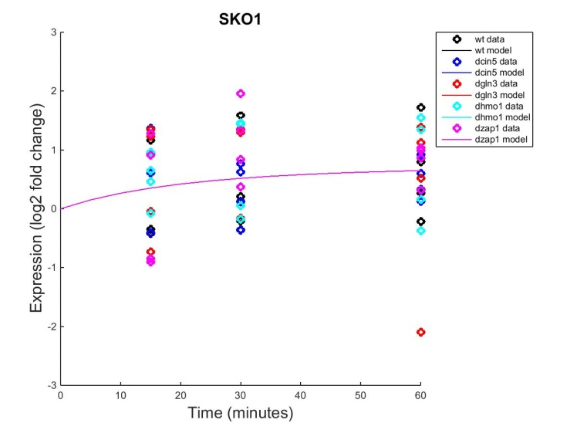
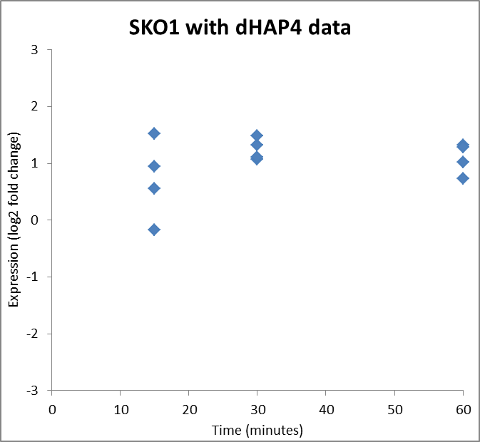
SKO1 is missing an input.
Production vs. degradation rate
At steady state, expect logFC = 0.7
Increase is observed in output graphs
No p-value significance for wt ANOVA
Could be because of variance, or just little dynamics
P-value significance (B&H 0.015) for dHAP4 ANOVA
SKO1 is affected by the deletion of HAP4
SKO1 has a fairly good fit with stable parameters, however the dHAP4 p-value indicates that SKO1 could be missing an input connected to HAP4 (not in current network)

Slide 11
Auto-regulators with no other inputs revealed problems fitting the model to the data.
For self-regulating genes, you would expect:
Uncontrolled increasing dynamics, or
Cycles of up- then down-regulation
MBP1: missing regulator
SKN7: missing an input
ZAP1: lacks various inputs

Slide 12
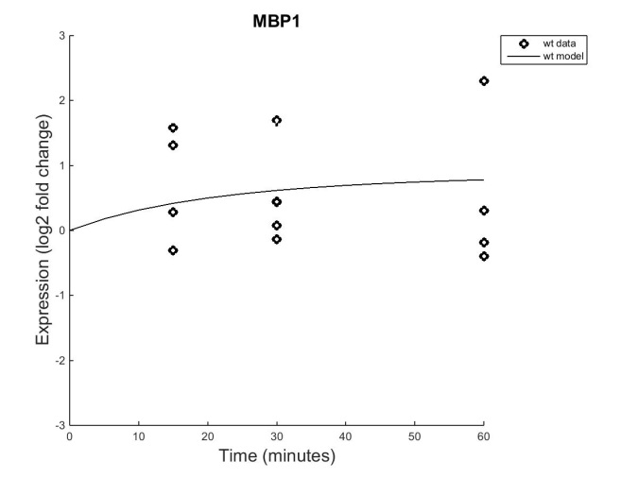
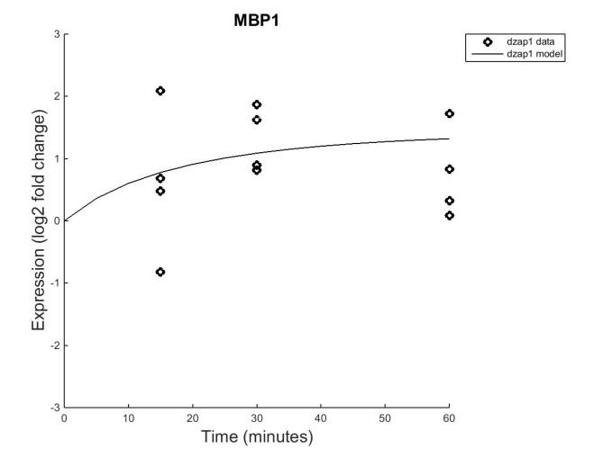
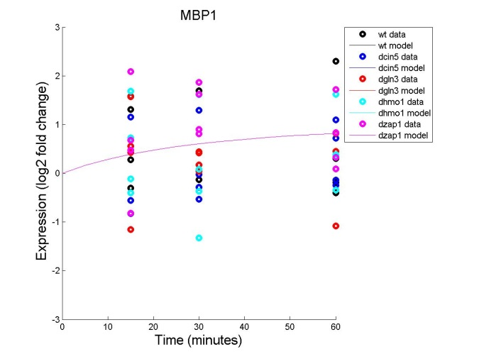
MBP1 needs an additional input
Production B values
Production vs. Degradation rate
All production rates fell within 0.08 – 0.13 range
No significance in ANOVA p-values
A lot of variance or little dynamics
MBP1 needs input from ZAP1
The model fit the trends of the provided data points, however it failed to correctly adjust to T60
Production rate values seem stable, but the threshold values vary in magnitude

Slide 13
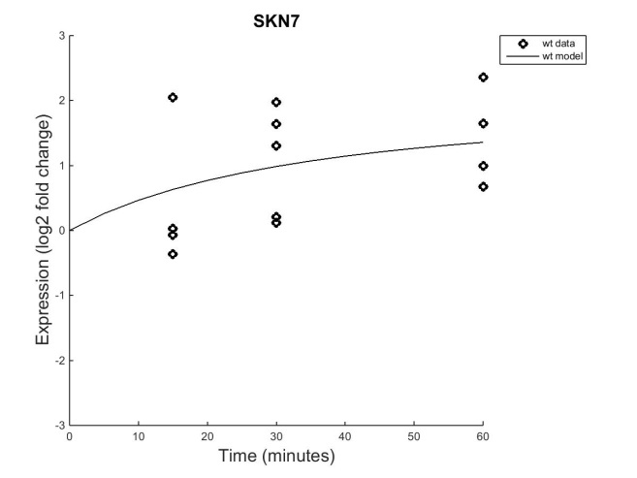
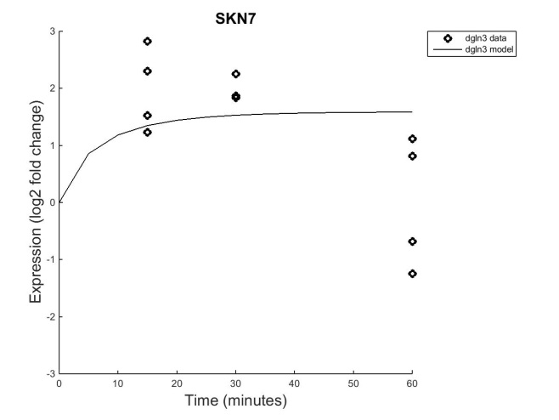
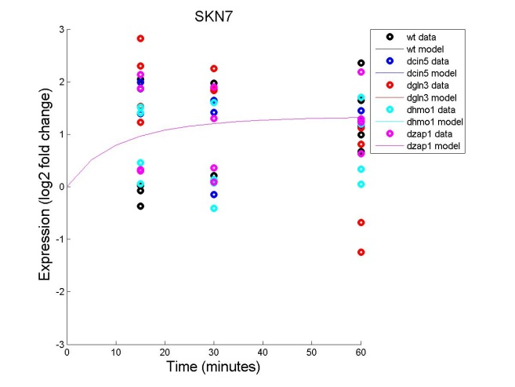
SKN7 is missing an input
Production vs. degradation rate
Initial dynamics of model relate to production rate
Significant p-value (B&H: 0.0228; 0.0045)
Significance most likely results from large changes in the dynamics
SKN7 should have GLN3 as a regulator
Exceptional fit of the data except for dGLN3 model for T30 & T60
The parameters are very unstable with a lot of variance
P-value to Fit of Model: wt is significant
The model fits this data better than other strains
Should analyze dGLN3 p-value
Production B values

Slide 14
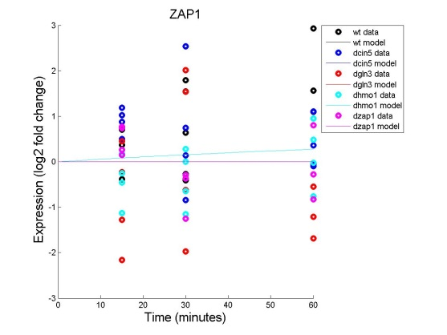
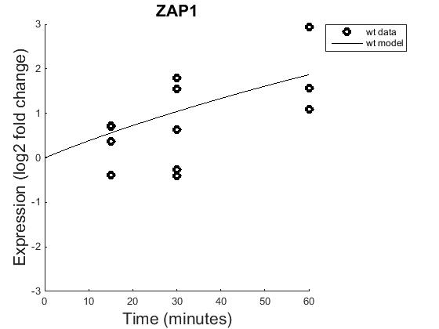
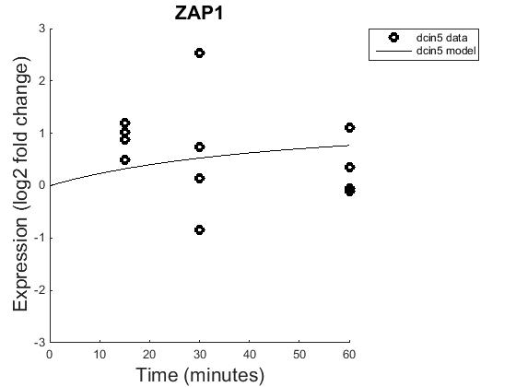
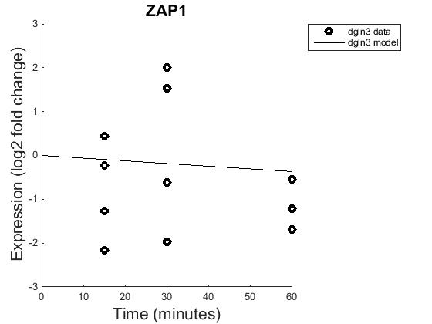
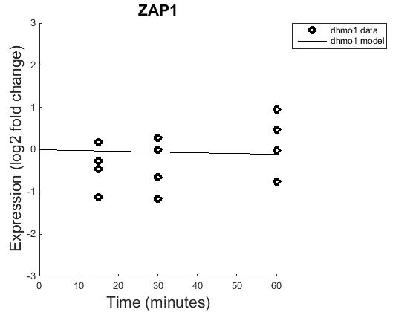
ZAP1 lacks necessary inputs.
Production vs. degradation rate
All values lie below 0.1
There were two negative overall effects (pro rate – deg rate)
Significant p-values (B&H: 0.0086; 0.0012)
The magnitude of change makes the gene significant
ZAP1 seems to be activated by CIN5, GLN3, and HMO1
The model fits the data poorly, but best fit to wt
Does not adjust to fit T60
ZAP1 Production
B values

Slide 15
General Conclusions
Production vs. degradation rate seems to drive most dynamics
Sets the model on its trajectory
Difficult for model to alter its dynamics to fit to T60
Correlation between p-value and better fit of model to data
Accounting for variance

Slide 16
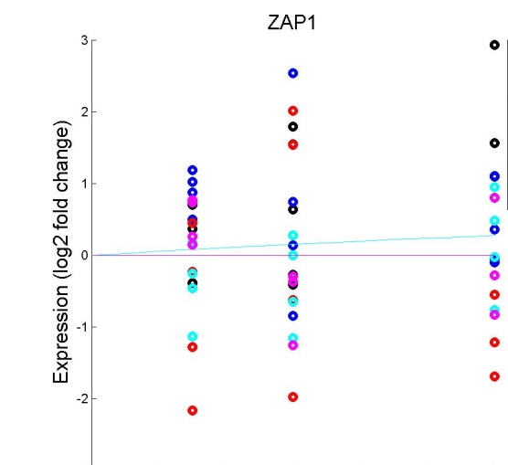
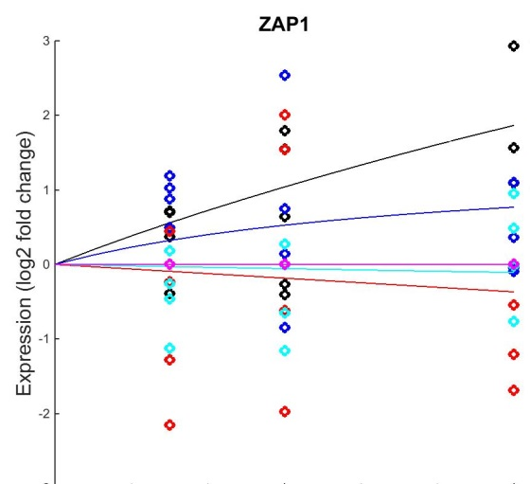
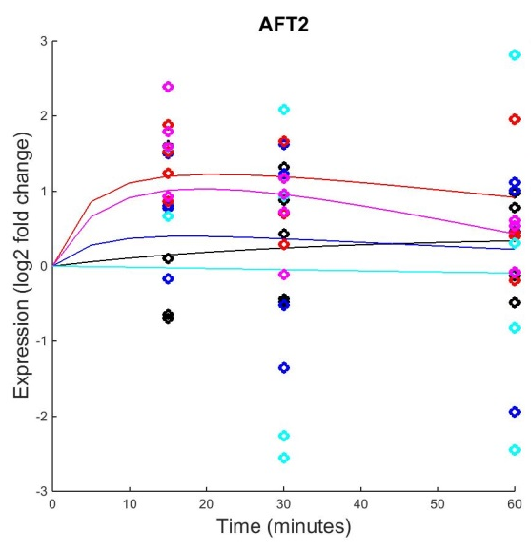
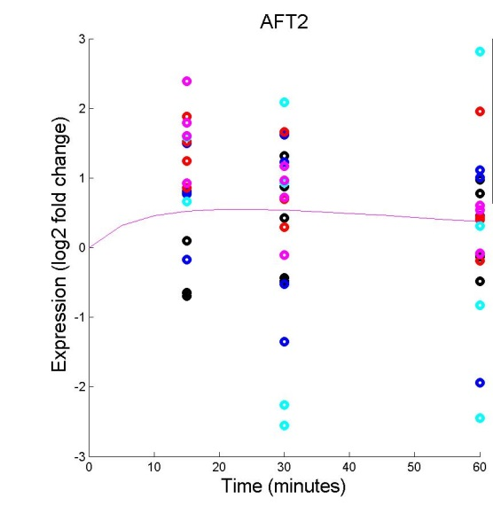
Model uses overall average of provided data points to fit multi-strain runs
Finds curve that fits all data, not individual strains
Averages similar slopes from individual runs to create single curve
5 Output Overlay
All-Strain Run

