Slide 1
Lab 1: Eau That Smell
Itinerary:

Slide 2
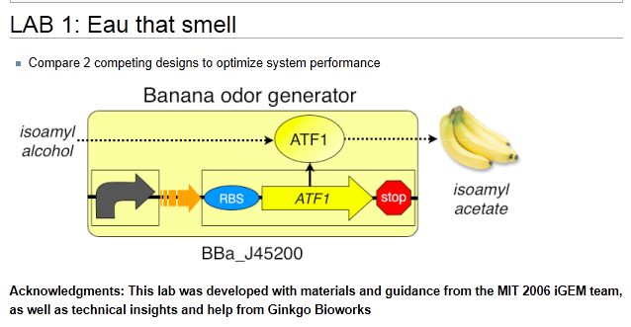

Slide 3
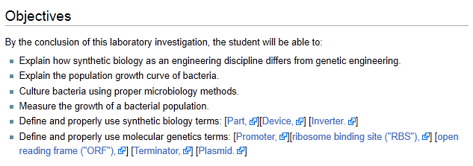

Slide 4
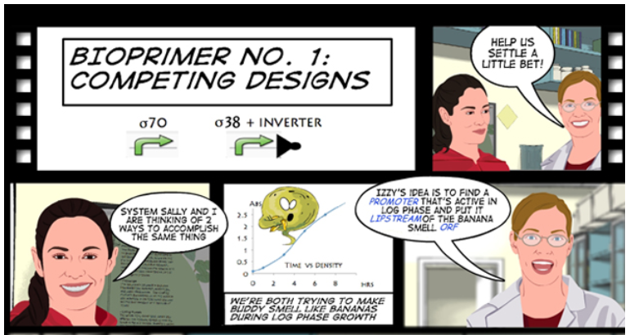

Slide 6
An engineering paradigm
Design
Build
Test
The focus of this lab

Slide 7
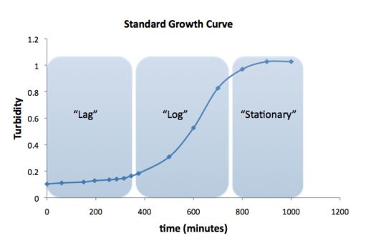
The Eau d’coli device designed by the 2006 iGEM team expresses
the banana smell during the stationary phase.
Why?

Slide 8
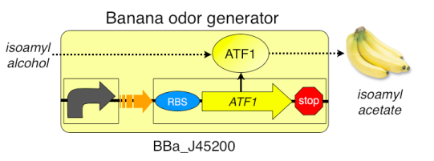
What happens in the original design?
What is the role of the promoter?
What is the role of the ATF1 ORF?
What is the role of the ATF1 enzyme?

Slide 9
There are two designs that could change this device to log phase expression:
Log phase promoter
Inverter + stationary phase promoter
Your challenge is to test both and see which works better.
Any educated guesses?

Slide 10
We have been sent 4 strains of E. coli. Each has a different device:
Strain 1-1 is the original Eau d’ coli device
Strain 1-2 has the original Eau d’coli device with an inverter
Strain 1-3 has the log phase promoter
Strain 1-4 has no smell generating device
Why should we test strains 1-1 and 1-4?

Slide 11
Today we will be doing Protocol A:
We have prepared cultures of each strain:
For each strain we placed a sample in the refrigerator before it had time to incubate. This is the lag phase sample.
For each strain we let a sample run for 6 hours. This is the log phase sample.
For each strain we let a sample run overnight. This is the stationary phase.
There are 12 samples all together (4 cultures each at three time points).

Slide 12
For each sample you will measure:
The OD 600 using the spec 20. This will tell you the population of bacteria.
The banana smell by comparison with the banana standards
Be sure to replace the foil on the culture after smelling
Record your observations—does everyone in the group smell the same things?

Slide 13
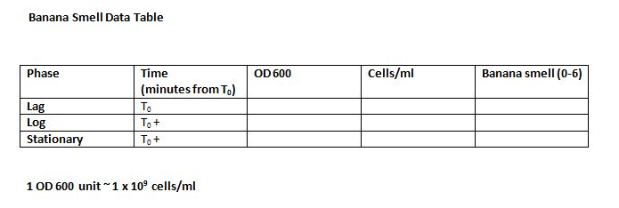
You will need to make 4 data tables like this, one for each strain

Slide 14
Today we will be doing Protocol B:
You will prepare cultures of each strain:
Every 20 minutes you will take a sample from each culture
The OD 600 using the spec 20. This will tell you the population of bacteria.
The banana smell by comparison with the banana standards
Record your observation—does everyone in the group smell the same thing?
Be sure to replace the foil on the cultures after smelling

Slide 15
At the end of class the cultures will be refrigerated until tomorrow morning
Sampling will resume in class tomorrow and continue for another day
This will allow us to collect data from various parts of the growth curve
It is important to note the time after the cultures were started for each measurement you take

Slide 16
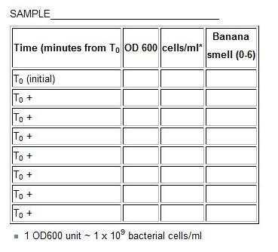
You will need to make 4 data tables like this, one for each strain

Slide 17
Summary of today’s procedure:
We’ve prepared the cultures
The lag and stationary phase samples are on the front desk. Take a whiff when you get the chance. We’ll do the OD600
Each team has one of the log phase samples. We did not prepare strain 1-4
Use the spectrophotometer to measure the OD 600
Use the banana standards to measure the banana smell
Visit a neighboring team with different strains to smell their cultures
Report your data to us

Slide 18
Your Assignments:
Super Team | Team | Sample
M | red | 1-1
 | orange | 1-2
 | yellow | 1-3
I | green | 1-1
 | blue | 1-2
 | indigo | 1-3
T | violet | 1-1
 | grey | 1-2
 | white | 1-3

